Slide 1
Material Didáctico Audiovisual
Sólo Visión Proyectables Diapositivas
Inglés 1 - Módulo I
Bachillerato Universitario 2015
Información personal
Elaborado por: M. en I. y G. E. Cesar Martínez Acevedo
Plantel “Dr. Ángel Ma. Garibay Kintana” de la Escuela Preparatoria

Slide 2
Inglés 1
PROPÓSITO GENERAL
Emplea el idioma inglés de forma sencilla para satisfacer sus necesidades inmediatas de interacción, supervivencia o de relación con su entorno, por medio de expresiones cotidianas y representaciones lingüísticas básicas asociadas al contexto cultural y social en el que se desenvuelve.
Continuar

Slide 3
Módulo I
Nombre del Módulo
Información personal.
Propósitos del Módulo
Asocia los elementos lingüísticos y comunicativos, tanto de forma oral como escrita, para relacionarse e interactuar con su entorno inmediato.
Continuar

Slide 4
Competencia Disciplinar
Comunicación Básica
10 Identifica e interpreta la idea general y posible desarrollo de un mensaje oral o escrito en una segunda lengua, recurriendo a conocimientos previos, elementos no verbales y contexto cultural.
11. Se comunica en una lengua extranjera mediante un discurso lógico, oral o escrito, congruente con la situación comunicativa.
Extendida
9. Trasmite mensajes en una segunda lengua o lengua extranjera atendiéndolas características de contextos socioculturales diferentes.
Continuar

Slide 5
Competencia Genérica
4 Escucha, interpreta y emite mensajes pertinentes en distintos contextos mediante la utilización de medios, códigos y herramientas apropiados.
4.4 Se comunica en una segunda lengua en situaciones cotidianas.
7. Aprende por iniciativa e interés propio a lo largo de la vida.
7.1 Define metas y da seguimiento a sus procesos de construcción de conocimiento.
10. Mantiene una actitud respetuosa hacia la interculturalidad y la diversidad de creencias, valores, ideas y prácticas sociales.
10.2 Dialoga y aprende de personas con distintos puntos de vista y tradiciones culturales mediante la ubicación de sus propias circunstancias en un contexto más amplio.
Continuar

Slide 6
Temas
Tema 1
Tema 2
Instrucciones y órdenes para interactuar en el salón de clases.
Presentación de información personal.

Slide 7
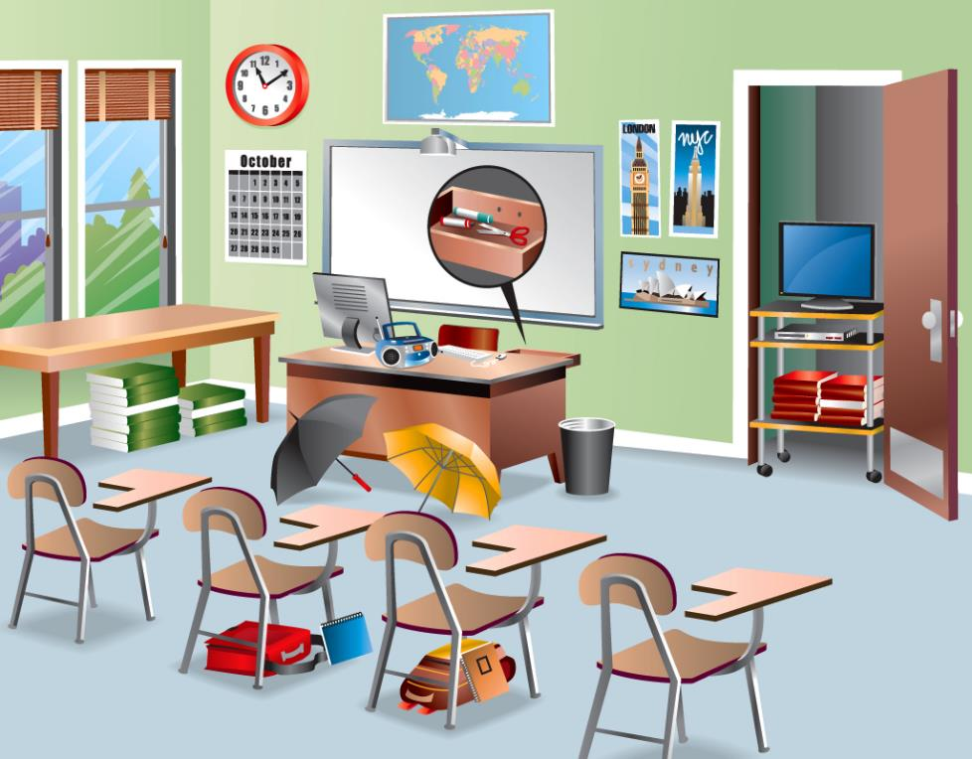
Instrucciones y órdenes para interactuar en el salón de clases

Slide 8
CLASSROOM LANGUAGE
TO SAY HELLO
Hi!
Hello
What’s up!
How you doing?
Morning
TO SAY BYE
Bye / Good bye
See you
Later
Take care
Have a nice day

Slide 9

IN THE CLASSROOM
May I go to the bathroom?
Can I go out?
Can I come in?
Can I answer the phone?
Can I make a phone call?
Can I send a message?
Can I open the door/window?
Can I close the door/window?

Slide 10

TEACHER
Please, be quiet.
Please, open your books on page _____.
Please, pay attention.
Listen.
Do you have a question?
Do you have a doubt?
What’s the matter?
Come to the board, please.
Finish / Are you done?
Can I have your homework?

Slide 11
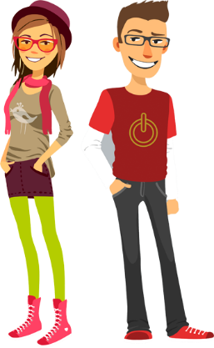
STUDENT
I don’t understand. Can you repeat (that), please?
How do you say ___________ in Spanish?
How do you say ___________ in English?
How do you spell it/________?
What’s the meaning of ____________?
Present / Here (attendance)

Slide 12
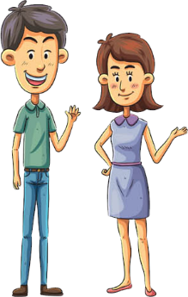
QUESTIONS
WRITING
1. What’s up? / How are you? / What’s going on?
Nothing much. / I am fine thank you. / I am sad today. / I am excited! / I am okay. / I am tired. /
I am sick.
2. What’s your name?
My name is _____________________.
What’s your last name?
My last name is ____________________.

Slide 13
QUESTIONS
WRITING
3. Where do you live? / Where are you from?
I live in ____________________.
My address is ________________________________.
I am from ______________________.
4. Where do you study? / Do you work? / Where do you work?
I study at _________________________.
I work at _________________________.

Slide 14
QUESTIONS
WRITING
5. What’s your telephone number?
My telephone number is __________________________.
6. What’s your e-mail account?
My e-mail account is ________________@_________.
7. What’s your Facebook account? / What’s your Twitter account?
My Facebook account is _____________.
My Twitter account is ________________.

Slide 15
QUESTIONS
WRITING
8. How old are you? / When were you born?
I am _____ years old.
I was born on (month/day/year) ___________________.
9. Are you single? Yes, I am. / No, I’m not.
10. Do you have boyfriend/girlfriend?
Yes, I am in a relationship.
No, I don’t.

Slide 16
QUESTIONS
WRITING
11. Do you have brother or sisters?
Yes, I have ______ (#) brothers or sisters. /
No, I do not have any brothers or sisters.
How old are they?
My brothers or sisters are ___________ years old.

Slide 17
QUESTIONS
WRITING
12. What is your favorite activity?
My favorite activity is _____________________________
(reading, going to the beach, working on my car, spending time with my family, etc.)

Slide 18
Speaking Activity
Work with a partner.
Make some questions about personal information to know more about the other people.

Slide 19
QUESTIONS
SPEAKING
What’s your name? / What’s your last name?
Where do you live? / Where are you from?
Where do you study? / Do you work? / Where do you work?
What’s your telephone number?
What’s your e-mail account / What’s your Facebook account? / What’s your Twitter account?
How old are you? / When were you born?
Are you single? / Do you have boyfriend/girlfriend?
Do you have brother or sisters? How old are they?
What is your favorite activity?

Slide 20
Reading Activity
READING
Read the text and answer the questions opposite.
Hi. I'm Roxanne. I'm 13 years old. I'm from Montreal, a big city in Canada. Montreal isn't the capital of Canada. The capital city of our country is Ottawa.
Guadalupe and Martina are my friends. Guadalupe is 13 and Martina is 14. They aren't from Canada; they are from Mexico. They are on holiday in Montreal!
Where is Roxanne from?
Are Guadalupe and Martina from Canada?
Where are they from?
Is Montreal the capital of Canada?
What is the capital of Canada?

Slide 21
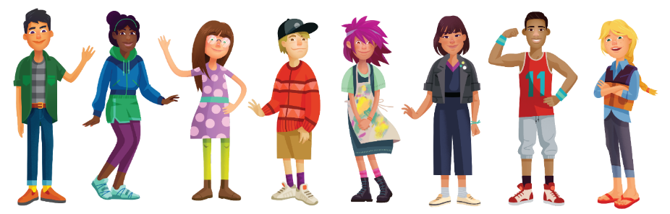






Nouns
Describing objects

Slide 22
What is a Noun?
Of all the parts of speech, nouns are perhaps the most important. A noun is a word that identifies a person, animal, place, thing, or idea.
Nouns are singular when they refer to just one person, place, thing, or idea.
Nouns are plural when they refer to two or more people, places, things, or ideas.

Slide 23
Regular Nouns
The regular plural form of nouns is made by adding an “s” to the end of the word. However, some words do not follow that rule. Plural forms that are made in some way other than just adding an “s” are called irregular plural forms.
Make the plural form of nouns ending in “ch”, “sh”, “x”, “o” or “ss” by adding “es”.
one church one brush one fox
two churches two brushes two foxes

Slide 24
Regular Nouns
Make the plural form of some nouns ending in “f” or “fe” by dropping the “f” or “fe” and adding “ves”.
one knife one wolf
two knives two wolves
Make the plural form of many words ending in “y” by dropping the “y” and adding “ies”.
one baby two babies

Slide 25
Regular Nouns
Make the plural form of some “oo” words by changing to “ee”.
one foot one tooth
two feet two teeth

Slide 26
Irregular Nouns
Some irregular plurals just have to be remembered:
one man two men
one child two children
one woman two women
one cactus two cacti
one index two indices
one mouse two mice

Slide 27
Exercise
Make plurals of the following words.
WRITING
Singular | Plural |  | Singular | Plural
animal |  |  | house
baseball |  |  | lake
bench |  |  | life
box |  |  | lunch
box |  |  | man
business |  |  | plant
butterfly |  |  | potato
car |  |  | puppy
chair |  |  | shelf

Slide 28
Making sentences
WRITING
Write sentences describing objects that are in the classroom. Use THERE IS A/AN or THERE ARE. Use singular and plural nouns.
_______________________________________________________.
_______________________________________________________.
_______________________________________________________.
_______________________________________________________.
_______________________________________________________.
_______________________________________________________.
_______________________________________________________.
_______________________________________________________.

Slide 29
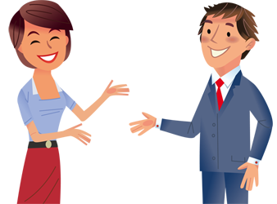
Presentación de información personal

Slide 30

VERB TO BE
Personal Information

Slide 31

Use
We use the verb be for personal information. Things about you!
For example your name, your job, your nationality and your feelings.
Look at Jessica
I am Jessica. I am 21 years. I am Mexican, but now I live in Germany.
I am a journalist. I work in a magazine in Frankfurt. I am single because I am a busy person.

Slide 32
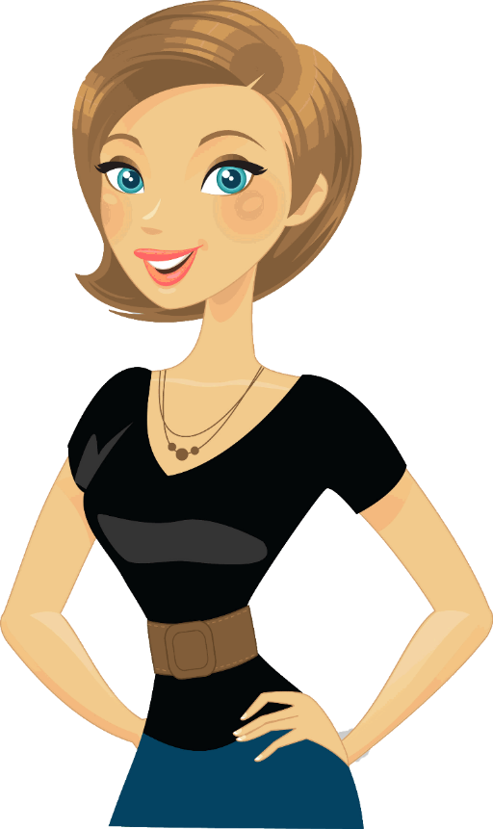
Personal Information
We have information about Katya.
Her name: She is Katya.
Her age: She is forty years old.
Her nationality: She is Russian.
Her job/no job: She is unemployed.
Her marital status: She is divorced.
Her feelings: She is a very happy person.

Slide 33
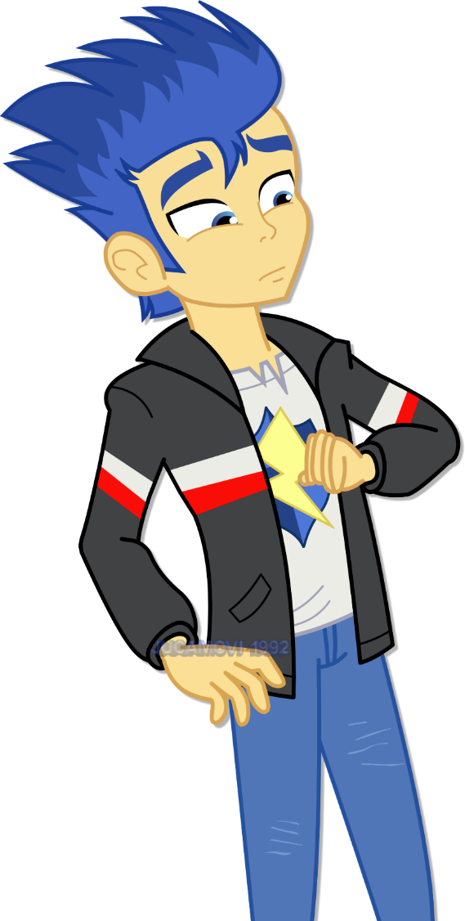
Questions Personal Information
How are you?
What’s your name?
How old are you?
Where are you from?
Where do you live?
What do you do?
How do you spell your name?
How do you spell your last name?

Slide 34

Personal Information
Write information about you.
Your name: My name is…
Your age: I am … years old.
Your nationality: I am…
Your job/no job: I am a…
Your marital status: I am…
Your feelings: I am a/an … person

Slide 35
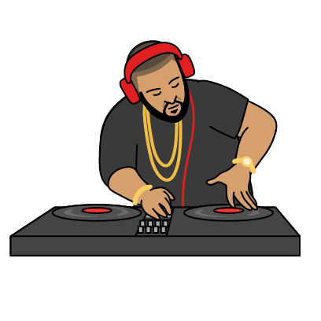
Personal Facts
Name:
Last Name:
Age:
Country:
Residence:
Occupation:
Name: David
Last Name: Stenvenson
Age: 28
Country: Italy
Residence: Mexico
Occupation: Disc Jockey (DJ)

Slide 36
Personal Facts
SPEAKING
Ask your friend and
complete the information.
Name: David
Last Name: Stenvenson
Age: 28
Country: Italy
Residence: Mexico
Occupation: Disc Jockey (DJ)
Name:
Last Name:
Age:
Country:
Residence:
Occupation:

Slide 37
AFFIRMATIVE SENTENCES
SUBJECT
LONG FORM
SHORT FORM
I
YOU
HE
SHE
IT
I AM
YOU ARE
HE IS
SHE IS
IT IS
I’M
YOU’RE
HE’S
SHE’S
IT’S
WE
YOU
THEY
WE ARE
YOU ARE
THEY ARE
WE’RE
YOU’RE
THEY’RE

Slide 38
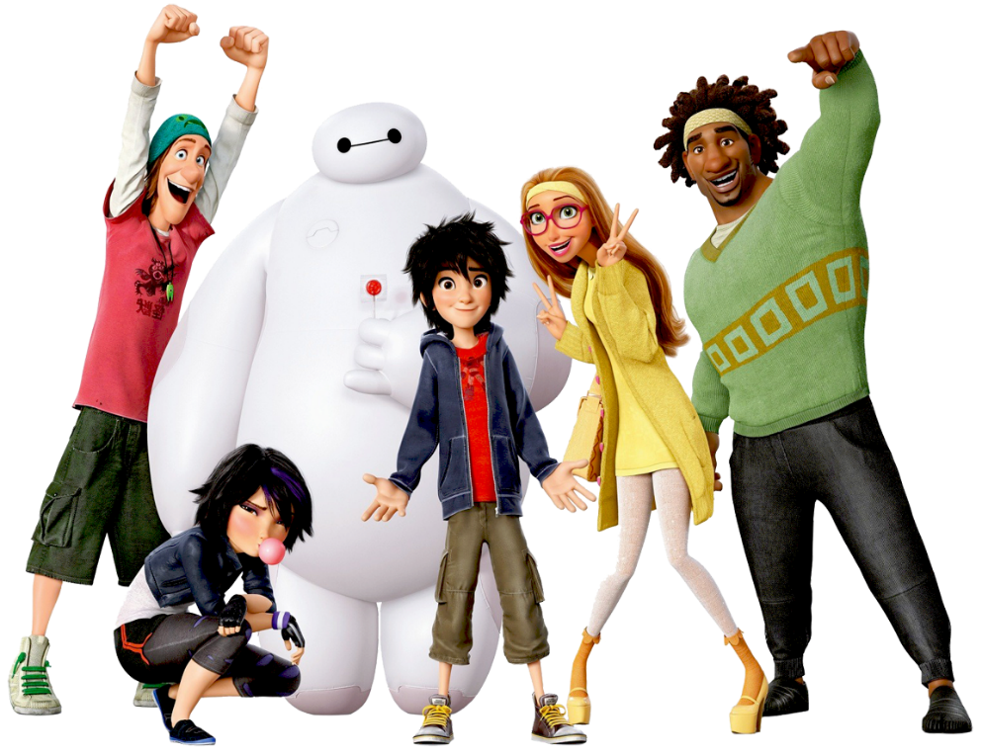
Exercise
WRITING
Complete the sentences using verb TO BE.
She ________ pretty.
I ________ tired.
We ________ sleepy.
I ________ hungry.
He ________ cool.
It ________ fast.
You ________ nice.
I ________ late!
They ________ funny.

Slide 39
Complete the sentences using verb “to be”
WRITING
John _____ excited.
Tiffany and Uma _____ my friends.
Ricardo, John and I _____ watching a movie.
Hadil _____ kind.
Alisa _____ young.
The hammer _____ new.
My mother and father _____ cooking dinner.
Rachel _____ driving to school.
Nikkos and Billy _____ playing at the park.
The students _____ studying English.
The test _____ hard!
My best friend _____ coming to my house.

Slide 40

Pronouns

Slide 41
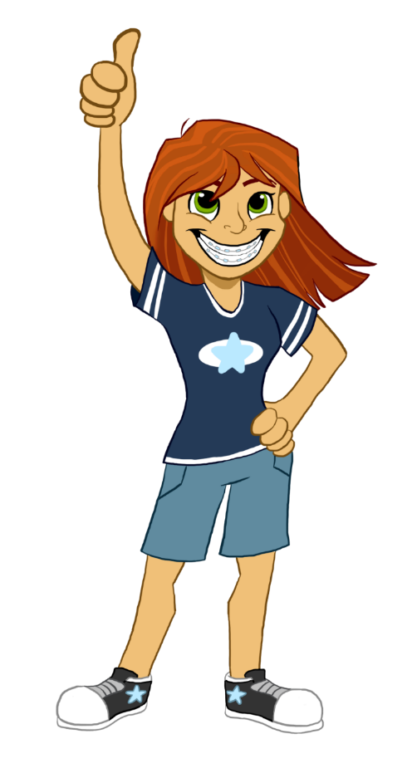
Pronouns
What’s a pronoun?
A pronoun is a word that takes the place of a noun.
What’s a personal pronoun?
A personal pronoun is a pronoun that is associated primarily with a particular person, in the grammatical sense.

Slide 42
Personal Pronouns | Possessive Adjectives
I | My
You | Your
He | His
She | Her
It | Its
We | Our
You | Your
They | Their

Slide 43
Personal Pronouns
I
You
He
She
It
We
You
They
A Personal Pronoun always substitutes the person or object that we are talking about. It always goes at the beginning of a sentence.
Example
Maria is my sister.
She is a nurse.
She is 24 years old.

Slide 44
Possessive Adjectives
My
Your
His
Her
Its
Our
Your
Their
A Possessive Adjective is used to say that something belongs to someone. It is important to mention the object or person we are talking about.
Example
My house is there.
His brother is Joseph.
Our classroom isn’t clean.

Slide 45
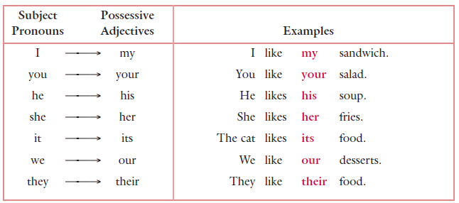
Examples

Slide 46

Exercise: Complete each sentence with the appropriate pronoun.
WRITING
(The Andersons) _________ are our neighbors.
(Amanda Sanderson) _________ is the prettiest girl in school.
(Adam’s grandfather) _________ is a General in the U.S. Army.
(The pens and pencils) _________ are on the teacher’s table.
(The small girl) _________ is the youngest student in the class.
(Joe, Scott, and Bob) _________ go hiking on the mountain together.
(My Aunt Jane) _________ likes to watch scary movies on television.

Slide 47
Exercise: Complete each sentence with the appropriate pronoun.
WRITING
(Nick and I) _________ have got a favorite restaurant in town.
(The neighbor’s car) _________ has got a very noisy engine.
(Jenny and Fatima) _________ wear heavy coats to school because of the rain.
(The little old lady) _________ walks very slowly with a cane.
(The blue notebook) _________ contains all the notes from Science class.
(Your Uncle Peter) _________ works for a large company in Europe.
(The boy wearing red) _________ scored the most points in the basketball game.
(Your parents) _________ live in a beautiful home in the country.

Slide 48
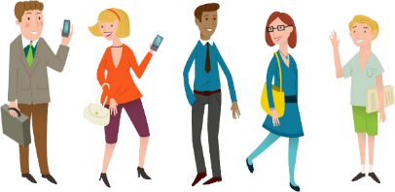
Exercise: Fill the gaps in these sentences.
WRITING
This book belongs to me. It is ______ book.
This bag belongs to Andrew. It is ______book.
This car belongs my mother. It is ______car.
These shoes belong to you. They are ______ shoes.
The bedroom belongs to the girls. It is ______bedroom.
The dog, Wolfie, belongs to my family. It is ______ dog.
The cat has a sore leg. The cat is licking ______ leg.
I am holding some money. It is ______ money!

Slide 49
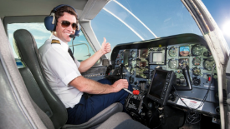
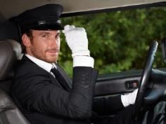
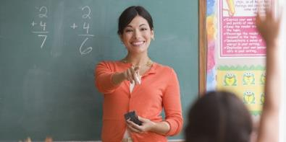
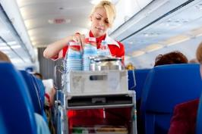


Complete the sentences with personal pronouns or possessive adjectives.
_____ is a pilot. ______ name’s Charles.
_____ is a teacher. _______ name’s Melanie.
_____ is a driver. _______ name’s David.
_____ are engineers. _______ names are Alex and Jesica.
This is Anna. _____ surname’s Pereira. _____ is a flight attendant.
This is Samantha. _______ is a nurse.
This is Snowball. ______ house is big.
Hi, Chris. How are _______ today? _______ look tired!
WRITING

Slide 50
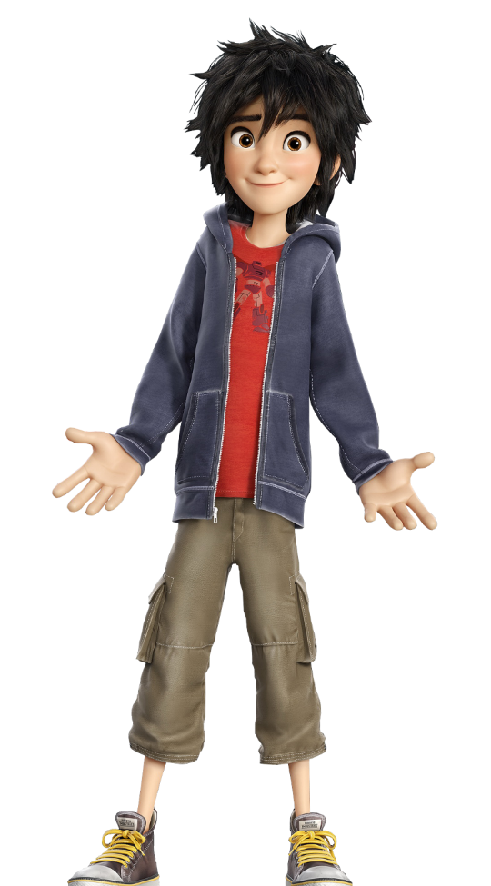
Demonstratives
indicating where specific items are

Slide 51
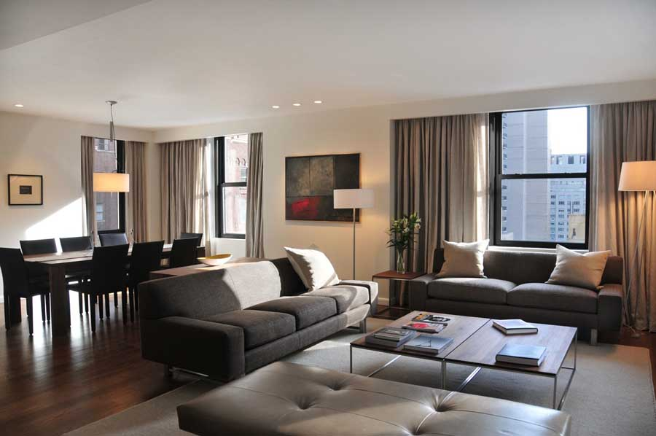
What are demonstratives adjectives?
In English, the demonstrative adjectives are used to indicate where specific items are in relation to ourselves.

Slide 52

Demonstratives
 | NEAR | FAR
SINGULAR | THIS | THAT
PLURAL | THESE | THOSE

Slide 53




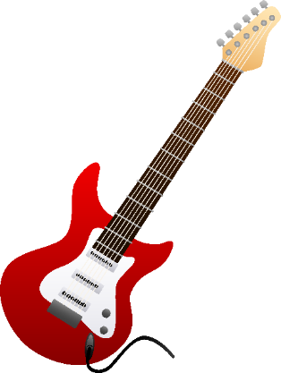
This is an smartphone.
SPEAKING
What’s this?
This is a bottle of ketchup.
NEAR
SINGULAR
This is a guitar.

Slide 54

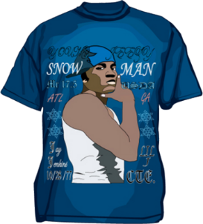

That is a car.
SPEAKING
What’s that?
That is a t-shirt.
That is a tree.
FAR
SINGULAR

Slide 55





These are balls.
SPEAKING
What are these?
These are animals.
NEAR
PLURAL

Slide 56
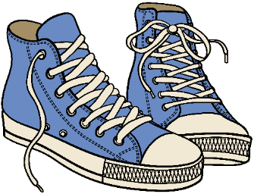
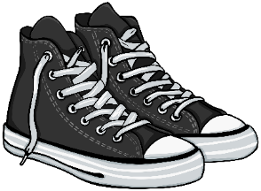
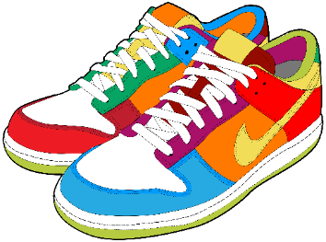

Those are sneakers.
SPEAKING
What are those?
Those are buildings.
FAR
PLURAL

Slide 57

Time to write!
WRITING
Describe objects that are NEAR from you.
2 singular This is…
2 plural These are…
Describe objects that are FAR from you.
2 singular That is…
2 plural Those are…

Slide 58
Change the following sentences using singular or plural.
This is my car.
Those girls are very tall.
These offices are near the bank.
That is my notebook.
This book is good.
Those dogs are black.
These boys are fourteen years old.
That guitar is red.

Slide 59
Complete the sentences using:
THIS, THESE, THAT, THOSE
WRITING
NEAR
FAR
a. _______ chips are baked. b. _______ chips are fried.
a. _______ nuts are salty. b. _______ nuts are salt-free.
a. _______ coffee is decaffeinated. b. _______ coffee has caffeine.
a. _______ potatoes are fried. b. _______ potatoes are boiled.
a. _______ ice cream is fattening. b. _______ ice cream is low-fat.
a. _______ vegetables are fried. b. _______ vegetables are raw.
a. _______ meat is fatty. b. _______ meat is lean.
a. _______ salad dressing is oily. b. _______ salad dressing is light.
a. _______ candy is sugar-free. b. _______ candy has sugar.
a. _______ bread is white. b. _______ bread is whole wheat.

Slide 60
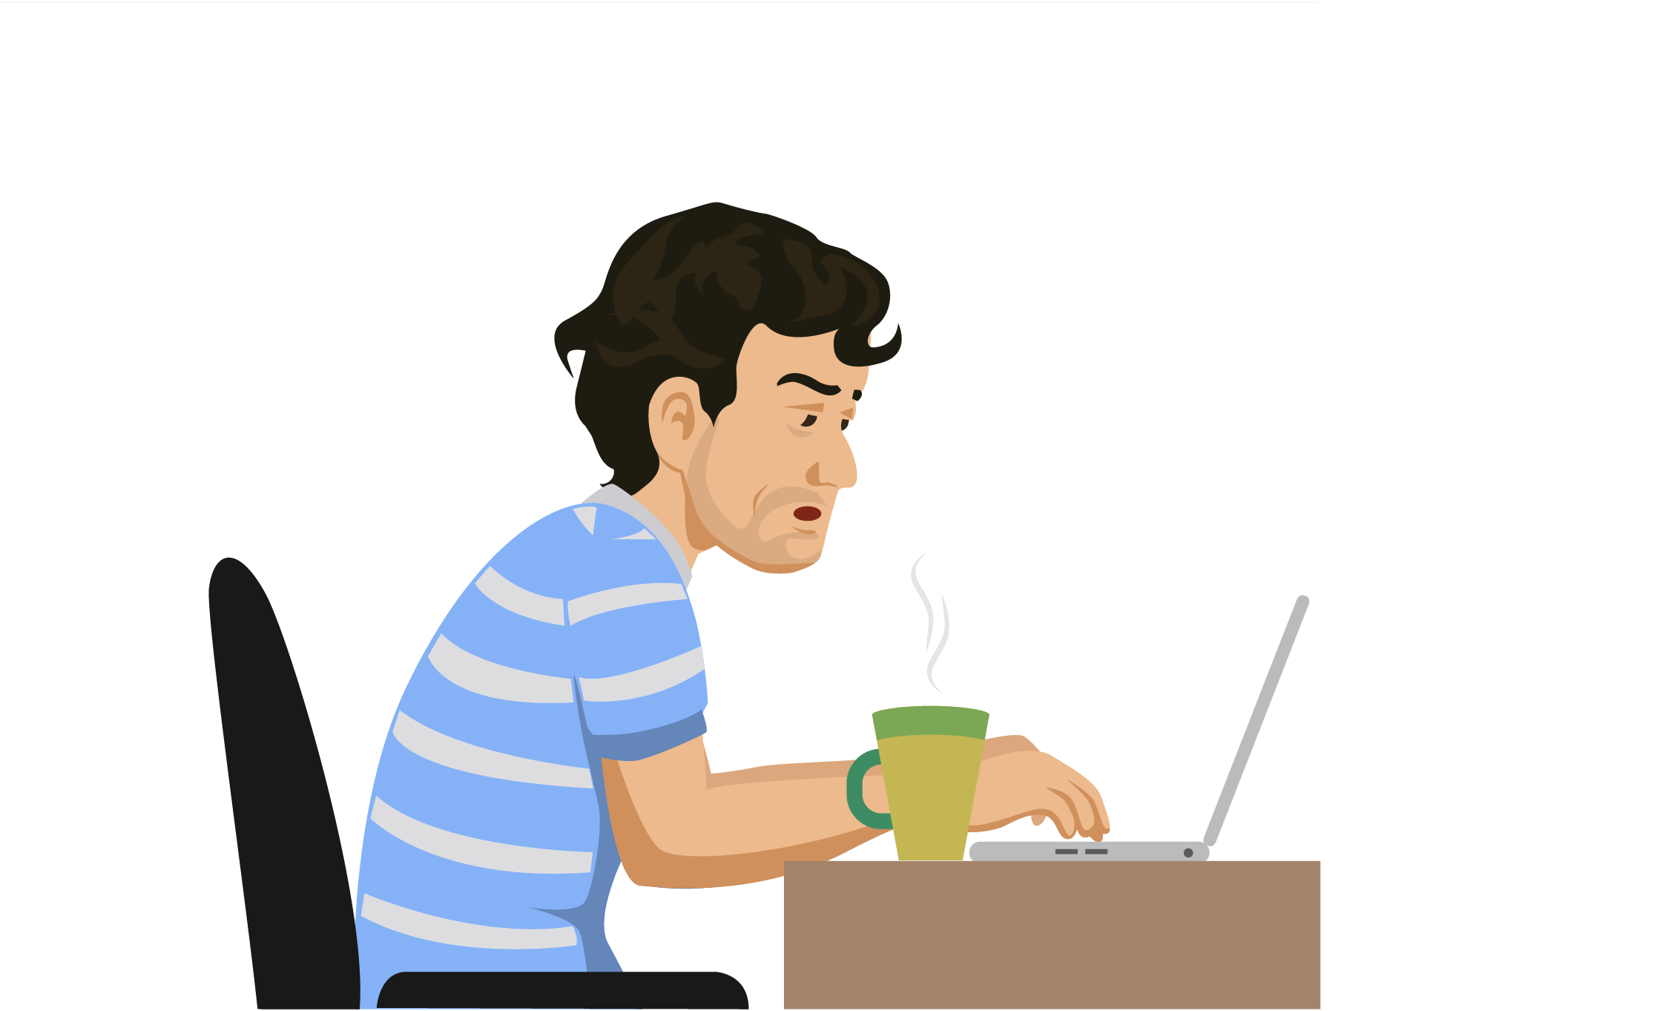

REFERENCIAS

Slide 61
Referencias
Mesografía
Tema 1
http://www.englishexercises.org/makeagame/viewgame.asp?id=6160
http://www.gingersoftware.com/content/grammar-rules/nouns/
Tema 2
http://www.englishforeveryone.org/PDFs/To_Be_Exercise_1.pdf
http://www.gingersoftware.com/content/grammar-rules/personal-pronouns/
http://hagwon.weebly.com/uploads/1/2/1/4/12149210/lesson_2.pdf
http://www.learnenglishfeelgood.com/pronouns-possessive2.pdf
http://www.drlemon.com/Grammar/demonstrative.html
Imágenes
Las imágenes se obtuvieron del sitio Freepik: http:www.freepik.com

