Slide 1
Material Didáctico Audiovisual
Sólo Visión Proyectables Diapositivas
Inglés 1 - Módulo II
Bachillerato Universitario 2015
Vida diaria: hábitos y rutinas.
Elaborado por: M. en I. y G. E. Cesar Martínez Acevedo
Plantel “Dr. Ángel Ma. Garibay Kintana” de la Escuela Preparatoria

Slide 2
Inglés 1
PROPÓSITO GENERAL
Emplea el idioma inglés de forma sencilla para satisfacer sus necesidades inmediatas de interacción, supervivencia o de relación con su entorno, por medio de expresiones cotidianas y representaciones lingüísticas básicas asociadas al contexto cultural y social en el que se desenvuelve.
Continuar

Slide 3
Módulo I
Nombre del Módulo
Vida diaria: hábitos y rutinas.
Propósitos del Módulo
Construye de forma oral y escrita, un texto simple y coherente, sobre su familia, hábitos y rutinas, así como la frecuencia con que las realiza.
Continuar

Slide 4
Competencia Disciplinar
Comunicación Básica
10 Identifica e interpreta la idea general y posible desarrollo de un mensaje oral o escrito en una segunda lengua, recurriendo a conocimientos previos, elementos no verbales y contexto cultural.
11. Se comunica en una lengua extranjera mediante un discurso lógico, oral o escrito, congruente con la situación comunicativa.
Extendida
9. Trasmite mensajes en una segunda lengua o lengua extranjera atendiéndolas características de contextos socioculturales diferentes.
Continuar

Slide 5
Competencia Disciplinar
4 Escucha, interpreta y emite mensajes pertinentes en distintos contextos mediante la utilización de medios, códigos y herramientas apropiados.
4.4 Se comunica en una segunda lengua en situaciones cotidianas.
7. Aprende por iniciativa e interés propio a lo largo de la vida.
7.1 Define metas y da seguimiento a sus procesos de construcción de conocimiento.
10. Mantiene una actitud respetuosa hacia la interculturalidad y la diversidad de creencias, valores, ideas y prácticas sociales.
10.2 Dialoga y aprende de personas con distintos puntos de vista y tradiciones culturales mediante la ubicación de sus propias circunstancias en un contexto más amplio.
Continuar

Slide 6
TEMAS
Relaciones familiares
TEMA 1
Hábitos y rutinas
TEMA 2
Frecuencia de hábitos y rutinas
TEMA 3

Slide 7
TEMAS
Possessive: ‘s -To Be Verb
Have got/has got
Rules to form plural nouns
Regresar

Slide 8
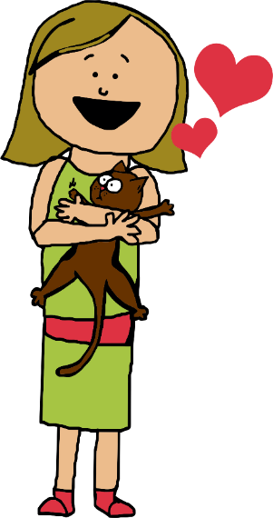
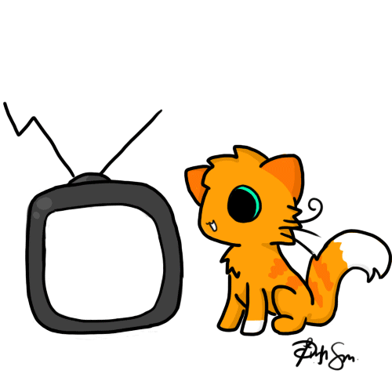
Possessive
‘s
BACK
The people’s objects.

Slide 9
Possessive(‘s)
It shows that something belongs to someone or something.
The coat belongs to the girl.
The bone belongs the dog.
The girl’s coat.
The dog’s bone.

Slide 10
Possessive(‘s)
It shows that something belongs to someone or something.
The pencil belongs to the teachers.
The jump rope belong to the students.
The teachers’ pencil.
The students’ jump rope.

Slide 11


Rules
Singular nouns
The cat The cat’s milk.
The girl The girl’s book.
Plural nouns
  The cats The cats’ milk.
The girls The girls’ book.

Slide 12
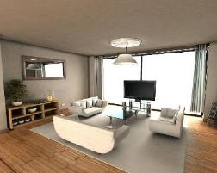

Rules
Irregular Plurals that don’t end with “S”.
The man (sing) → The men (plural)
The men’s house.
The mouse (sing) → The mice (plural)
The mice’s cheese.

Slide 13
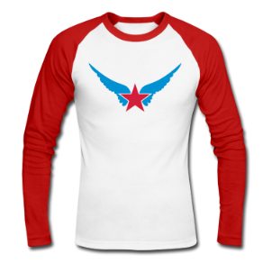
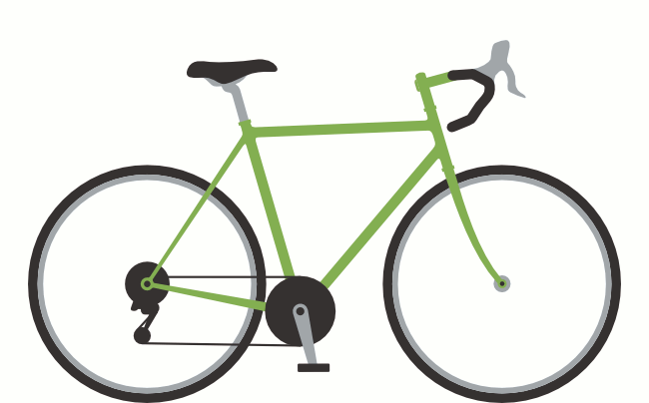

Whose are these objects?
Natalia
Peter
Children
It’s Natalia’s bike.
It’s Peter’s t-shirt.
It’s children’s bus.

Slide 14
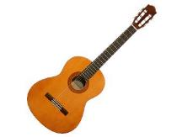

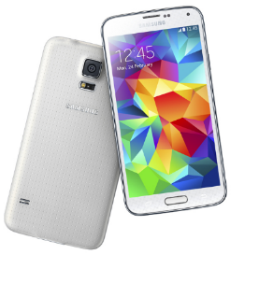
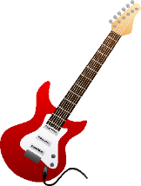

Whose are these objects?
Andre
Anna
Friends
They’re Andre’s
balls.
They’re Anna’s
cell phones.
They’re my friends’
guitars.

Slide 15
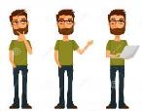
Possessive ‘S
Look at the underline word. Write SINGULAR or PLURAL.
The footballer’s clothes are nice. ________________
The players’ diet is good. ________________
The children’s favourite food is pasta. ________________
John’s hairstyle is great. ________________
The boys’ match is on Saturday. ________________
The team’s boots are new. ________________
The mice’s cheese is delicious. ________________
The teachers’ bags are blue. ________________

Slide 16
Describe 6 things that your relatives own.
Example:
This is Melissa’s notebook.
It’s Mario’s car.
These are my mother’s dresses.
That is my brother’s cell phone.
This is my father’s house.
Those are Alicia’s shoes.

Slide 17
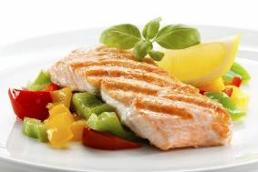

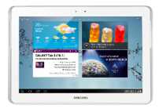
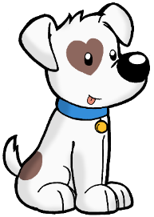
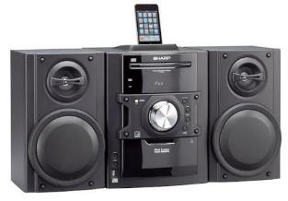
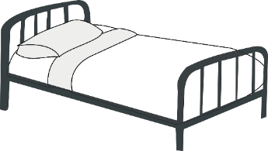

Whose are these abjects?
Monica
My lover
My brothers
Paul and Jake
Kids
Stephanie

Slide 18
Whose are these abjects?
They’re Monica’s tablets.
It’s my lover’s food.
It’s my brothers’ computer.
It’s Paul & Jake’s stereo.
It’s Stephanie’s bed.
They’re Kids’ dogs.

Slide 19
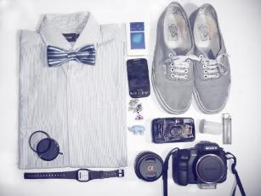
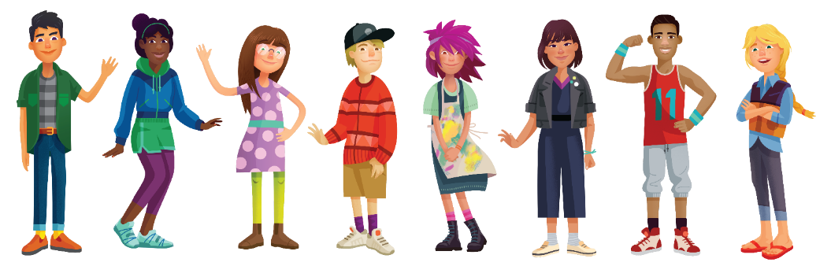
HAVE GOT
BACK

Slide 20
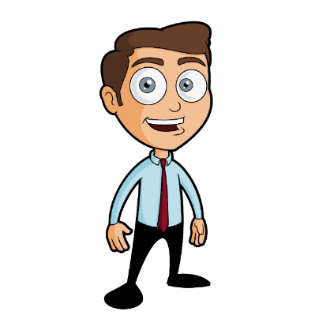
USE
We use “HAVE GOT” to talk about possession, relationships, illnesses or characteristics.
Examples:
I HAVE GOT a new house. (possession)
He HAS GOT three brothers. (relationships)
I HAVE GOT a bad cold. (illness)
Her office HAS GOT a nice view. (characteristics)

Slide 21
NEGATIVE
POSITIVE
AFFIRMATIVE |  | NEGATIVE
I HAVE GOT |  | I HAVEN’T GOT
YOU HAVE GOT |  | YOU HAVEN’T GOT
HE HAS GOT |  | HE HASN’T GOT
SHE HAS GOT |  | SHE HASN’T GOT
IT HAS GOT |  | IT HASN’T GOT
WE HAVE GOT |  | WE HAVEN’T GOT
YOU HAVE GOT |  | YOU HAVEN’T GOT
THEY HAVE GOT |  | THEY HAVEN’T GOT

Slide 22
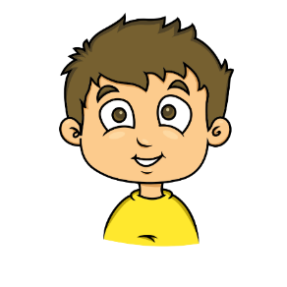



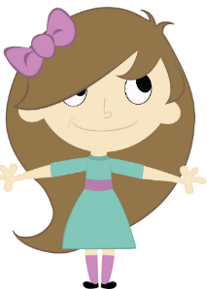

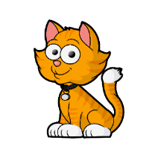
These are my toys
Hi Alice, these are my toys.
I have got a horse,
I have got a rabbit and
I have got some cars.
Have you got any toys Alice?
Yes, I have got a dog and
I have got some cats.

Slide 23

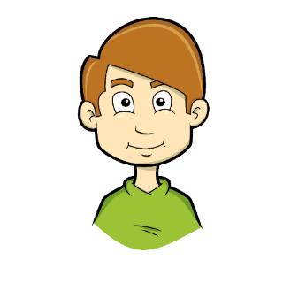
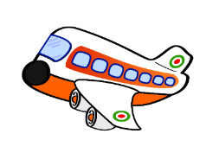
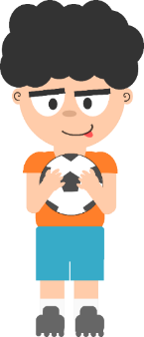

Have you got any toys Peter?
No.
I haven´t got any horse and
I haven’t got any car.
I have got a plane and a ship.
Have you got any toys Daniel?
No. I haven’t got a cat.
No. I haven’t got a car.
I have got a ball.

Slide 24
Remember
A + Consonant = 1
A + Vowel = 1
Some (positive) (plural) = More than 2
Any (Negative) = Nothing

Slide 25
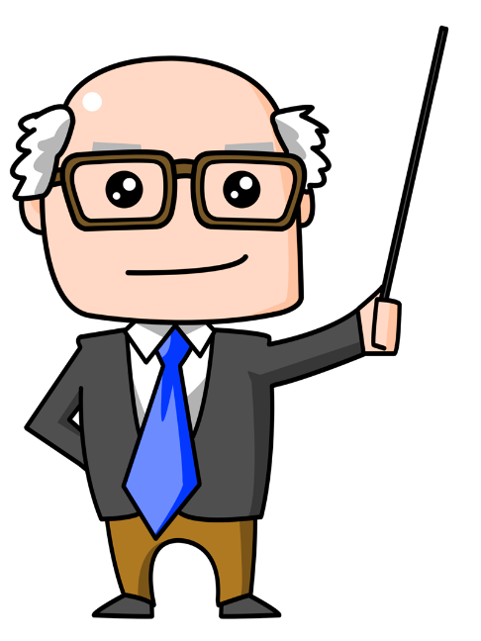
Look at the pictures and describe them.
Use verb “HAVE GOT”

Slide 26


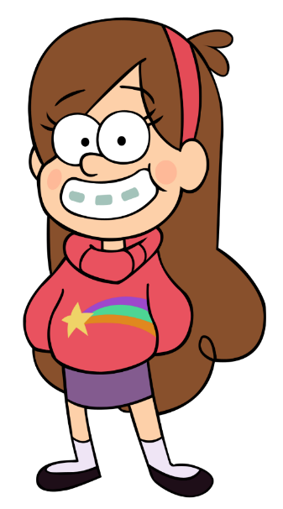

Mabel

Slide 27
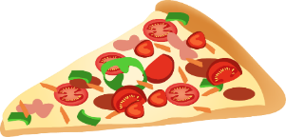
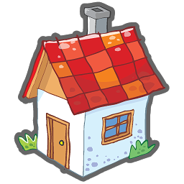
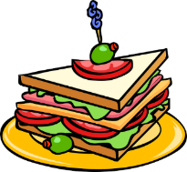
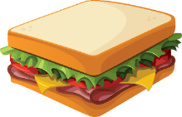
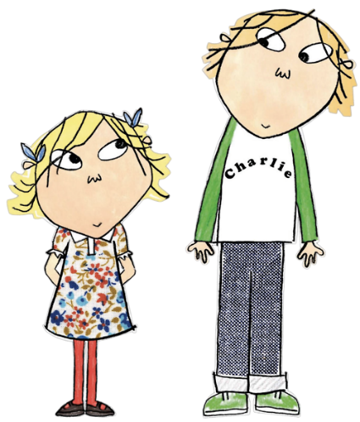

Charlie
& Lola

Slide 28

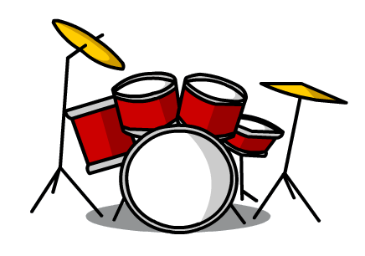

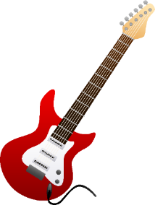
Jack

Slide 29
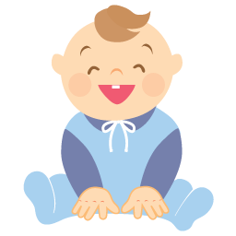
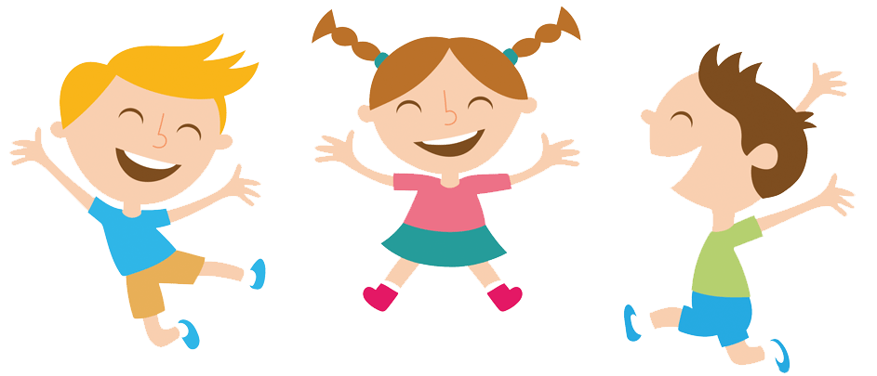
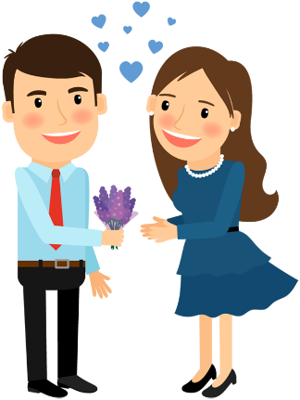

Monica
&
Steve

Slide 30

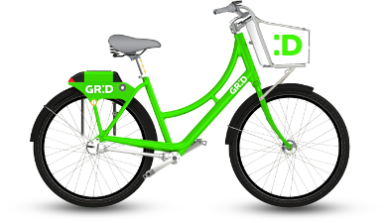
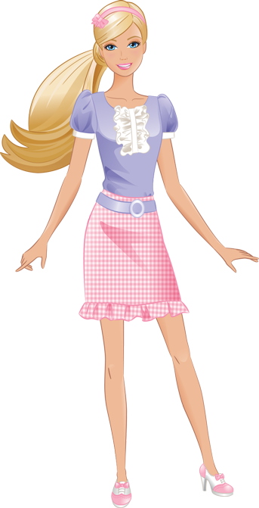

Melissa

Slide 31
Complete the following sentences with HAVE GOT, HAS GOT, HAVEN’T GOT or HASN’T GOT
My mother _____________ some pairs of shoes.
I’m sad. I _____________ any friends in the school.
Steve _____________ a sister. He is only son.
We _____________ an enormous house. We like it.
They _____________ any pets. They don’t like animals.
Mariana _____________ any new smartphone.
My car _____________ a powerful engine.
I _____________ some interesting books at home.
Maria _____________ some books at home.
You _____________ an old car.

Slide 32

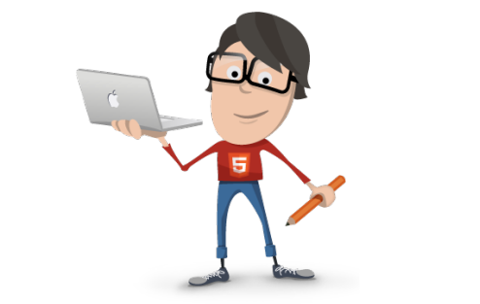
Time to write
Write 6 sentences using “have got”.
I have got a/an…
I have got some…
Write 4 sentences using “haven’t got”.
I haven’t got a/an…
I haven’t got any…
1 ELEMENT
MANY ELEMENTS
1 ELEMENT
0 ELEMENTS

Slide 33
Complete the chart with real information.
HAVE YOU GOT…? | ABOUT ME
boyfriend or girlfriend?
friends?
a cell phone ?
siblings?
a personal computer?
an instrument?

Slide 34
Complete the chart with real information.
HAVE YOU GOT…? | ABOUT ME
boyfriend or girlfriend? | No, I haven’t.
friends? | Yes, I have.
a cell phone ? | No, I haven’t.
siblings? | Yes, I have.
a personal computer? | Yes, I have.
an instrument? | No, I haven’t.

Slide 35
Complete the chart with real information.
HAVE YOU GOT…? | ABOUT ME | My friend _______ (Girl) | My friend _______ (Boy)
boyfriend or girlfriend? | No, I haven’t.
friends? | Yes, I have.
a cell phone ? | No, I haven’t.
siblings? | Yes, I have.
a personal computer? | Yes, I have.
an instrument? | No, I haven’t.

Slide 36
Complete the chart with real information.
HAVE YOU GOT…? | ABOUT ME | My friend _______ (Girl) | My friend _______ (Boy)
boyfriend or girlfriend? | No, I haven’t. | Yes, she has. | No, he hasn’t’.
friends? | Yes, I have. | Yes, she has. | No, he hasn’t’.
a cell phone ? | No, I haven’t. | Yes, she has. | Yes, he has.
siblings? | Yes, I have. | No, she hasn’t’. | Yes, he has.
a personal computer? | Yes, I have. | Yes, she has. | No, he hasn’t’.
an instrument? | No, I haven’t. | No, she hasn’t’. | No, he hasn’t’.

Slide 37
Complete the following sentences with HAVE GOT, HAS GOT, HAVEN’T GOT or HASN’T GOT
(+) I __________ a nice room.
(-) She __________ a cat.
(+) Jack __________ a pet.
(-) The sisters __________ great teachers.
(-) He __________ an old bike.
(+) They __________ a goldfish.
(-) Emma __________ lots of friends.
(-) We __________ a problem.
(-) Joe and Philip __________ a sister.
(+) My uncle __________ two cars.

Slide 38







Nouns
BACK
Rules to form plural nouns

Slide 39
What is a Noun?
Of all the parts of speech, nouns are perhaps the most important. A noun is a word that identifies a person, animal, place, thing, or idea.
Nouns are singular when they refer to just one person, place, thing, or idea.
Nouns are plural when they refer to two or more people, places, things, or ideas.

Slide 40
Regular Nouns
The regular plural form of nouns is made by adding an “s” to the end of the word. However, some words do not follow that rule. Plural forms that are made in some way other than just adding an “s” are called irregular plural forms.
Make the plural form of nouns ending in “ch”, “sh”, “x”, “o” or “ss” by adding “es”.
one church one brush one fox
two churches two brushes two foxes

Slide 41
Regular Nouns
Make the plural form of some nouns ending in “f” or “fe” by dropping the “f” or “fe” and adding “ves”.
one knife one wolf
two knives two wolves
Make the plural form of many words ending in “y” by dropping the “y” and adding “ies”.
one baby two babies

Slide 42
Regular Nouns
Make the plural form of some “oo” words by changing to “ee”.
one foot one tooth
two feet two teeth

Slide 43
Irregular Nouns
Some irregular plurals just have to be remembered:
one man two men
one child two children
one woman two women
one cactus two cacti
one index two indices
one mouse two mice

Slide 44
Exercise
Make plurals of the following words.
Singular | Plural |  | Singular | Plural
animal |  |  | house
baseball |  |  | lake
bench |  |  | life
box |  |  | lunch
box |  |  | man
business |  |  | plant
butterfly |  |  | potato
car |  |  | puppy
chair |  |  | shelf

Slide 45
Making sentences
Write sentences describing objects that are in the classroom. Use THERE IS A/AN or THERE ARE. Use singular and plural nouns.
_______________________________________________________.
_______________________________________________________.
_______________________________________________________.
_______________________________________________________.
_______________________________________________________.
_______________________________________________________.
_______________________________________________________.
_______________________________________________________.

Slide 46

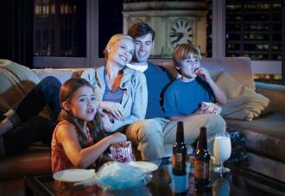
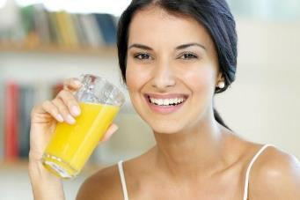
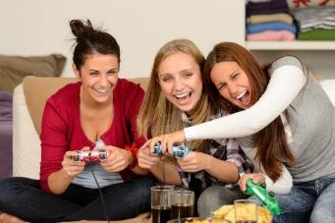
Every day Activities
BACK
My Daily Routine

Slide 47
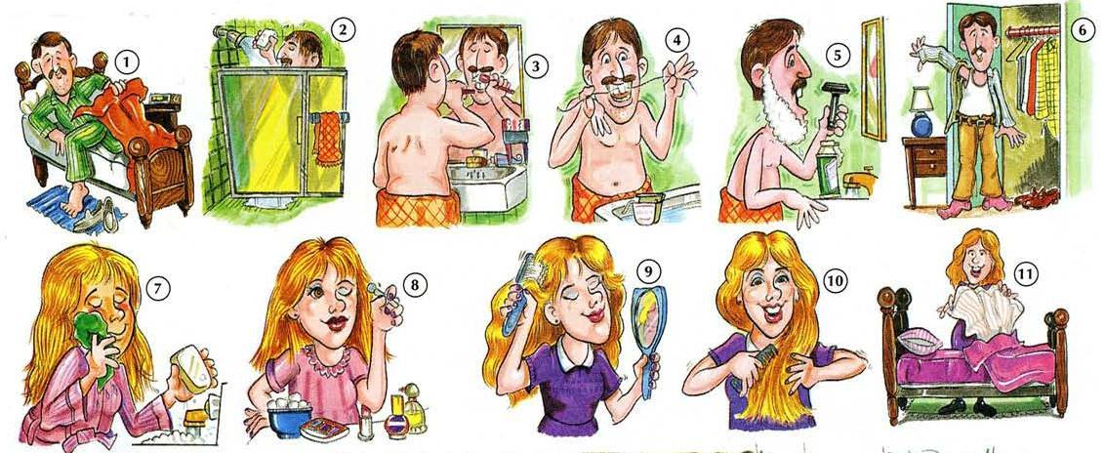
EVERYDAY ACTIVITES

Slide 48
EVERYDAY ACTIVITES

Slide 49
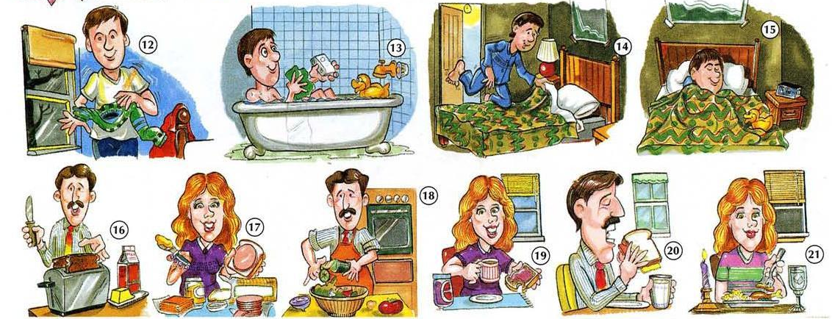
EVERYDAY ACTIVITES

Slide 50
EVERYDAY ACTIVITES

Slide 51
EVERYDAY ACTIVITES
1. get up
2. take a shower
3. brush my teeth
4. floss my teeth
5. shave
6. get dressed
7. wash my face
8. put on makeup
9. brush my hair
10. comb my hair
11. make the bed
12. get undressed
13. take a bath
14. go to bed
15. sleep
16. Make breakfast
17. make lunch
18 cook/make
dinner
19. have breakfast
20. have lunch
21. have dinner

Slide 52
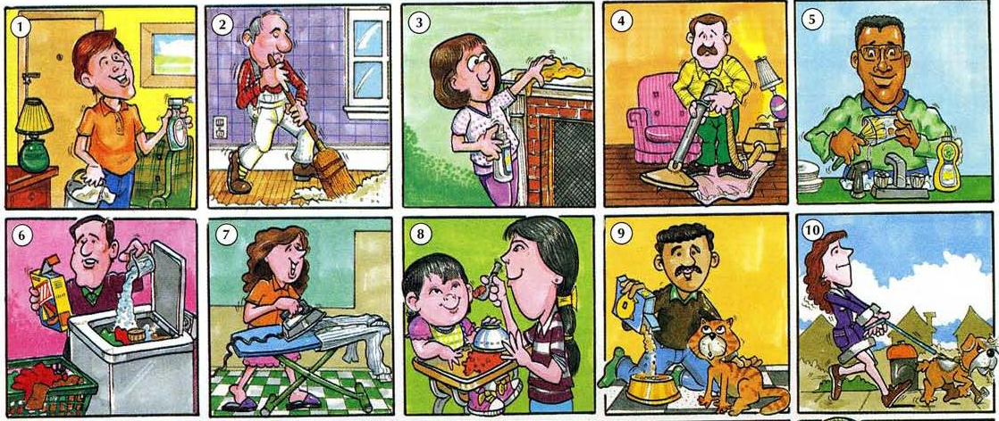
EVERYDAY ACTIVITES

Slide 53
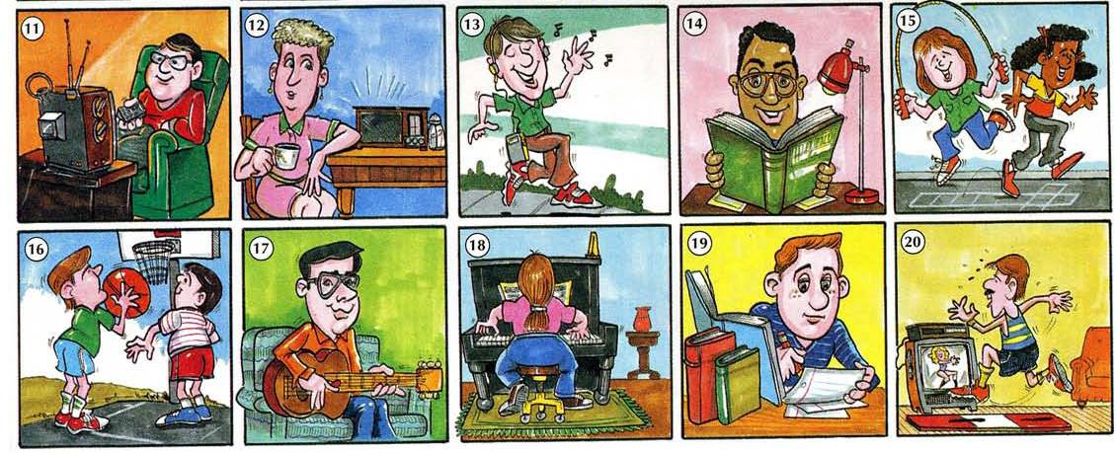
EVERYDAY ACTIVITES

Slide 54
EVERYDAY ACTIVITES
1. clean the house
2. sweep the floor
3. dust
4. vacuum
5. wash the dishes
6. do the laundry
7. iron
8. feed the baby
9. feed the cat
10. walk the dog
11. watch TV
12. listen to the
radio
13. listen to music
14. read
15. play
16. play basketball
17. play the guitar
18. play the piano
19. study
20. exercise

Slide 55
Complete the chart with everyday activities
Write two things you do…
Every day | I… | I…
In the afternoon | I… | I…
At weekends | I… | I…
At night | I… | I…
After breakfast | I… | I…
Before bed | I… | I…

Slide 56
Complete the chart with everyday activities
Write two things you do…
Every day | I read the newspaper. | I travel by bus.
In the afternoon | I eat at school. | I talk to my friends.
At weekends | I go to church. | I send messages.
At night | I watch TV. | I study maths.
After breakfast | I do homework. | I travel by bus.
Before bed | I check Facebook. | I kiss my girlfriend.

Slide 57
What do you do…?
Every day | I read the newspaper. | I travel by bus.
In the afternoon | I eat at school. | I talk to my friends.
At weekends | I go to church. | I send messages.
At night | I watch TV. | I study maths.
After breakfast | I do homework. | I travel by bus.
Before bed | I check Facebook. | I kiss my girlfriend.

Slide 58
My daily routine
Now organize your information and write a text about your routine.
My name is _______________.
At ___________ I get up and then I take a shower, I eat breakfast at ________. Finally, I ___________my teeth and I ____________ to school.
I go to school from ___________ to ___________. I study at home from ________ to ________. I eat lunch at___________. I do homework from__________ to ___________. I have dinner at ____________. I watch TV with my ________ at __________. I do exercise on __________.
On Saturdays I _____________, I ___________ and I ______________.
On Sundays I _____________, I ___________ and I ______________.

Slide 59
Tom is showing his friends a family photo in his birthday party.

Slide 60
The children are my sister, Sally, and my brother, Peter.
We like playing badminton on Monday afternoon.

Slide 61
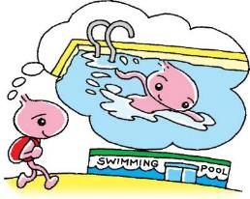

Look at my Activity Timetable.
Tuesday | Wednesday | Thursday

Slide 62
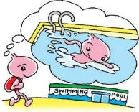

On Tuesday, I go swimming.
Tuesday
Wednesday
On Wednesday, I draw pictures.
Thursday
On Thursday, I make models with Peter and Sally.

Slide 63
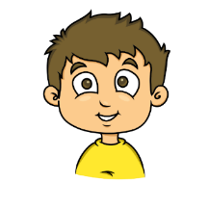
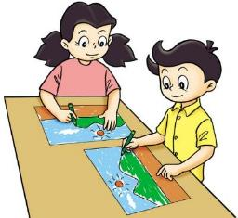
Look at Peter’s Activity Timetable.
Friday | Saturday

Slide 64
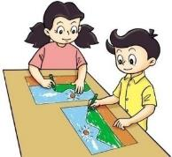
On Friday, Peter paints the model.
He likes painting very much.
Friday
Saturday
On Saturday, he goes to a painting class.

Slide 65

This is Sally’s Activity Timetable.
Tuesday | Wednesday | Thursday | Friday

Slide 66
On Tuesday, Sally goes jogging.
Tuesday
Wednesday
On Wednesday, she plays chess with her friend Tom.
Thursday
On Thursday, Sally and Tom go cycling.
Friday
On Friday, they play table tennis.

Slide 67
John, you like playing ball games. Do you like playing with us ?
Yes, I do.
My dog likes picking up balls.
It likes running too.
Let me bring it to our games !

Slide 68
Study Table
There is no ‘s’ at the end of the verb. | There is an ‘s’ or ‘es’ at the end of the verb.
I go swimming. I make models. We like playing badminton. You like playing ball games. Sally and Lily go cycling. They play table tennis. | Peter goes swimming. He makes models . Sally likes playing badminton. She likes playing ball games. Sally goes cycling. She plays table tennis. The dog likes playing table tennis. It likes running.

Slide 69



Look at the
following people.
Describe the
activities they do

Slide 70







What activities does Maria do?

Slide 71






What activities does Steve do?

Slide 72




What activities do Andre and Melissa do?

Slide 73
COMPLETE THE SENTENCES WITH THE VERBS IN PRESENT
I ________ (go) shopping with my brother.
We sometimes ________ (use) a dictionary in class.
My friends ________ (study) Italian at their school.
School ________ (finish) at three o´clock.
He ________(listen to) rap music.
She ________ (do) her homework before dinner.
We ________ (play) tennis in school on Wednesday afternoon.
I ________ (watch) TV in the evening.
My mother ________ (teach) art at school.

Slide 74
Complete the sentences with the verbs in present
Brian _________ (get) up at eight o´clock.
John and Martin _________ (do) exercise.
Serena _________ (know) what to do.
Wendy _________ (like) to do shopping.
My grandfather _________ (live) in London.
My sisters _________ (walk) to school every day.
My best friend _________ (relax) at home.
My brother and I _________ (have) breakfast half past seven.
You ________ (live) near me.

Slide 75
Adverbs of Frequency
BACK

Slide 76

Study Habits
Well, I always do my homework, and I often ask the teacher for help.
Hmmm… Well, I am usually late for class, and I never do my homework.
Maybe I need to try your study habits.
You got an “A+” again!?!? How do you do it?
I got an “A+.”
I got an “F” again.

Slide 77
Use & Meaning
Use ADVERBS OF FREQUENCY to say how often you do something. Adverbs of frequency are often used with the present simple because they indicate repeated or routine activities.

Slide 78



Adverbs of Frequency 1
Adverbs of frequency say how often something happens.
always
100%
usually
often
sometimes
50%
rarely
He always studies.
He rarely studies.
usually
hardly ever
He sometimes studies.
never
often
never
0%

Slide 79


Adverbs of Frequency 2
Adverbs of frequency come after the verb to be.
She is sometimes late.
The students are never bored.

Slide 80


Adverbs of Frequency 3
Adverbs of frequency usually come before other verbs.
She often checks her answers.
He usually pays attention in class.

Slide 81

Usually and Sometimes
Usually and sometimes can also come at the beginning or end of a sentence.
The dog eats his homework sometimes.
Sometimes the dog eats his homework.
The dog sometimes eats his homework.

Slide 82
Practice 1
Rewrite the following sentences using adverbs of frequency in the correct position.
1) I do my homework on Saturday (never).
2) I am happy at the weekend (always).
3) I meet my best friend at the cinema. (sometimes).
4) I go out on Saturday Morning (often).
5) The films are interesting (usually).
6) We see a boring film (hardly ever).
7) We have pizza after the film (sometimes).
8) I play volleyball in a team. (usually).
9) I don’t like teaching maths. (always).
10) I tidy my room when I’m happy. (often).

Slide 83
Practice 1
Rewrite the following sentences using adverbs of frequency in the correct position.
I never do my homework on Saturday (never).
I am always happy at the weekend (always).
I sometimes meet my best friend at the cinema. (sometimes).
I often go out on Saturday Morning (often).
The films are usually interesting (usually).
We hardly ever see a boring film (hardly ever).
We sometimes have pizza after the film sometimes).
I usually play volleyball in a team. (usually).
I don’t always like teaching maths. (always).
I often tidy my room when I’m happy. (often).

Slide 84

Practice 1
Work with a partner. Describe your study habits. Use adverbs of frequency and the phrases below.
Example: study at my computer
study in front of the TV
ask the teacher for help
be early to class
tidy my room on weekdays
do homework
be attentive in class
I sometimes study at
my computer.
always
100%
usually
often
sometimes
50%
rarely
hardly ever
never
0%

Slide 85


REFERENCIAS
BACK

Slide 86
Referencias
Mesografía
Tema 1
Subtema 1
https://brainly.pl/zadanie/170191
Subtema 2
https://www.englisch-hilfen.de/en/exercises/tenses/have_got.htm
Tema 3
https://www.language-worksheets.com/present-simple-elementary.html
http://centros4.pntic.mec.es/~deprac15/iglessandra/quinto/Adverbs%20of%20frequency%20GUAY.pdf
https://learnenglishteens.britishcouncil.org/grammar/beginner-grammar/present-simple?page=1
Imágenes
Las imágenes se obtuvieron del sitio Freepik: http:www.freepik.com

