Slide 1
Material Didáctico Audiovisual
Sólo Visión Proyectables Diapositivas
Inglés 2 - Módulo III
Bachillerato Universitario 2015
Elaborado por: M. en I. y G. E. Cesar Martínez Acevedo
Plantel “Dr. Ángel Ma. Garibay Kintana” de la Escuela Preparatoria
Mi PASADO

Slide 2
Inglés 2
PROPÓSITO GENERAL
Emplea el idioma inglés para satisfacer sus necesidades inmediatas de interacción, supervivencia y de relación con su entorno inmediato, de forma simple, por medio de expresiones cotidianas, frases comunes, familiares y aprendidas; y representaciones lingüísticas asociadas al contexto cultural y social.
Continuar

Slide 3
Módulo I
Nombre del Módulo
Ocasiones especiales: ¿Qué está pasando? y ¿Qué hacen las personas que están a mí alrededor?
Propósitos del Módulo
Describe su entorno social inmediato mencionando lo que está pasando a su alrededor y lo que hacen las personas a su alrededor.
Continuar

Slide 4
Competencia Disciplinar
Comunicación Básica
10 Identifica e interpreta la idea general y posible desarrollo de un mensaje oral o escrito en una segunda lengua, recurriendo a conocimientos previos, elementos no verbales y contexto cultural.
11. Se comunica en una lengua extranjera mediante un discurso lógico, oral o escrito, congruente con la situación comunicativa.
Extendida
9. Trasmite mensajes en una segunda lengua o lengua extranjera atendiéndolas características de contextos socioculturales diferentes.
Continuar

Slide 5
Competencia Genérica
4 Escucha, interpreta y emite mensajes pertinentes en distintos contextos mediante la utilización de medios, códigos y herramientas apropiados.
4.4 Se comunica en una segunda lengua en situaciones cotidianas.
7. Aprende por iniciativa e interés propio a lo largo de la vida.
7.1 Define metas y da seguimiento a sus procesos de construcción de conocimiento.
10. Mantiene una actitud respetuosa hacia la interculturalidad y la diversidad de creencias, valores, ideas y prácticas sociales.
10.2 Dialoga y aprende de personas con distintos puntos de vista y tradiciones culturales mediante la ubicación de sus propias circunstancias en un contexto más amplio.
Continuar

Slide 6
TEMAS
PAST OF CAN:
COULD
PAST OF BE:
WAS & WERE
SIMPLE PAST
ADJECTIVES TO
DESCRIBE FEELINGS

Slide 7
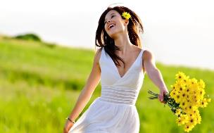
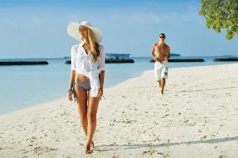
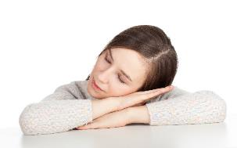
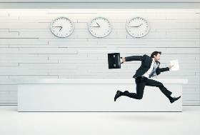
CAN & COULD
Abilities in the past
Regresar

Slide 8

Competencia Genérica
4. Escucha, interpreta emite mensajes pertinentes en distintos contextos mediante utilización medios, códigos herramientas apropiados.
Atributos
4.4 Se comunica una lengua situaciones cotidianas.

Slide 9
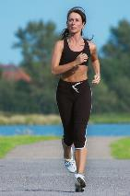

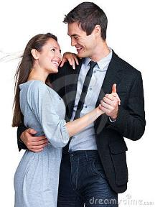
Use
NOW
We use “CAN” when we perform an activity in particular in the PRESENT. We use it use in POSITIVE SENTENCES.
I can run very fast.
She can play the guitar.
We can dance in the competence.
I can speak French & Italian.
My best friend can play soccer very well.
My sister and her boyfriend can travel abroad.
Pao can write poems and write music.

Slide 10
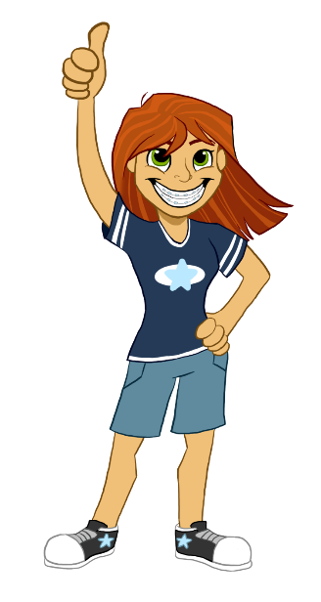
Abilities: Things I can do
Can you speak Spanish?
Can you play an instrument?
Can you dance cumbia?
Can you type quickly?
Can you cook?
Can you skateboard?
Can you drive a car?
Yes, I can
No, I can’t

Slide 11
Tick
(✓) what you can do.
Can you…?
 | You
Drive a car
Play golf
Sing
Speak French
Jump the rope
Eat chilli
Draw or write poems
Play soccer
Skateboard
Yes, I can
No, I can’t

Slide 12
Use
IN THE PAST
We use “COULD” when we perform an activity in particular in the PAST. We use it use in POSITIVE SENTENCES.
When I was 5 years, I could sleep till late.
Last year, my brother could play tennis very well.
Five years ago, they could travel. They were very rich.
In 2012, Maria could run 100 metres in 12 seconds.

Slide 13
Activities in the past
Think about some activities that you COULD do in the past.
When I was a kid, I COULD eat free in a restaurant.
______________________.
______________________.
______________________.
______________________.
______________________.
______________________.

Slide 14
Speaking activity
Work with 3 different people and ask about their past activities.
What could you do in the past?
Try to memorize the information.

Slide 15
Look the following chart and thick the activities you could in the past.
Activities | 10 Years ago | NOW
Ride a bike
Stay up late
Watch television alone in your room
Speak English
Cook tasty meals
Use the Internet, specially Facebook
Sleep at my friend’s house
Go to parties until very late
Go shopping in town with a friend
Go out in the evening with your girlfriend or boyfriend
Go on vacation with a friend
Drive to school alone

Slide 16
Now, write sentences as in the example.
I couldn’t ride a bike 10 years ago, but now I can ride a bike.
___________________________________________________.
___________________________________________________.
___________________________________________________.
___________________________________________________.
___________________________________________________.
___________________________________________________.

Slide 17
Tick
(✓) what you COUlD do in the past.
Yes, I could
No, I couldn’t
Could you…?
 | You
Drive walk
Speak Spanish
Sing
Travel by bus
Jump the rope
Eat chilli
Cycle a bike
Play soccer
Use mobile phone

Slide 18

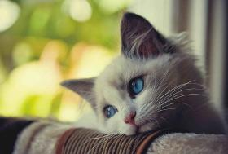
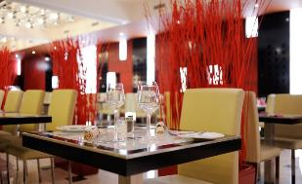
WAS / WERE
SIMPLE PAST
Regresar

Slide 19
Competencia Genérica
4. Escucha, interpreta emite mensajes pertinentes en distintos contextos mediante utilización medios, códigos herramientas apropiados.
Atributos
4.4 Se comunica una lengua situaciones cotidianas.

Slide 20

Present
Today, I am 38 years old.
Today, I am a teacher.
Today, I am happy but tired.
Today, I am in the school with my students.
Now, it is ______.

Slide 21
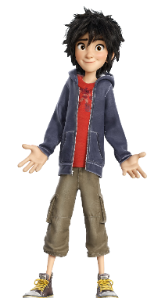
Past
5 years ago, I was 33 years old.
17 years ago, I was a student.
Yesterday, I was so sad.
In the morning, I was at home having breakfast.
10 minutes ago, it was ______.

Slide 22
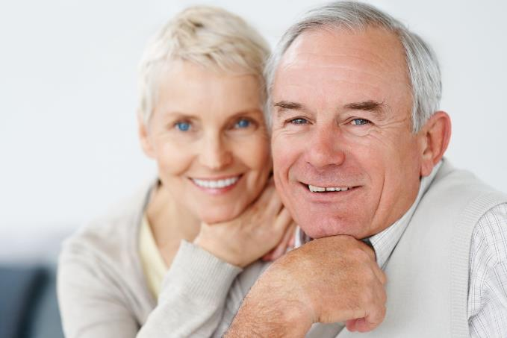
USE
NOW
Bob is eighty. He is old and weak.
Mary, his wife is seventy-nine. She is old, too.

Slide 23
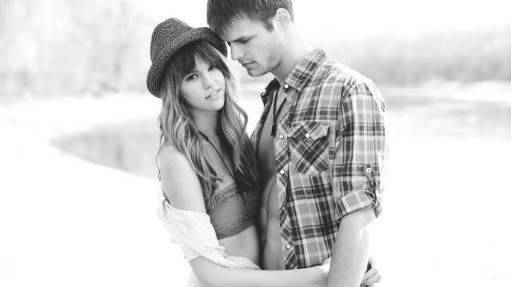
USE
THEN
Fifty years ago they were young. Bob was strong.
He wasn’t weak. Mary was beautiful and young.
She wasn’t old.

Slide 24
Now make sentences using VERB TO BE IN THE PAST.
15 years ago, I was ____________________.
10 years ago, I was ____________________.
5 years ago, I was ______________________.
Yesterday, I was _________________________.
In the morning, I was ____________________.

Slide 25

USE
We use WAS & WERE to describe the following:
Age
The way we feel (mood)
Location (place)
An occupation
The time (hour) & the weather
EXAMPLES:
I was happy yesterday.
Everybody was at the party.
My friends were in the park.
They were soccer players.
It was very cold at night.

Slide 26
Answer the following questions.
1. Where were you yesterday?
2. How old were you 4 years ago?
3. How did you feel last weekend?
4. What was the weather like yesterday afternoon?
5. What time was it 35 minutes ago?

Slide 27
Examples
Today, I am a teacher.
Now, He is well.
Right now, we are in the classroom.
At the moment, it is cold.
Now, I am happy and active.
Right now, Maria is 15.
10 years ago, I was a student.
Last week, he was sick.
On Sunday, we were at home.
At midday, it was hot.
Yesterday, I was so sad.
Last year, Maria was 14.

Slide 28
Where were we yesterday ?
I
You
He
She
It
We
You
They
was
at the beach.
were
at the club.
was
at home.
was
at school.
was
in the bag.
were
Positive
at the cinema.
were
at the airport.
were
at the shopping.

Slide 29
Look at the pictures and describe them using
WAS or WERE.
Write sentences.

Slide 30
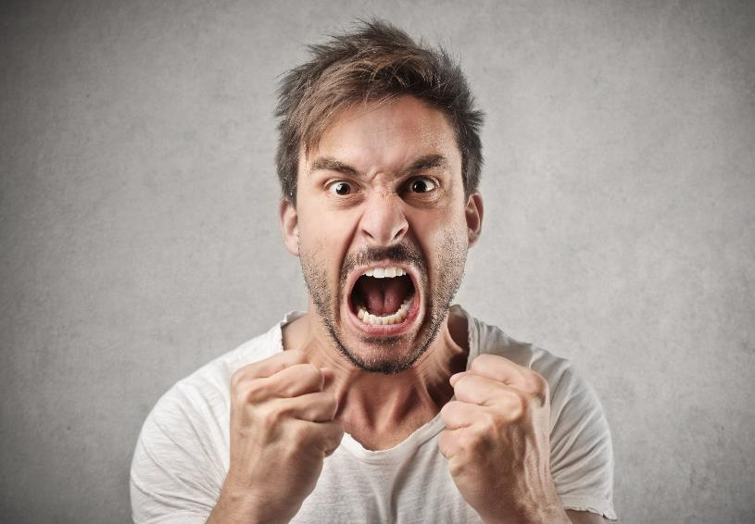
Peter
Angry
Yesterday
How did he feel?

Slide 31

My friends
At the library
Where were my friends?
3 days
ago

Slide 32
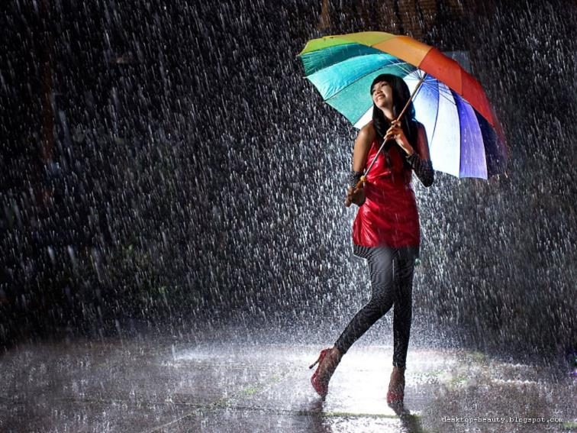
Rainy
What was the weather like?
Last week

Slide 33
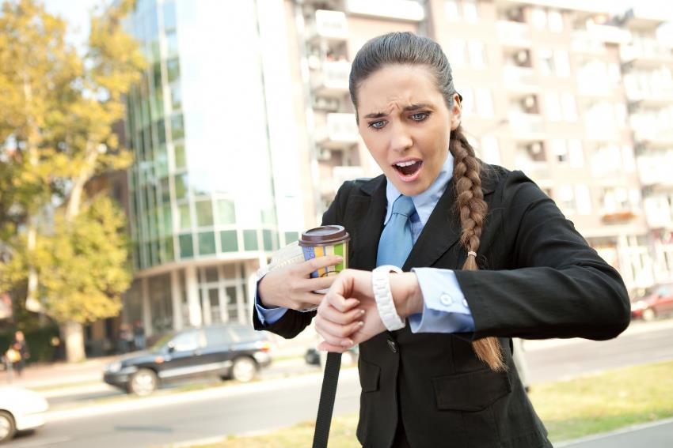
Julissa
Late
How did she feel?
Last
Monday

Slide 34
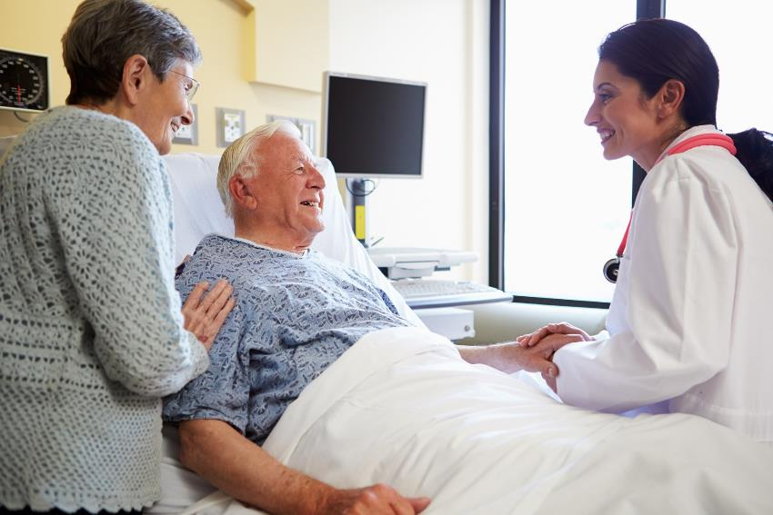
Joseph
At the hospital
Where was Joseph?
For one
week

Slide 35
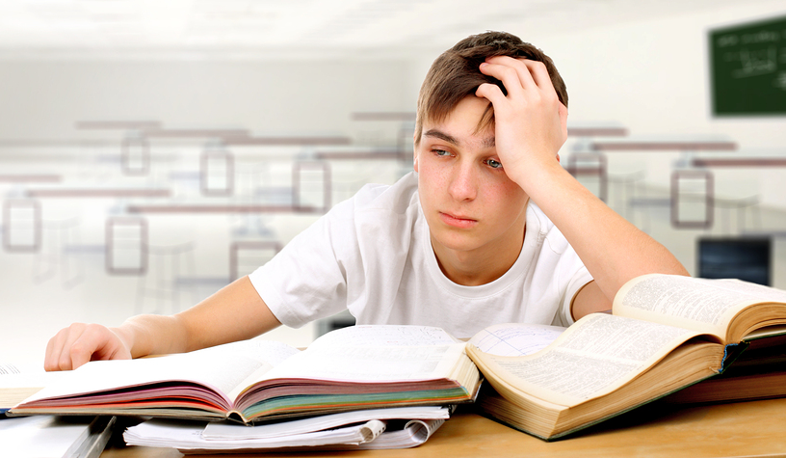
Jacob
Tired
How did he feel?
This
morning

Slide 36

Sunny
What was the weather like?
Yesterday

Slide 37

The cat
Sad
How did the cat feel?
5 days
ago

Slide 38
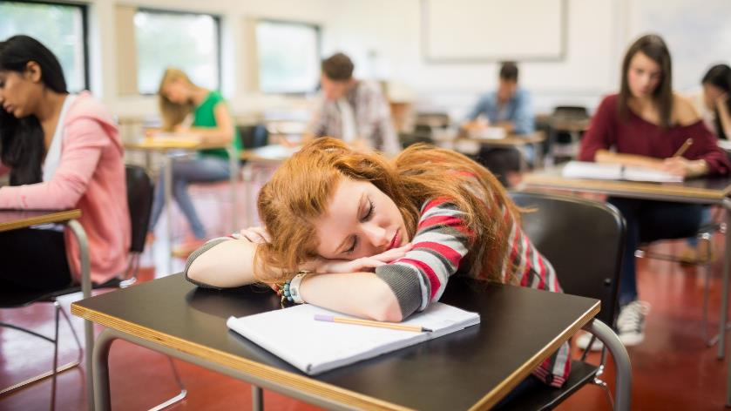
Nicole
Sleepy
How did Nicole feel?
In the
class

Slide 39
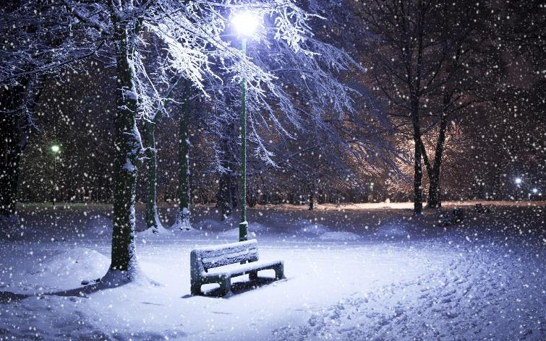
Snowy
What was the weather like?
Last
holiday

Slide 40
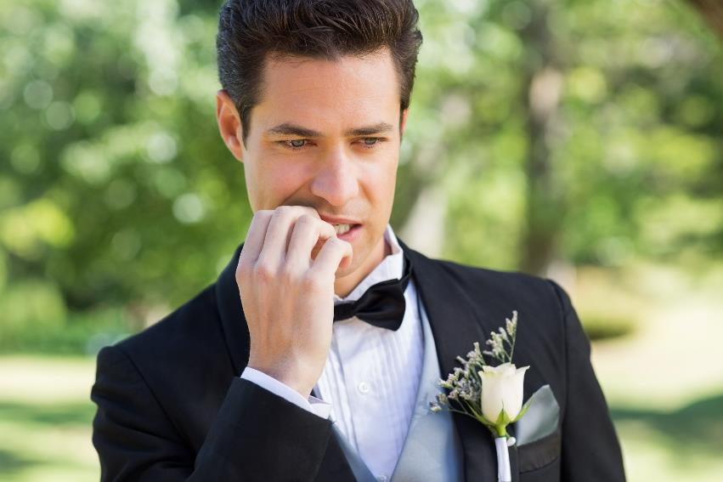
The Groom
Nervous
How did the groom feel?
Last
Month

Slide 41
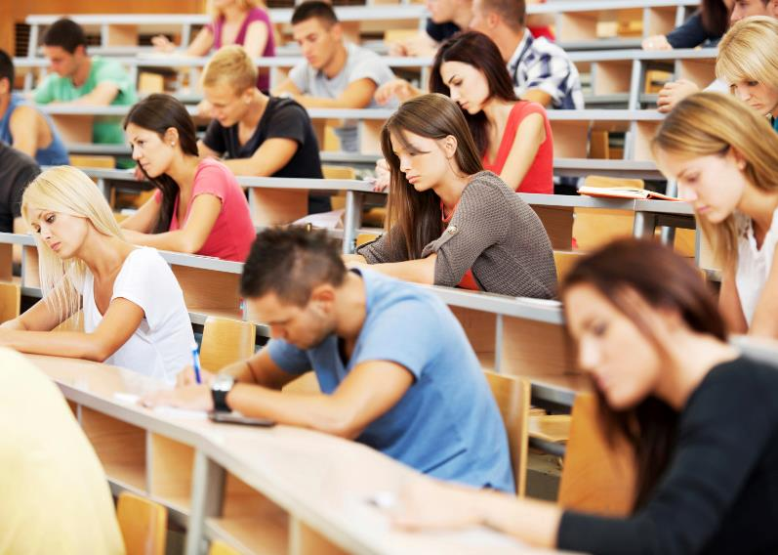
Teenagers At the school
Where were the teenagers?
This
morning

Slide 42

Heather
Happy
How did she feel?
Last
weekend

Slide 43
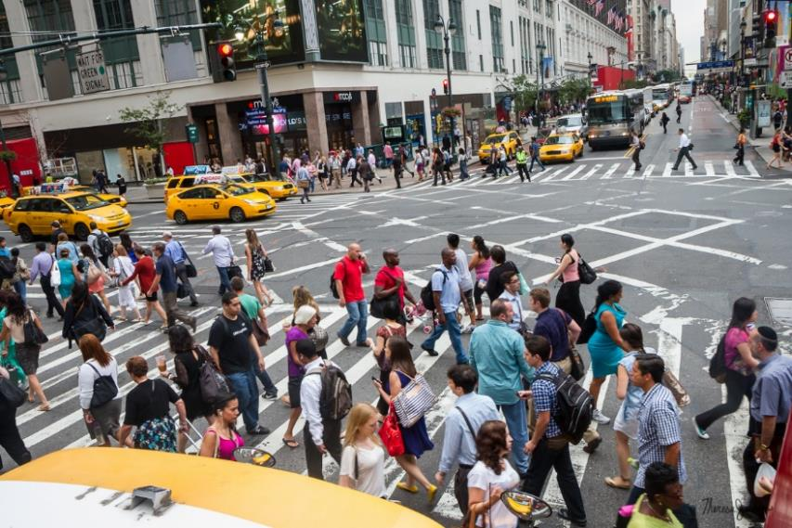
The Street
Crowded
What was the street like?
On
holiday

Slide 44
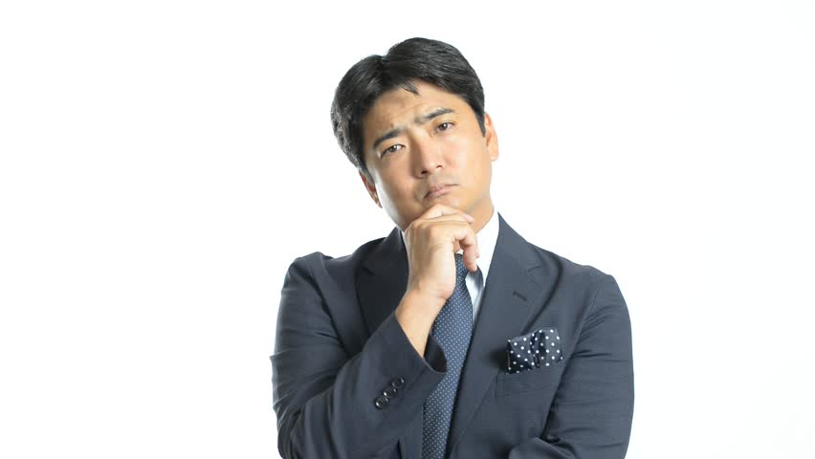
Jack
Serious
How did he feel?
At work

Slide 45
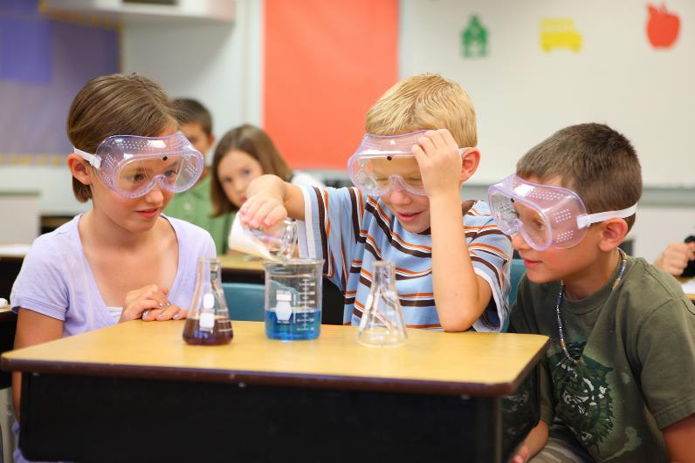
Children
At the laboratory
Where were the chidren?
This
morning

Slide 46

My sister
Exahusted
2 weeks ago
How did she feel?

Slide 47
Write sentences about you. Use WAS
How did you feel in the first day of class?
Where were you last night?
Who was with you in the party?
What was the weather like this morning?
__________________________________________________.
__________________________________________________.
__________________________________________________.
__________________________________________________.

Slide 48
Complete with was or were
The book _________ on the desk.
They _________ so sad last night.
Sam _________ in the hall in the morning.
Mari and Jenna _________ in the room 2 hours ago.
I _________ first in line for the cinema.
You and I _________ at the table last night.

Slide 49
Complete with was or were
Steve _________ exhausted yesterday.
We _________ at the Zoo yesterday.
Mum and Dad _________ in a restaurant last weekend.
They _________ in the disco club last night.
You _________ late for school yesterday.
I _________ very hungry in the afternoon.

Slide 50
Complete the sentences with WAS or WERE
1. My best friend _________ very sad this morning.
2. Peter and Sara _________ in the cinema last night.
3. When I called my mother, it _________ late.
4. We _________ busy last weekend. We worked a lot.
5. The books _________ very interesting.
6. In the beach the weather _________ hot.
7. I _________ very tired this morning.
8. Sara _________ my best friend in school.
9. My dogs _________ hungry. They barked a lot.
10. The bus _________ full in the afternoon.

Slide 51

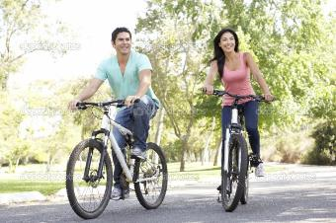
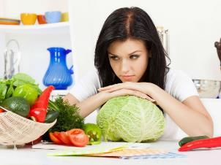
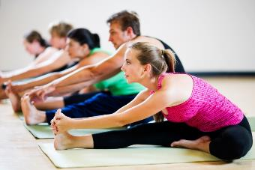
Simple Past
Regresar

Slide 52
Competencia Genérica
4. Escucha, interpreta emite mensajes pertinentes en distintos contextos mediante utilización medios, códigos herramientas apropiados.
Atributos
4.4 Se comunica una lengua situaciones cotidianas.

Slide 53

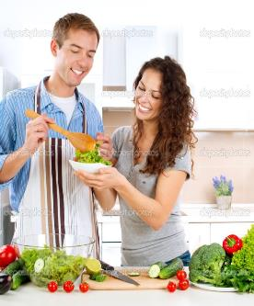
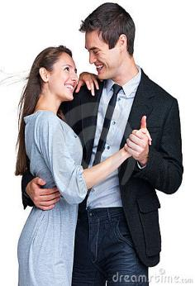
SIMPLE PAST
We use this tense to talk about things that happened in the past.

Slide 54

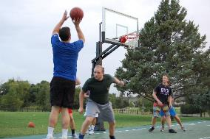
SIMPLE PAST
Use the Simple Past to describe actions, events, or states at a specific past time.
Last month I went shopping with my girlfriend.
Last weekend I played basketball with my friends.
Now
Past
Future

Slide 55
TIME EXPRESSIONS
2 days ago
2 weeks ago
5 years ago
a long time ago
AGO
for 2 weeks
for 5 months
FOR
LAST
last night, week, month, year
YESTERDAY
I went to the school yesterday.

Slide 56
Regular & Irregular Verbs

Slide 57
Affirmative Sentences

Slide 58
How do we form the simple past tense?
English has two types of verbs in the past:
Regular
Irregular

Slide 59
SIMPLE PAST
Regular Verbs
Irregular Verbs
Most verbs are regular and show this regularity by having -ed on the end.
The irregular verbs can end in a variety of ways.
walked regular
studied regular
taught irregular
gave irregular
became irregular
cried regular
lived regular
did irregular

Slide 60
REGULAR VERBS
IRREGULAR
VERBS
We add -ED
We have to learn the irregular verb list by heart
I worked
You worked
He worked
She worked
It worked
We worked
You worked
They worked
I went
You went
He went
She went
It went
We went
You went
They went

Slide 61
Do you know the past verbs?
Present Past
begin ___
buy ___
drive ___
do ___
feel ___
go ___
grow ___
hear ___
  Present Past
know ___
leave ___
lose ___
mean ___
pay ___
sell ___
sit ___
think ___

Slide 62
Do you know the past verbs?
Present Past
begin began
buy bought
drive drove
do did
feel felt
go went
grow grew
hear heard
  Present Past
know knew
leave left
lose lost
mean meant
pay paid
sell sold
sit sat
think thought

Slide 63
Base Form Simple Past Tense
wear
ride
use
go
have
try
shop
enjoy
take
wore
rode
used
went
had
tried
shopped
enjoyed
took

Slide 64
Look at the following pictures and describe what the people did some time ago.
Use the given information.

Slide 65
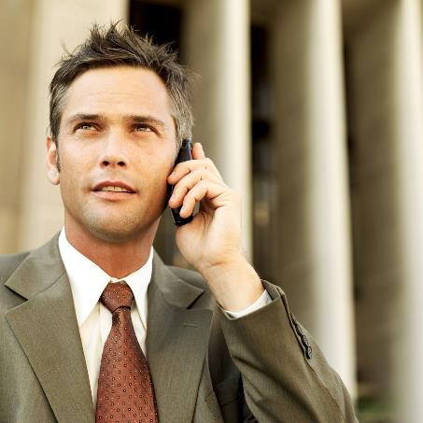
Steve
What did he do?
yesterday

Slide 66
Steve called
his mother
yesterday.
Steve phoned his mother
yesterday.

Slide 67
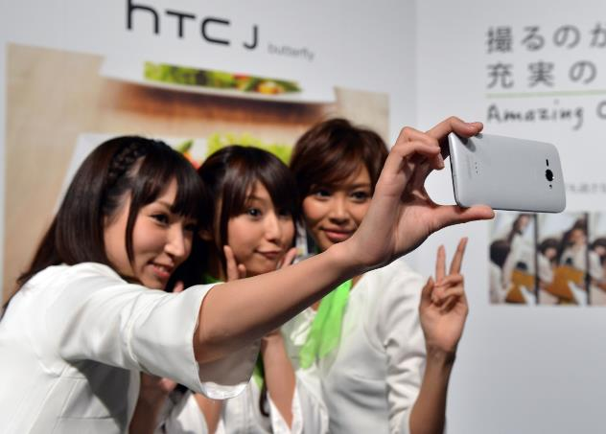
Tania and her friends
What did they do?
last weekend

Slide 68
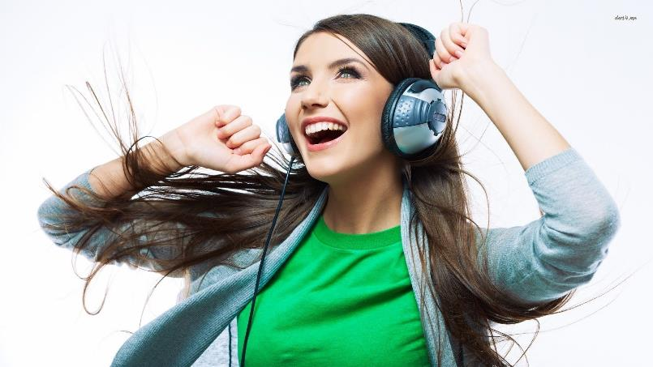
Sofia
What did she do?
last night

Slide 69
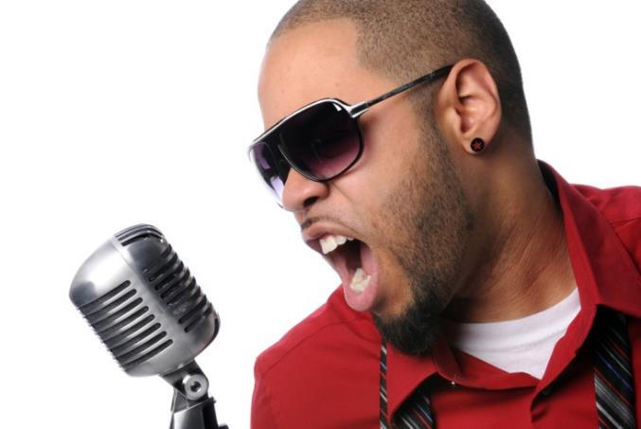
Andre
What did he do?
last month

Slide 70

My friends and I
What did we do?
two weeks ago

Slide 71

Steve
What did he do?
last monday

Slide 72
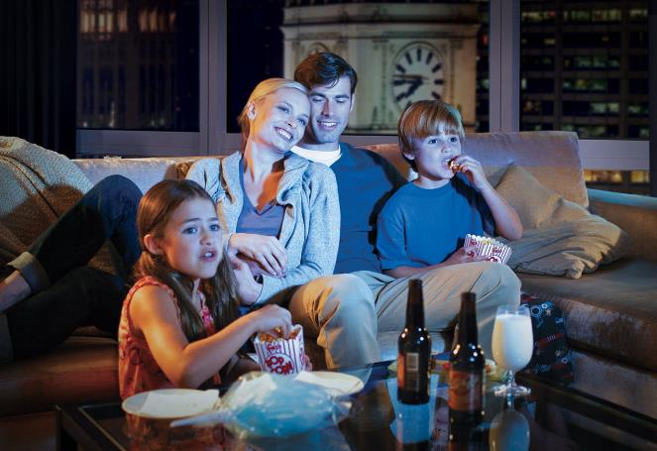
My family
What did they do?
last night

Slide 73
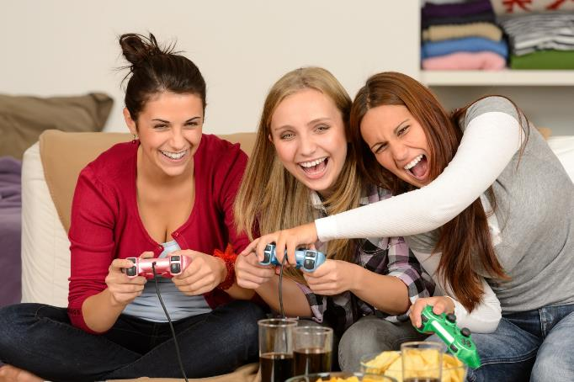
Karla, Maria and Sara
What did they do?
one week ago

Slide 74

Melissa
What did she do?
this morning

Slide 75
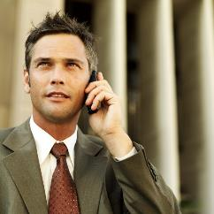

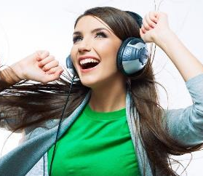







Slide 76
Now, answer the following questions.
Use Simple Past.

Slide 77
Questions | My answer
What did you do yesterday?
Where did you go last weekend?
What did you read two months ago?
How did you feel last week?
Who was your best friend last semester?
What did you eat this morning?

Slide 78
Now, ask a classmate and complete the chart.

Slide 79
Questions | My answer | Classmate 1
What did you do yesterday? | I bought a new camera. I watched a movie at home.
Where did you go last weekend? | I went to the cinema.
What did you read two months ago? | I read a cartoon magazine.
How did you feel last week? | I was very tired and angry.
Who was your best friend last semester? | Sofia was my best friend.
What did you eat this morning? | I ate some tacos.

Slide 80
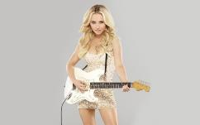
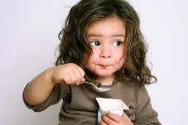


Match the pictures and the description
We ride in the park.
Hayden plays the guitar.
Melissa reads a book.
My daughter eats yogurt.

Slide 81
Match the pictures and the description
We rode in the park.
Hayden played the guitar.
Melissa read a book.
My daughter ate yogurt.

Slide 82


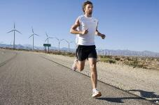
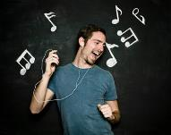
Match the pictures and the description
They dance in the party.
Jessica works on the PC.
Steve listens to pop music.
My brother runs a lot.

Slide 83
Match the pictures and the description
They danced in the party.
Jessica worked on the PC.
Steve listened to pop music.
My brother ran a lot.

Slide 84
AFFIRMATIVE SENTENCE
I went to Rome yesterday.
Subject
Verb in past
Complement
Time expression
She cleaned the house last week.
We played soccer two hours ago.

Slide 85
Fill in the blanks with the SIMPLE PAST of the verbs in brackets.
Last Saturday my father …. took…. (take) my friends and me to the circus. We ………(see)lots of things. My father …………………. (buy) us some popcorn and orange juice. We……………………. (eat) the popcorn and ………………………… (drink) the orange juice.
We …………………….. (laugh) at the funny clowns. There …………………. (be) a lion-tamer. The lions …………………… (do) tricks; they ………………………… (jump) through hoops. A girl ………………………. (ride) an elephant around the ring. We all ………………… (have)a wonderful time.

Slide 86
Negative Sentences

Slide 87
NEGATIVE SENTENCES
We add “DID NOT” or “DIDN’T” before the main verb to form negative sentence.
I did not see Sandy this morning.
John did not go to church last Sunday.
David did not watch TV last night.
I didn’t see Sandy this morning.
John didn’t go to church last Sunday.
David didn’t watch TV last night.

Slide 88
NEGATIVE SENTENCE
I went to Rome yesterday.
I didn’t go to Rome yesterday.
She cleaned the house last week.
She didn’t clean the house last week.
We played soccer two hours ago.
We didn’t play soccer two hours ago.

Slide 89

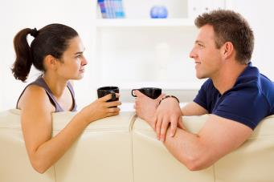
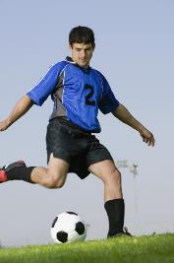
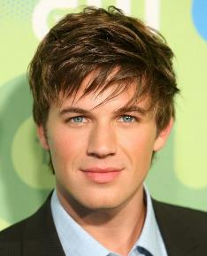
✓
✗
Marcus
✗
✓
What didn’t he do?
What did he do?

Slide 90


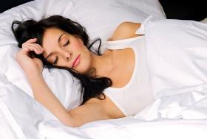


✓
✗
✗
✓
Fernanda
What didn’t she do?
What did she do?

Slide 91


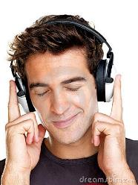
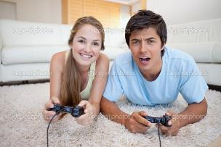
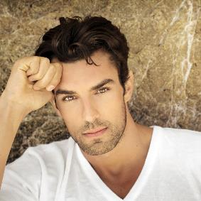
✓
✗
Steve
✓
✗
What didn’t he do?
What did he do?

Slide 92

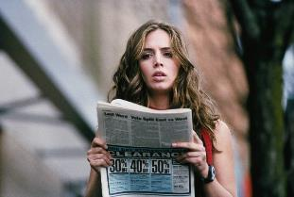



✓
✗
Gabriela
✗
✓
What didn’t she do?
What did she do?

Slide 93

What did you do?
What didn’t you do?
1.______________________________.
2.______________________________.
3.______________________________.
4._______________________________.
5._______________________________.
6.______________________________.
YOU

Slide 94
Now, ask three friends about the activities they did and didn’t do.
 | Classmate 1 | Classmate 2 | Classmate 3
What did you do yesterday?
What didn’t you do yesterday?

Slide 95
NEGATIVE SENTENCES
I didn’t go to Rome yesterday.
Subject
Verb in present
Comple-
ment
Time expre-ssion
Didn’t
She didn’t clean the house last week.
We didn’t play soccer two hours ago.

Slide 96
Translate the following sentences into English
1. Ayer no vi la televisión con mis amigos.
2. Ellos estudiaron mucho anoche.
3. Juan fue al cine con su novia.
4. Ellas comieron en el restaurante la semana pasada.
5. Ayer nosotros no fuimos al teatro.
6. Llovió hace dos meses.
7. Yo vendí mi casa y mi auto el fin de semana pasado.
8. Ella no visitó a sus papás esta mañana.
9. Tú caminaste en el parque anoche.
10. Mónica no compró una tableta. Ella compró un celular.

Slide 97
Translate the following sentences into English
1. I didn’t watch TV with my friends yesterday.
2. They studied much last night.
3. Juan went to the cinema with his girlfriend.
4. They ate in the restaurant last week.
5. Yesterday we didn’t go to the theatre.
6. It rained two months ago.
7. I sold my house and my car last weekend.
8. She didn’t visit her parents this morning.
9. You walked in the park last night.
10. Monica didn’t buy a Tablet. She bought a cell phone.

Slide 98


Adjectives to describe feelings
Regresar

Slide 99

Adjectives
We use ADJECTIVES to describe the way we feel. It depends on our mood.
Today I feel…

Slide 100

FEELINGS
ANGRY
BORED
HAPPY
HUNGRY
NERVOUS
SCARED
TIRED
WORRIED
SURPRISED

Slide 101
FEELINGS
ANGRY
BORED
HAPPY
HUNGRY
NERVOUS
SCARED
TIRED
WORRIED
SURPRISED

Slide 102





Complete the sentences using adjectives
Today I’m happy, but yesterday I was ____________.
Last night I was ____________. I didn’t know what to do.
My brother was ___________ because he lost his cell phone.
I was very ___________ this morning because they gave me a present.
Me made me ____________ when she told me “I love you”.
1
2
3
4
5

Slide 103
Write 5 sentences using adjectives
Describe the way you felt…
Last night ________________________.
Three days ago ____________________.
Last weekend _____________________.
Last holiday ______________________.
When you were a child ______________.

Slide 104


REFERENCIAS
Regresar

Slide 105

Referencias
Mesografía
Simple Past: Was & Were
https://goo.gl/jS2nHi
Simple Past
https://www.englishexercises.org/makeagame/viewgame.asp?id=5183
Imágenes
Las imágenes se obtuvieron del sitio Freepik: http:www.freepik.com

