Slide 1
Material Didáctico Audiovisual
Sólo Visión Proyectables Diapositivas
Inglés 3 - Módulo II
Bachillerato Universitario 2015
Mis Experiencias
Elaborado por: M. en I. y G. E. Cesar Martínez Acevedo
Plantel “Dr. Ángel Ma. Garibay Kintana” de la Escuela Preparatoria

Slide 2
Propósito General
Inglés 3
Interactúa en el idioma inglés de forma oral y escrita, en situaciones sociales o académicas relacionadas con áreas de experiencia que
le son especialmente familiares, para proporcionar información sobre sí mismo u obtener información de las personas que le rodean,
pasatiempos, describir intereses, actividades rutinarias, actividades en progreso, aspectos de su pasado personal y del lugar en donde
vive, eventos recientes, experiencias de vida; así como extraer información de distintas fuentes: visuales, auditivas y audiovisuales.
Continuar

Slide 3
Módulo I
Nombre del Módulo
Mis experiencias
Propósitos del Módulo
Asocia elementos lingüístico – comunicativos para que de manera oral o escrita exprese sus planes en el futuro y haga predicciones basadas en una situación familiar que le sea familiar.
Continuar

Slide 4
Competencia Disciplinar
Comunicación
Básica
10. Identifica e interpreta la idea general y posible desarrollo de un mensaje oral o escrito en una segunda lengua, recurriendo a conocimientos previos, elementos no verbales y contexto cultural.
11. Se comunica en una lengua extranjera mediante un discurso lógico, oral o escrito, congruente con la situación comunicativa.
Extendida
9. Trasmite mensajes en una segunda lengua o lengua extranjera atendiéndolas características de contextos socioculturales diferentes.
Continuar

Slide 5
Competencia Genérica
4. Escucha, interpreta y emite mensajes pertinentes en distintos contextos mediante la utilización de medios, códigos y herramientas apropiados.
4.4 Se comunica en una segunda lengua en situaciones cotidianas.
7. Aprende por iniciativa e interés propio a lo largo de la vida.
7.1 Define metas y da seguimiento a sus procesos de construcción de conocimiento.
10. Mantiene una actitud respetuosa hacia la interculturalidad y la diversidad de creencias, valores, ideas y prácticas sociales.
10.2 Dialoga y aprende de personas con distintos puntos de vista y tradiciones culturales mediante la ubicación de sus propias circunstancias en un contexto más amplio.
Continuar

Slide 6

TEMAS
Descripción de
Experiencias

Slide 7
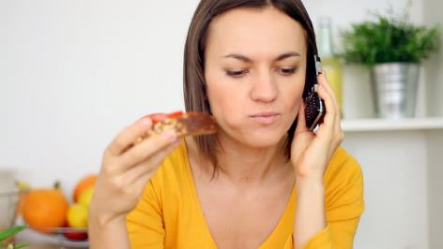

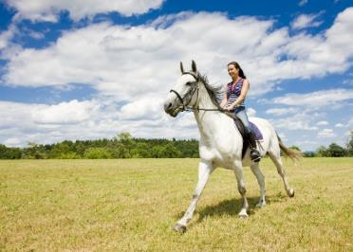


Present Perfect
Recent Activities

Slide 8
Explanation
1996
2000
2003
2011
2015
Past
Present
In 1996 I went to USA.
In 2000 I went to USA.
I have been to USA 5 times.
In 2003 I went to USA.
In 2011 I went to USA.
In 2015 I went to USA.

Slide 9

Uses
Explanation
We use the Present Perfect Tense to…
…talk about several different actions which have occurred in the past at different times. Present Perfect suggests the process is not complete and more actions are possible.
…talk about an action which started in the past and continuous up to now (and may continue into the future).
…talk about experiences.

Slide 10

Examples
Explanation
I have been to France many times.
I have had four quizzes and five tests so far this semester.
I have seen that movie twenty times.
There have been many earthquakes in California.
People have traveled to the Moon.

Slide 11
Structure
Explanation
Verb
Have
Verb in Past Participle
Have gone
Have been
Have eaten
Have danced
Have worked

Slide 12
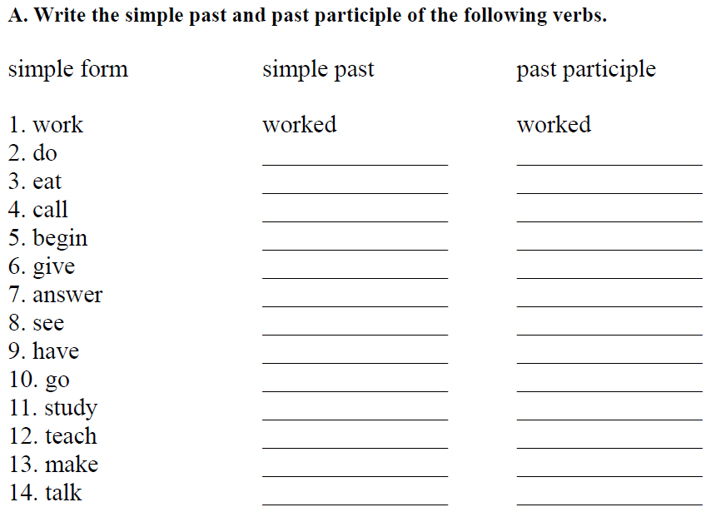
Practice

Slide 13


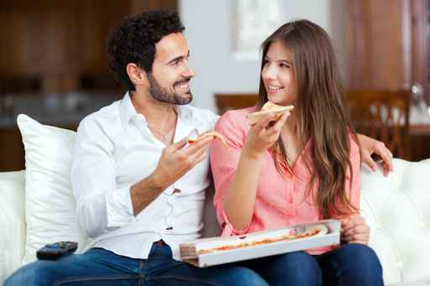
Experiences & Recent Activities

Slide 14
Recent Activities
Writing
Think about different activities that you have done recently and write some of them.
Example: I have listened to pop music.
I have…__________________________.
_________________________________.
_________________________________.
_________________________________.
_________________________________.

Slide 15
Have you ever…?
Writing
Activity | Me
… tried Chinese food?
… kissed an stranger?
… cheated on exams?
… stolen anything from a shop?
… fallen in front of people?
… found a lot of money?
…
…
…
…

Slide 16
Have you ever…?
Speaking & Writing
Activity | Me | Friend 1 | Friend 2
… tried Chinese food?
… kissed an stranger?
… cheated on exams?
… stolen anything from a shop?
… fallen in front of people?
… found a lot of money?

Slide 17
Complete the following sentences using Present Perfect.
I ____________ War and Peace many times. (read)
He ____________ the film “The Conjuring 2” ten times. (see)
She ____________ too many chocolates this week. (eat)
Man ____________ to the moon once. (be)
I hope all of you ____________ a lot on the Network. (learn)
We ____________ to do the test in the lesson. (forget)
No one ____________ on the moon. (live)
I ____________ my medicine, but it ____________ a nasty taste in my mouth. (take/leave)
I ____________ that they ____________ a new singer. (hear/find)
My mother _______________ spaghetti all this week. (cook)

Slide 18
Complete the following sentences with the present perfect of the verb in parentheses.
Belton is a small town. Brad Peltry (live) ____has lived___ in Belton all his life. Brad is 58 years old. Brad is married. He (be) ______________ married to Dora for 25 years. They (know) _______________ each other since high school. Brad and Dora have a son. He is a student at a university in Atlanta. He (study) ____________ medicine for three years now. Brad owns the grocery store in town. He (own) ______________ the store for 22 years. He (work) ________________ in the store for 22 years. Something strange has happened this week. Nobody (see) __________________ Brad for four days. His truck (disappear) ________________. Dora doesn’t know where he is. Dora (be) _________________ worried. Brad (have) ________________ money problems lately.

Slide 19
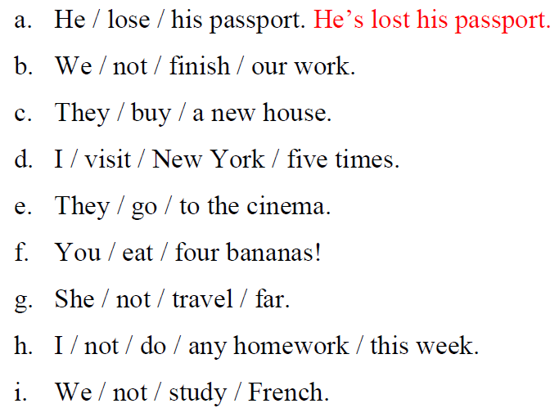
Write Sentences Using Present Perfect.
Writing

Slide 20


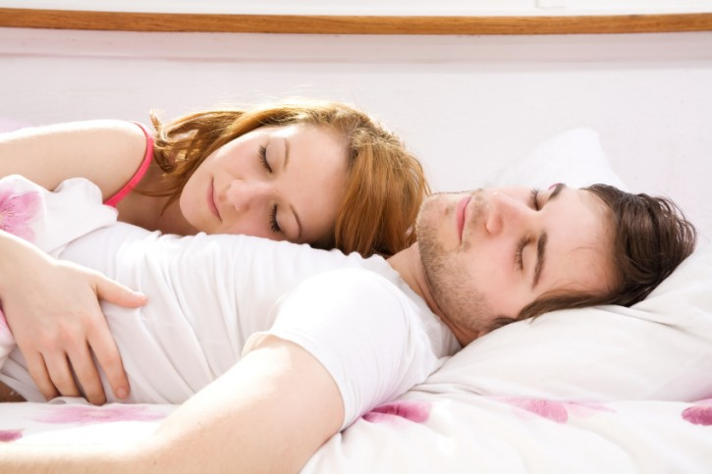
Already & YET
Things I’ve done & haven’t done

Slide 21
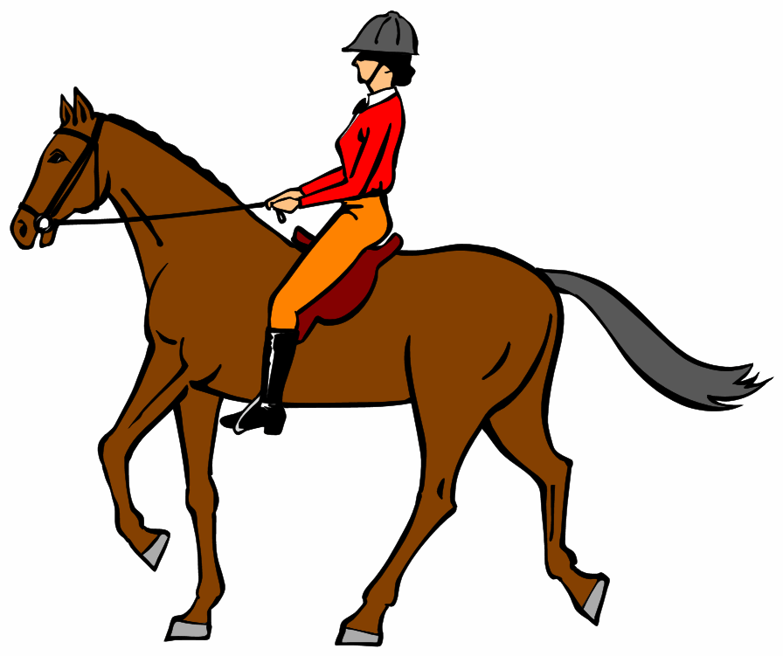
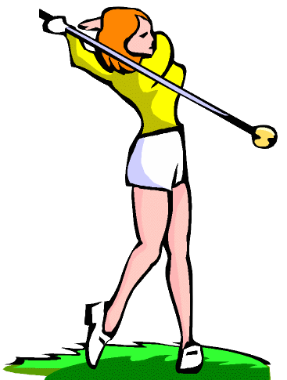
Already & Yet
Explanation
Already
We use “ALREADY” in positive sentences.
Example: I have already ridden a horse.
Yet
We use “YET” in negative sentences.
My sister hasn’t played golf yet.

Slide 22



ALREADY AND YET
Explanation
I have bought a new car.
I have already bought a new car.
I haven’t bought a new car yet.
Maria has met her true love.
Maria has already met her true love.
Maria hasn’t met her true love yet.
They have won the final.
They have already won the final.
They haven’t won the final yet.

Slide 23


Writing
Write 5 things that you have ALREADY done.
1. I have already ________________________________.
2. ____________________________________________.
3. ____________________________________________.
4. ____________________________________________.
5. ____________________________________________.
Write 5 things that you haven’t done YET.
1. I haven’t __________________________________ yet.
2. ____________________________________________.
3. ____________________________________________.
4. ____________________________________________.
5. ____________________________________________.

Slide 24
Writing
Tell me one thing that you have already done.
1. Mario has already_____________________________.
2. Jessica has already ____________________________.
3. Stella has already _____________________________.
4. Anna has already _____________________________.
5. Joseph has already ____________________________.
Tell me one thing that you haven’t done yet.
1. Melissa hasn’t______________________________yet.
2. Tanya hasn’t _______________________________yet.
3. Pedro hasn’t _______________________________yet.
4. Lucy hasn’t ________________________________yet.
5. Dave hasn’t _______________________________yet.

Slide 25
Rewrite the sentences adding: Already & Yet
Writing
1. I have eaten sushi before. (already) __________________________
2. She hasn’t visited Germany. (yet) __________________________
3. They have seen this movie. (already) __________________________
4. We have met your teacher. (already) __________________________
5. My brother hasn’t started school. (yet) __________________________
6. Daniel hasn’t fixed the broken pipe. (yet) _______________________
7. We haven’t participated in any internship programs. (yet) ____________
8. My daughter has lost her purse. (already) __________________________
9. He has finished his assignment. (already) __________________________
10. Your son has broken his arm. (already) __________________________

Slide 26
JUST & STILL
Things I’ve done recently

Slide 27
RECENT EVENTS: JUST
Explanation
We use “JUST” to talk about recent events. “JUST” goes before the main verb.
Examples:
I have eaten Chinese food.
Anna has finished homework.
We have gone to the movies.
I have just eaten Chinese food.
Anna has just finished homework.
We have just gone to the movies.

Slide 28
I’ve just…
Practice
Part 1. Think about some recent activities that you have done and write 3 of them. The activities have to be important or meaningful for you.
1. I have just broken up with my girlfriend.
2. I have just bought a nice car.
3. I have just lost all my money.
Part 2. Speaking: Ask 5 different classmates about their information. Try to memorize the information
Have you…?
No, but I’ve just…
Part 3. Writing: Write your classmates’ information.
1. Maria has just found a lot of money.

Slide 29
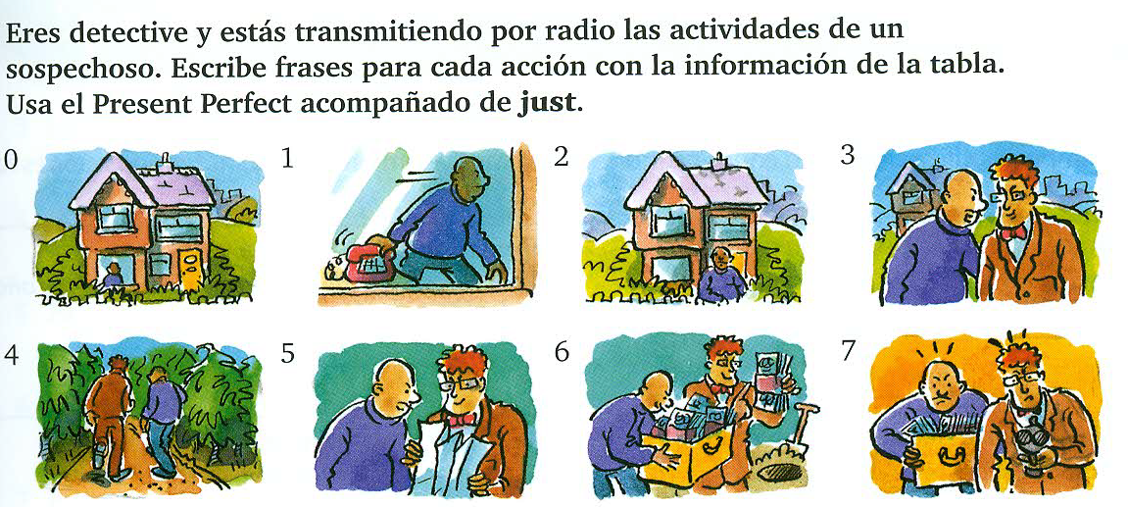
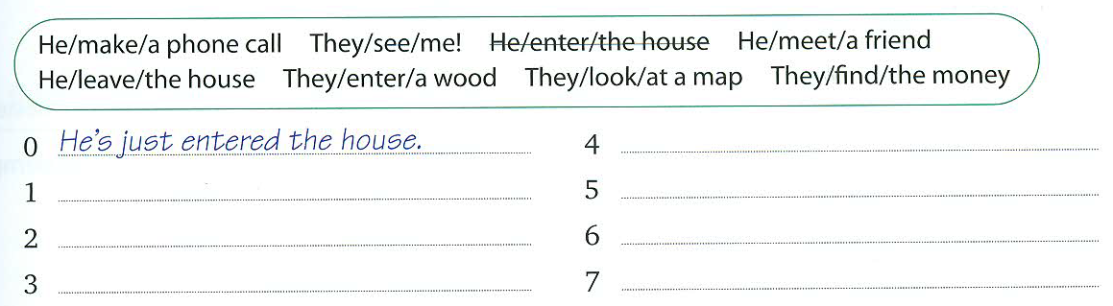
Writing

Slide 30
Just & Still
Explanation
I have bought a car recently.
I have just bought a car recently.
I haven’t still bought a car recently.
Maria has met her true love.
Maria has just met her true love.
Maria hasn’t still met her true love.
They have won the final.
They have just won the final.
They haven’t still won the final.

Slide 31
Make true sentences using
ALREADY, YET, JUST, STILL & NEVER.
Writing
Play volleyball
Eat seafood
Dance salsa
Buy a house
Travel to Europe
Meet a famous actor
Work in an office
Kiss someone
Listen to metal music
I have never played volleyball.
I have already played volleyball.
I have just played volleyball.
I haven’t still played volleyball.
I haven’t played volleyball yet.

Slide 32
Writing
Make true sentences using
ALREADY, YET, JUST, STILL & NEVER.
_____________________________.
_____________________________.
_____________________________.
_____________________________.
_____________________________.
_____________________________.
_____________________________.
_____________________________.

Slide 33
Now ask some friends about the activites you described
Speaking
Use the following question
Have you ever ….?
Have you ever played volleyball?

Slide 34
Speaking
Have you ever ….?
Have you ever played volleyball?
I have never played volleyball.
Play volleyball
I have already played volleyball.
I have just played volleyball.
I haven’t still played volleyball.
I haven’t played volleyball yet.

Slide 35
Choose the correct word.
Practice
Have you ever / never been camping with friends?
No, I haven’t been camping with my friends already / yet.
Yes, I’ve already / yet been camping with my friends.
Have you finished the book ever / yet?
Yes, I’ve just / yet finished it.
Have you ever / yet been to London?
No, I’ve ever / never been to London.

Slide 36
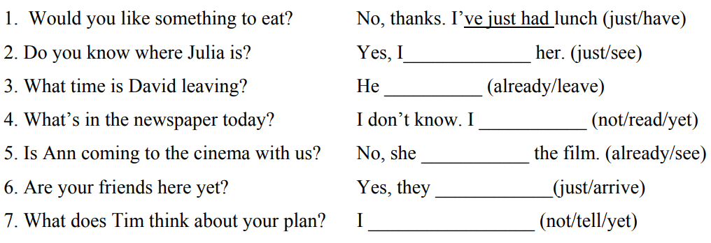
Complete these sentences with just, yet, already.
Practice

Slide 37
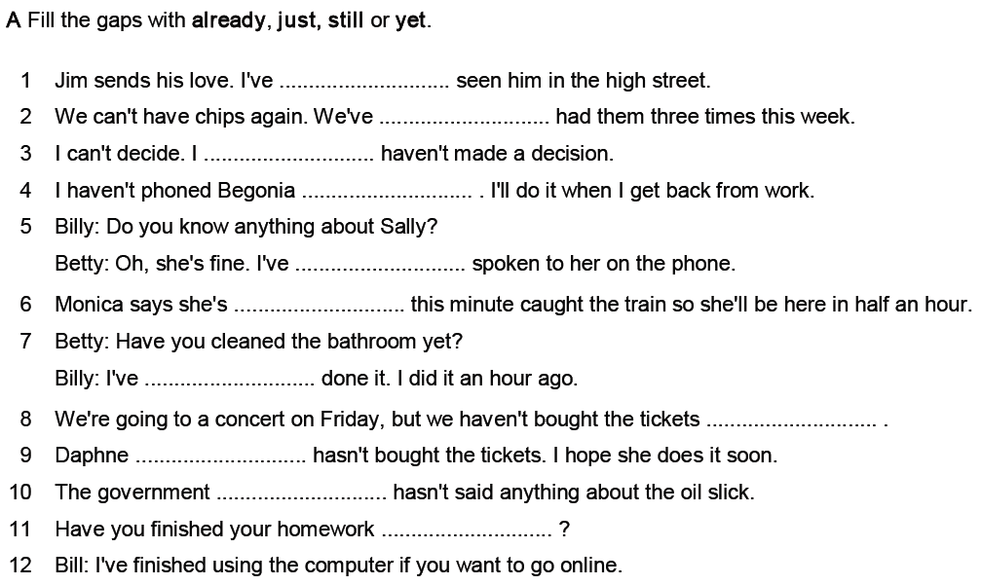
Practice

Slide 38


REFERENCIAS

Slide 39
Referencias
Mesografía
Presente Perfecto
http://www.wmp.ac.th/English2017/m4/New%20World%204%20Multimedia%20Pack/08_NW4_Supplementary%20Reading%20and%20Grammar/Exercise/09_NW4_SUP_Unit09.pdf
https://yoquieroaprobar.es/3_eso/8/4/eperfect4e1.pdf
http://www.grammarbank.com/support-files/present-perfect-tense-already-just-yet.pdf
http://www.macmillaninspiration.com/inspired/files/2012/07/Grammar-EXTRA_Inspired_3_Unit_5_Present_perfect_with_already_yet_ever_and_never.pdf
http://www.autoenglish.org/tenses/gr.presper.pdf
http://zoranasenglishclasses.weebly.com/uploads/1/6/6/4/16648790/present_perfect.pdf
http://www.macmillaninspiration.com/new/files/2010/12/Grammar-EXTRA_NI_3_Unit_5_Present-perfect-with-just-already-yet-ever-and-never.pdf
Imágenes
Las imágenes se obtuvieron del sitio Freepik: http:www.freepik.com

