Slide 1
Material Didáctico Audiovisual
Sólo Visión Proyectables Diapositivas
Inglés 4 - Módulo I
Bachillerato Universitario 2015
Compartir experiencias y decir cuando sucedieron
Elaborado por: M. en I. y G. E. Cesar Martínez Acevedo
Plantel “Dr. Ángel Ma. Garibay Kintana” de la Escuela Preparatoria

Slide 2
Propósito General
Inglés 4
Interactúa en el idioma inglés de forma oral y escrita, en situaciones sociales o académicas relacionadas con áreas de experiencia que le son relevantes, toma decisiones, realiza ofrecimientos, promesas y predicciones generales; expresa planes e intenciones, posibilidades, prohibiciones y necesidades. De igual modo establece condiciones, y asume las consecuencias de sus acciones, dando sugerencias y recomendaciones.
Continuar

Slide 3
Módulo I
Nombre del Módulo
Sharing experiences and telling when they happened.
(Compartir experiencias y decir cuando sucedieron)
Propósitos del Módulo
Expresa de forma oral y escrita experiencias recientes y acciones que sucedieron en un momento específico de su vida.
Continuar

Slide 4
Competencia Disciplinar
Comunicación
Básica
10. Identifica e interpreta la idea general y posible desarrollo de un mensaje oral o escrito en una segunda lengua, recurriendo a conocimientos previos, elementos no verbales y contexto cultural.
11. Se comunica en una lengua extranjera mediante un discurso lógico, oral o escrito, congruente con la situación comunicativa.
Extendida
9. Trasmite mensajes en una segunda lengua o lengua extranjera atendiéndolas características de contextos socioculturales diferentes.
Continuar

Slide 5
Competencia Genérica
4. Escucha, interpreta y emite mensajes pertinentes en distintos contextos mediante la utilización de medios, códigos y herramientas apropiados.
4.4 Se comunica en una segunda lengua en situaciones cotidianas.
7. Aprende por iniciativa e interés propio a lo largo de la vida.
7.1 Define metas y da seguimiento a sus procesos de construcción de conocimiento.
10. Mantiene una actitud respetuosa hacia la interculturalidad y la diversidad de creencias, valores, ideas y prácticas sociales.
10.2 Dialoga y aprende de personas con distintos puntos de vista y tradiciones culturales mediante la ubicación de sus propias circunstancias en un contexto más amplio.
Continuar

Slide 6
TEMAS
Present Perfect vs. Simple Past
Present Perfect Review
Simple Past Review

Slide 7




Present Perfect vs
Simple Past

Slide 8

What’s the difference?
Explanation
Present Perfect - We use it to talk about:
Recent events.
An experience at any time in the past.
An activity that starts in the past and continues into the present.
Simple Past - We use it to talk about:
An action that started and finished at a specific time in the past. Completed actions.
Habits in the past.

Slide 9
Expressions: Signal Words
Explanation
Simple Past |  | Present Perfect
Yesterday …Ago Last… In _1998_ The other day In the morning The day before yesterday |  | For Since Just Already Yet Ever Never Lately / Recently

Slide 10
What’s the difference?
Speaking
Read the following sentences and say the difference:
1. Yesterday, I went to the movies.
I have gone to the movies recently.
2. 10 days ago, my sister ran in the park.
My sister has run in the park for 1 hour.
3. Last week, Jeremy studied for his exams very hard.
Jeremy has studied for his exams since last week.

Slide 11
Complete using Past Simple or Present Perfect
Grammar
Last month I __________________ (go) to Scotland.
I’m sorry, John isn’t here now. He __________________ (go) to the shops.
We __________________ (finish) this room last week.
I __________________ (finish) my exams finally – I’m so happy!
Yesterday, I __________________ (go) to the library, the post office and the supermarket.
I __________________ (go) to the supermarket three times this week!
She __________________ (live) in London since 1994.
She __________________ (live) in London when she was a child.
I __________________ (drink) three cups of coffee this morning.
I __________________ (drink) seven cups of coffee yesterday.

Slide 12
Complete using Past Simple or Present Perfect
Grammar
Last night I __________________ (lose) my keys – I had to call my flatmate to let me in.
I __________________ (lose) my keys – can you help me look for them?
I __________________ (visit) Paris three times.
Last year I __________________ (visit) Paris.
I __________________ (know) my great grandmother for a few years – she died when I was eight.
I __________________ (know) Julie for three years – we still meet once a month.

Slide 13
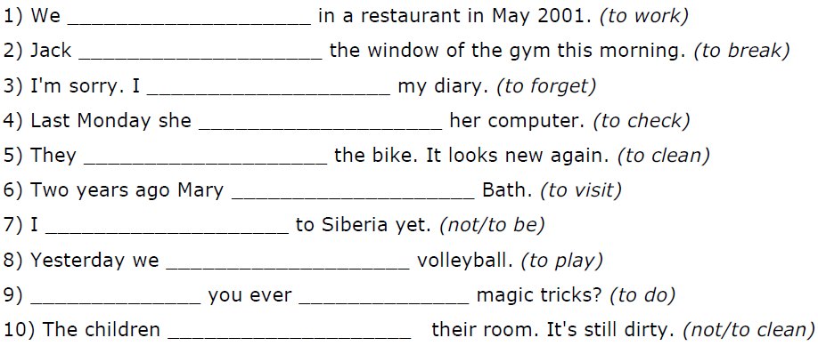
Complete using Past Simple or Present Perfect
Grammar
(
(
(
(
(
(
(not /
(
(
(not /

Slide 14
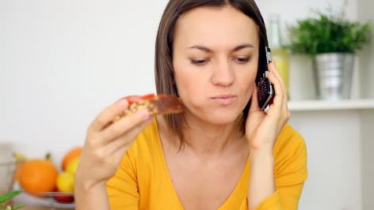

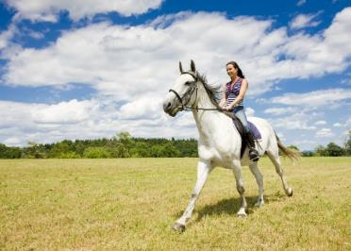

Present Perfect Review
Recent Activities

Slide 15
Competencias
Genéricas
4. Escucha, interpreta y emite mensajes pertinentes en distintos contextos mediante la utilización de medios, códigos y herramientas apropiados.
4.4 Se comunica en una segunda lengua en situaciones cotidianas.
Disciplinares
4 Produce textos con base en el uso normativo de la lengua, considerando la intención y situación comunicativa.
11 Se comunica en una lengua extranjera mediante un discurso lógico, oral o escrito, congruente con la situación comunicativa.

Slide 16
1996
2000
2003
2011
2015
Past
Present
In 1996 I went to USA.
In 2000 I went to USA.
I have been to USA 5 times.
In 2003 I went to USA.
In 2011 I went to USA.
In 2015 I went to USA.

Slide 17

Uses
We use the Present Perfect Tense to…
…talk about several different actions which have occurred in the past at different times. Present Perfect suggests the process is not complete and more actions are possible.
…talk about an action which started in the past and continuous up to now (and may continue into the future).
…talk about experiences.

Slide 18

Examples
I have been to France many times.
I have had four quizzes and five tests so far this semester.
I have seen that movie twenty times.
There have been many earthquakes in California.
People have traveled to the Moon.

Slide 19
Structure
Verb
Have
Verb in Past Participle
Have gone
Have been
Have eaten
Have danced
Have worked

Slide 20
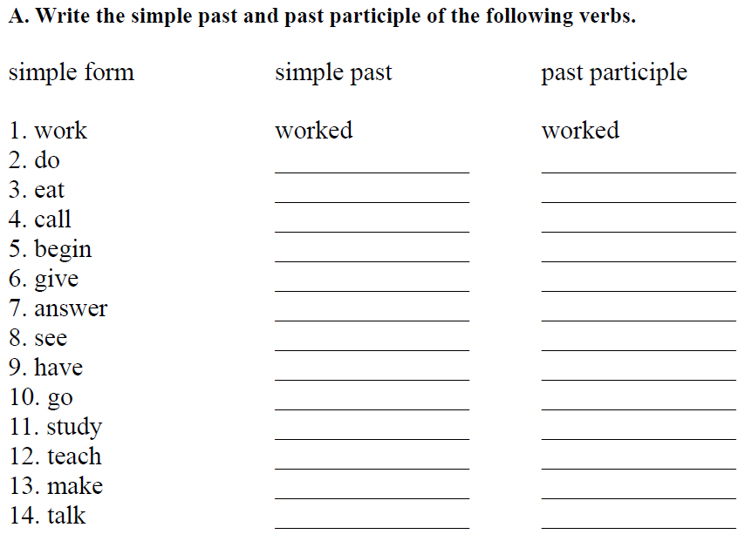

Slide 21


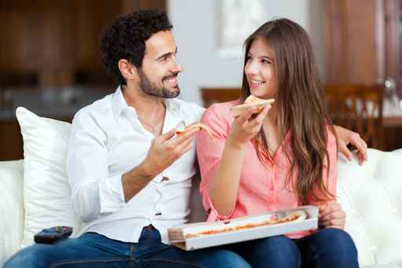
Experiences & Recent Activities

Slide 22
Recent Activities
Think about different activities that you have done recently and write some of them.
Example: I have listened to pop music.
I have…__________________________.
_________________________________.
_________________________________.
_________________________________.
_________________________________.

Slide 23
Have you ever…?
Activity | Me
… tried Chinese food?
… kissed an stranger?
… cheated on exams?
… stolen anything from a shop?
… fallen in front of people?
… found a lot of money?
…
…
…
…

Slide 24
Have you ever…?
Activity | Me | Friend 1 | Friend 2
… tried Chinese food?
… kissed an stranger?
… cheated on exams?
… stolen anything from a shop?
… fallen in front of people?
… found a lot of money?

Slide 25
Complete the following sentences using Present Perfect.
I ____________ War and Peace many times. (read)
He ____________ the film “The Conjuring 2” ten times. (see)
She ____________ too many chocolates this week. (eat)
Man ____________ to the moon once. (be)
I hope all of you ____________ a lot on the Network. (learn)
We ____________ to do the test in the lesson. (forget)
No one ____________ on the moon. (live)
I ____________ my medicine, but it ____________ a nasty taste in my mouth. (take/leave)
I ____________ that they ____________ a new singer. (hear/find)
My mother _______________ spaghetti all this week. (cook)

Slide 26
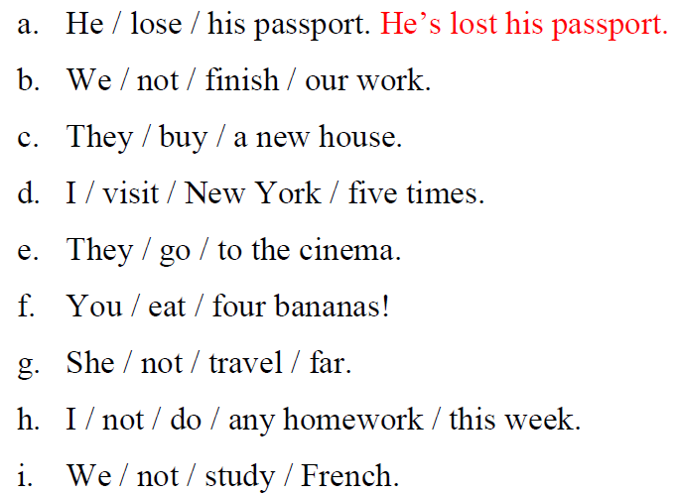
Write Sentences Using Present Perfect.

Slide 27


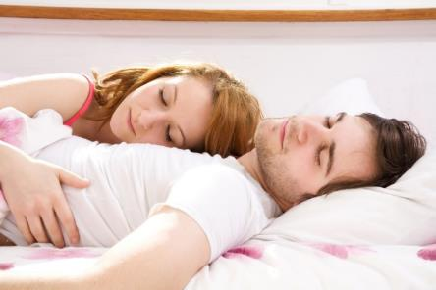

FOR & SINCE
Specific time or Period of time

Slide 28
Competencias
Genéricas
4. Escucha, interpreta y emite mensajes pertinentes en distintos contextos mediante la utilización de medios, códigos y herramientas apropiados.
4.4 Se comunica en una segunda lengua en situaciones cotidianas.
Disciplinares
4 Produce textos con base en el uso normativo de la lengua, considerando la intención y situación comunicativa.
11 Se comunica en una lengua extranjera mediante un discurso lógico, oral o escrito, congruente con la situación comunicativa.

Slide 29
Since
Explanation
Use the present perfect with since + point in time to show when something started.
Examples
I have studied French since February.
My sister has lived in Guadalajara since 2006.
Daniel has worked since nine this morning.
We have trained soccer since last summer.
They have worked here since yesterday.

Slide 30
Since
Explanation
Since can also introduce a time clause.
Examples
My mother has cooked since she was 8 years old.
I have studied maths since I was a kid.
We have trained since we were in the university.

Slide 31
Writing
Practice 1
Change the sentences to present perfect. Add the SINCE phrase in parentheses and delete any past tense time phrases.
SINCE
Example: Maria was in the garden yesterday. (9 a.m.)
Maria has been in the garden since 9 a.m.
1. My girlfriend wrote many emails yesterday. (1975)
2. The principal gave many books to schools last year. (1990)
3. I saw many friends last weekend. (I came home)
4. My father read many articles last night. (last August)
5. My friend worked at a pizza place a year ago. (2003)

Slide 32
For
Explanation
Use for + length of time to show how long something has lasted.
Examples
I have studied French for three months.
My sister has lived in Guadalajara for 20 years.
Daniel has worked for many hours.
We have trained soccer for 4 weeks.
They have worked here for 30 minutes.

Slide 33
Writing
Practice 1
Change the sentences using FOR to make new sentences.
FOR
Example: Maria has been in the garden since 9 a.m.
Maria has been in the garden for 3 hours.
1. My girlfriend has written many emails since 2010.
2. The principal has given many books to schools since 1990.
3. I have seen many friends since Monday.
4. My father has read many articles since May.
5. My friend has worked at a pizza place since 2003.

Slide 34
Remember
Explanation
Note the difference between since and for .
since + point in time
for + length of time
five o’clock
yesterday
last summer
1996
he was a child
ten minutes
two days
three decades
many years
a long time

Slide 35
Grammar
Complete the following sentences with SINCE or FOR.
She has worked as a secretary since 1991.
They have been married ________ a few years.
They have lived in Manchester ________ a long time.
He’s written 5 books ________ I met him.
We haven’t seen them ________ several weeks.
I haven’t been to the beach ________ last summer.
Have you used the phone ________ you arrived?
We haven’t heard any noise ________ many hours.
Has she studied hard ________ yesterday?

Slide 36
Writing
Andrew is a very hard-working student. It's midnight and he is still working at his computer. Make sentences with SINCE or FOR.
Example:
  be / at his computer / six hours
  He has been at his computer for six hours.
1 not / have / any fun / a long time
2 have / a cold / a week
3 not / see / his friends / ages
4 not / do / any sport / last year
5 be / busy with his studies / months

Slide 37
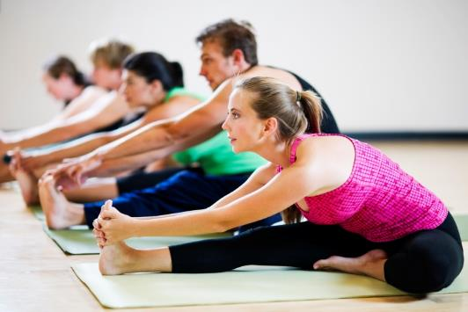
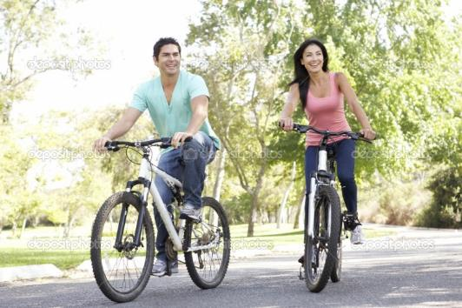
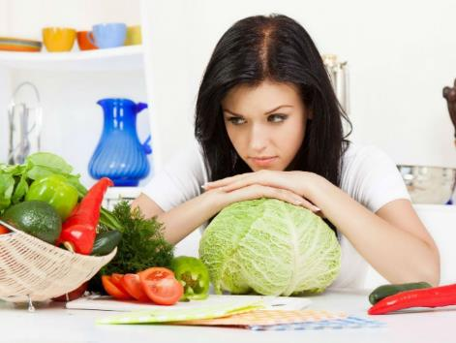
Simple Past Review

Slide 38
Competencias
Genéricas
4. Escucha, interpreta y emite mensajes pertinentes en distintos contextos mediante la utilización de medios, códigos y herramientas apropiados.
4.4 Se comunica en una segunda lengua en situaciones cotidianas.
Disciplinares
4 Produce textos con base en el uso normativo de la lengua, considerando la intención y situación comunicativa.
11 Se comunica en una lengua extranjera mediante un discurso lógico, oral o escrito, congruente con la situación comunicativa.

Slide 39

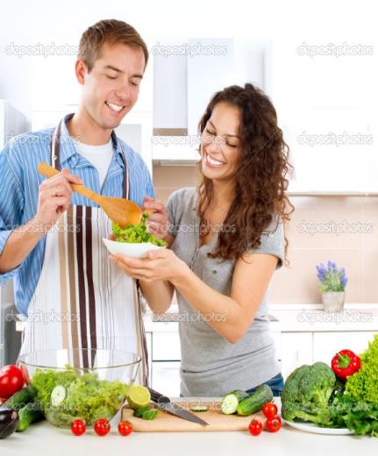

SIMPLE PAST
Explanation
We use this tense to talk about things that happened in the past, taking place once, never, or several times.

Slide 40

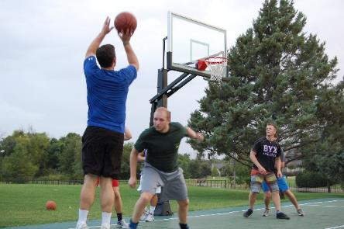
SIMPLE PAST
Explanation
Use the simple past to describe actions, events, or states at a specific past time.
Last month I went shopping with my girlfriend.
Last weekend I played basketball with my friends.
Now
Past
Future

Slide 41
Explanation
TIME EXPRESSIONS
2 days ago
2 weeks ago
5 years ago
a long time ago
AGO
FOR
for 2 weeks
for 5 months
LAST
last night, week, month, year
YESTERDAY
I went to the school yesterday.

Slide 42
VERB TO BE

Slide 43
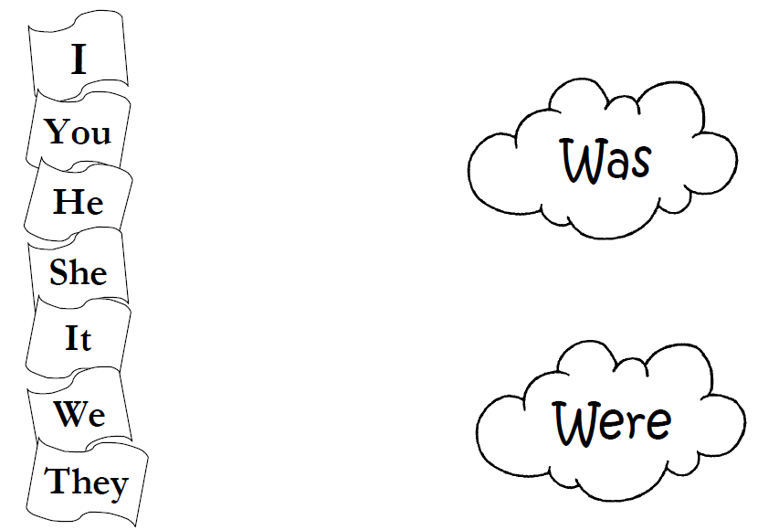
Explanation

Slide 44
Regular & Irregular Verbs

Slide 45
Affirmative Sentences

Slide 46
How do we form the simple past tense?
English has two types of verbs in the past:
Regular
Irregular

Slide 47
SIMPLE PAST
Explanation
Regular Verbs
Irregular Verbs
Most verbs are regular and show this regularity by having -ed on the end.
The irregular verbs can end in a variety of ways.
walked regular
studied regular
taught irregular
gave irregular
became irregular
cried regular
lived regular
did irregular

Slide 48
Explanation
REGULAR VERBS
IRREGULAR VERBS
We add -ED
We have to learn the irregular verb list by heart
I worked
You worked
He worked
She worked
It worked
We worked
You worked
They worked
I went
You went
He went
She went
It went
We went
You went
They went

Slide 49
Do you know the past verbs?
Explanation
Present Past
begin ___
buy ___
drive ___
do ___
feel ___
go ___
grow ___
hear ___
  Present Past
know ___
leave ___
lose ___
mean ___
pay ___
sell ___
sit ___
think ___

Slide 50
Do you know the past verbs?
Explanation
Present Past
begin began
buy bought
drive drove
do did
feel felt
go went
grow grew
hear heard
  Present Past
know knew
leave left
lose lost
mean meant
pay paid
sell sold
sit sat
think thought

Slide 51
Explanation
Base Form Simple Past Tense
wear
ride
use
go
have
try
shop
enjoy
take
wore
rode
used
went
had
tried
shopped
enjoyed
took

Slide 52
Look at the following pictures and describe what the people did some time ago.
Use the given information.

Slide 53

Speaking
Steve
What did he do?
yesterday

Slide 54
Speaking
Steve called
his mother
yesterday.
Steve phoned his mother
yesterday.

Slide 55
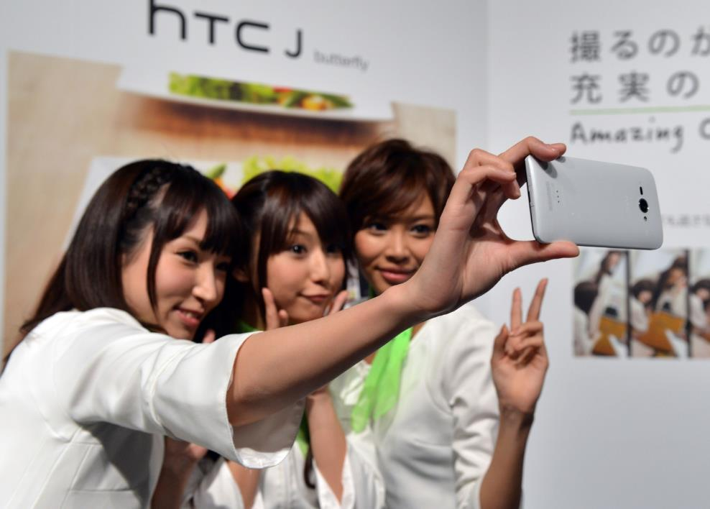
Speaking
Tania and her friends
What did they do?
last weekend

Slide 56

Speaking
Sofia
What did she do?
last night

Slide 57

Speaking
Andre
What did he do?
last month

Slide 58

Speaking
My friends and I
What did we do?
two weeks ago

Slide 59

Speaking
Steve
What did he do?
last monday

Slide 60
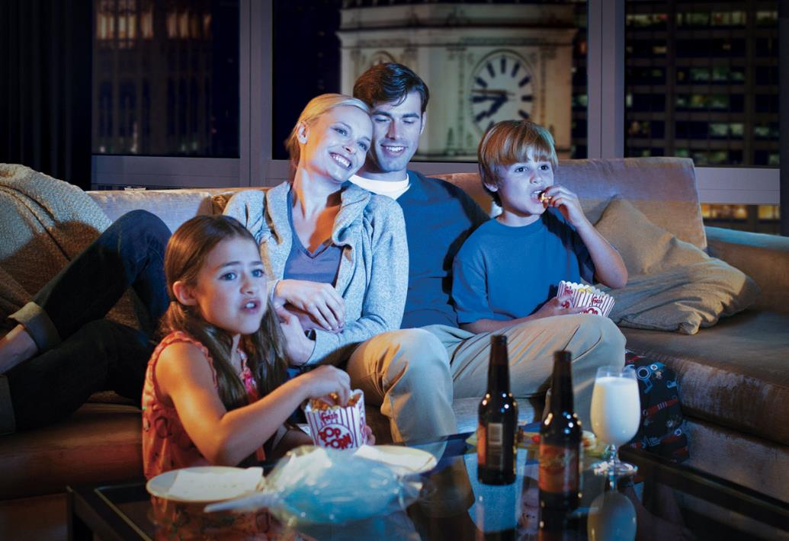
Speaking
My family
What did they do?
last night

Slide 61
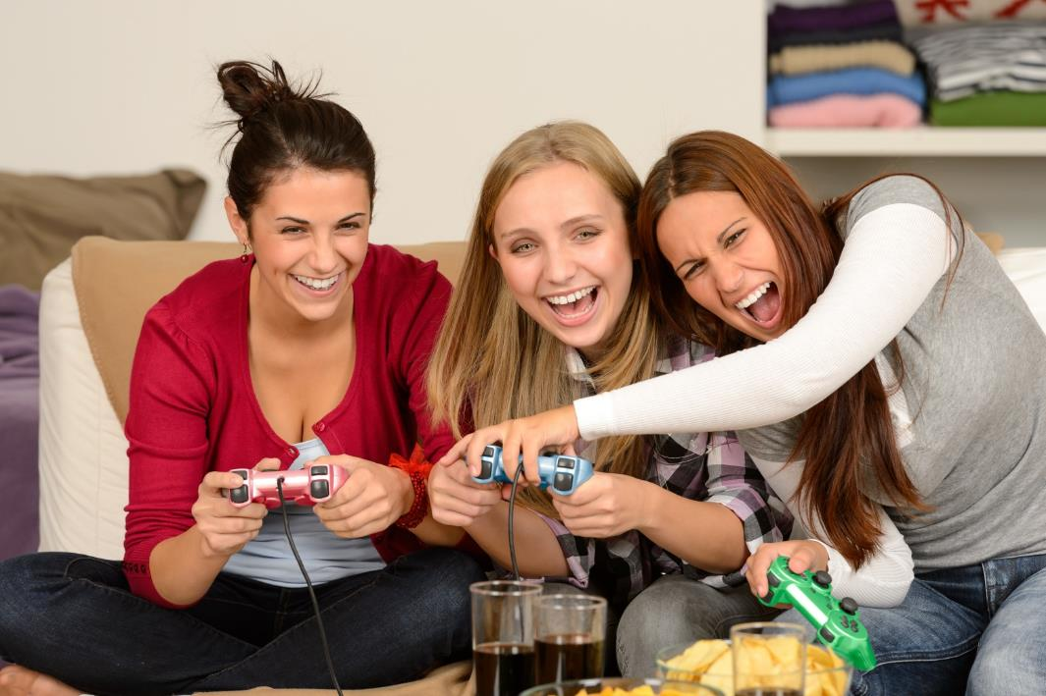
Speaking
Karla, Maria and Sara
What did they do?
one week ago

Slide 62

Speaking
Melissa
What did she do?
this morning

Slide 63
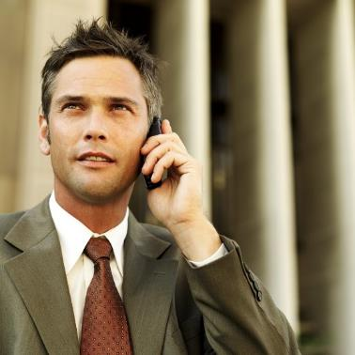
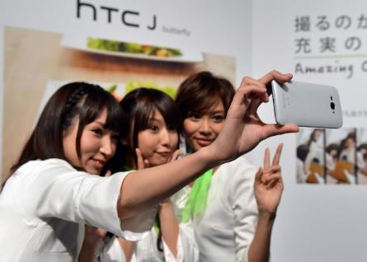







Writing

Slide 64
Now, answer the following questions.
Use Simple Past.

Slide 65
Writing & Speaking
Questions | My answer
What did you do yesterday?
Where did you go last weekend?
What did you read two months ago?
How did you feel last week?
Who was your best friend last semester?
What did you eat this morning?

Slide 66
Now, ask a classmate and complete the chart.

Slide 67
Writing & Speaking
Questions | My answer | Classmate 1
What did you do yesterday? | I bought a new camera. I watched a movie at home.
Where did you go last weekend? | I went to the cinema.
What did you read two months ago? | I read a cartoon magazine.
How did you feel last week? | I was very tired and angry.
Who was your best friend last semester? | Sofia was my best friend.
What did you eat this morning? | I ate some tacos.

Slide 68

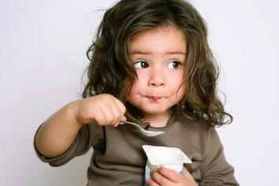


Match the pictures and the description
We ride in the park.
Hayden plays the guitar.
Melissa reads a book.
My daughter eats yogurt.

Slide 69
Match the pictures and the description
We rode in the park.
Hayden played the guitar.
Melissa read a book.
My daughter ate yogurt.

Slide 70


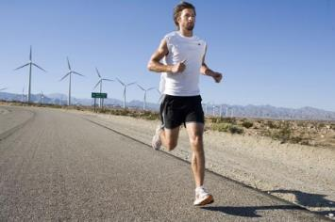
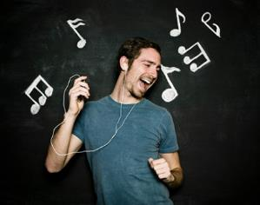
Match the pictures and the description
They dance in the party.
Jessica works on the PC.
Steve listens to pop music.
My brother runs a lot.

Slide 71
Match the pictures and the description
They danced in the party.
Jessica worked on the PC.
Steve listened to pop music.
My brother ran a lot.

Slide 72
AFFIRMATIVE SENTENCE
I went to Rome yesterday.
Subject
Verb in past
Complement
Time expression
She cleaned the house last week.
We played soccer two hours ago.

Slide 73
Negative Sentences

Slide 74
Explanation
NEGATIVE SENTENCE
We add “DID NOT” or “DIDN’T” before the main verb to form negative sentence.
I did not see Sandy this morning.
John did not go to church last Sunday.
David did not watch TV last night.
I didn’t see Sandy this morning.
John didn’t go to church last Sunday.
David didn’t watch TV last night.

Slide 75
Explanation
NEGATIVE SENTENCE
I went to Rome yesterday.
I didn’t go to Rome yesterday.
She cleaned the house last week.
She didn’t clean the house last week.
We played soccer two hours ago.
We didn’t play soccer two hours ago.

Slide 76

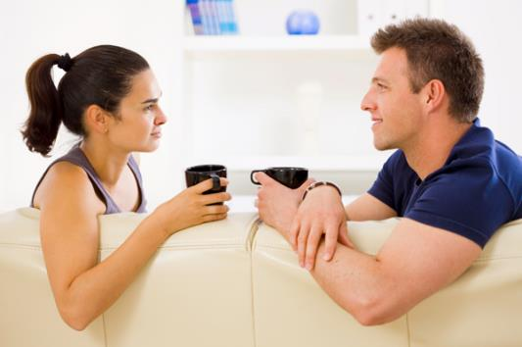

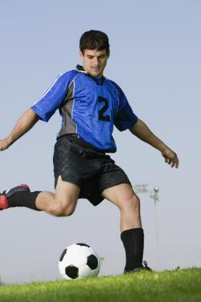
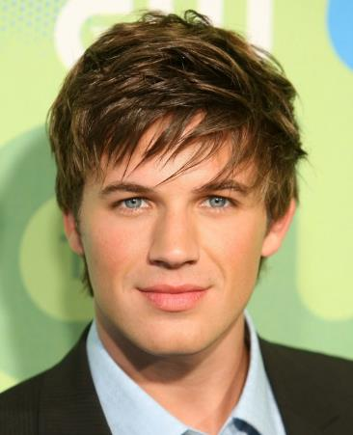
Speaking
✓
✗
Marcus
✗
✓
What didn’t he do?
What did he do?

Slide 77


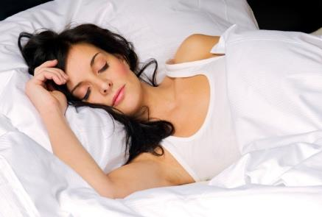


Speaking
✓
✗
✗
✓
Fernanda
What didn’t she do?
What did she do?

Slide 78


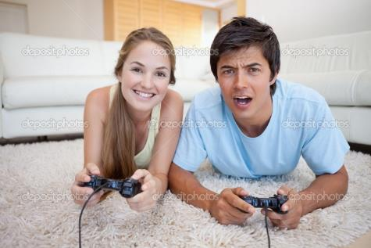

Speaking
✓
✗
Steve
✓
✗
What didn’t he do?
What did he do?

Slide 79

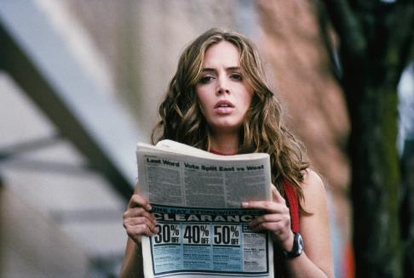
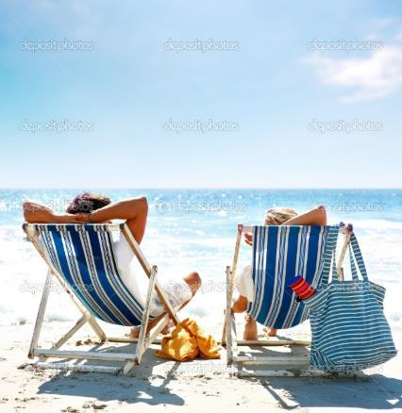


Speaking
✓
✗
Gabriela
✗
✓
What didn’t she do?
What did she do?

Slide 80

Writing
What did you do?
What didn’t you do?
1._______________________________.
2._______________________________.
3._______________________________.
4._______________________________.
5._______________________________.
6._______________________________.
YOU

Slide 81
Now, ask three friends about the activities they did and didn’t do.
Speaking & Writing
 | Classmate 1 | Classmate 2 | Classmate 3
What did you do yesterday?
What didn’t you do yesterday?

Slide 82
Explanation
NEGATIVE SENTENCES
I didn’t go to Rome yesterday.
Subject
Verb in present
Comple-
ment
Time expre-ssion
Didn’t
She didn’t clean the house last week.
We didn’t play soccer two hours ago.

Slide 83
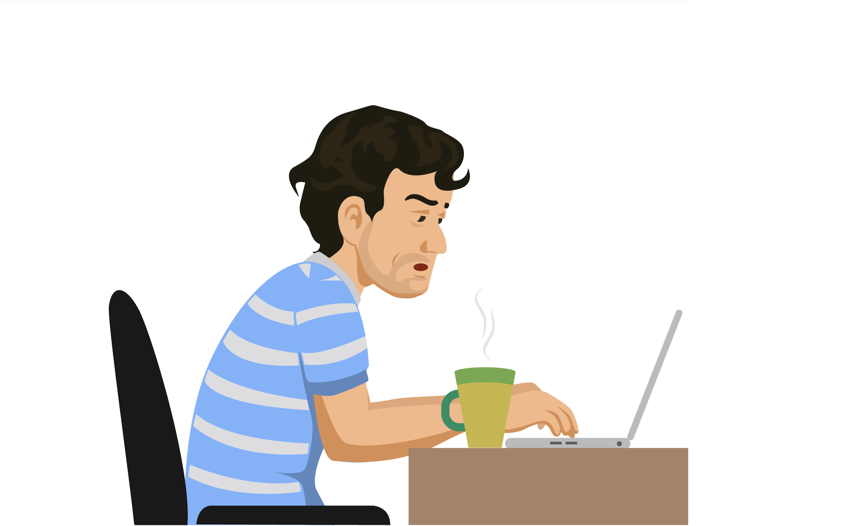

REFERENCIAS

Slide 84
Referencias
Mesografía
Presente Perfecto vs Pasado Simple
http://matellanes.org/wordpress/wp-content/uploads/downloads/2014/10/Dossier.GR-on-Present-Perfect.pdf
http://www.perfect-english-grammar.com/past-simple-present-perfect-1.html
https://www.englisch-hilfen.de/en/download/test_simple_past_present_perfect_en_answers.pdf
Repaso Presente Perfecto
https://www.englishpage.com/verbpage/presentperfect.html
https://es.scribd.com/document/57340638/Beginner-Book
http://www.englishservice.cz/download/Present%20Perfect%20Presentation%20and%20Practice.pdf
For & since
https://yoquieroaprobar.es/3_eso/8/4/eperfect4e1.pdf

Slide 85
Referencias
Mesografía
Repaso Pasado Simple
https://www.ego4u.com/en/cram-up/grammar/tenses
http://www.macmillanenglish.com/uploadedFiles/wwwmacmillanenglishcom/Content/Samples/Language_Practice_Series/First_Certificate%20Lang%20Prac%20Grammar%201-3%20-%20Intro.pdf
Imágenes
Las imágenes se obtuvieron del sitio Freepik: http:www.freepik.com

