Slide 1
Material Didáctico Audiovisual
Sólo Visión Proyectables Diapositivas
Inglés 4 - Módulo II
Bachillerato Universitario 2015
My future: Possibilities and Consequences
Elaborado por: M. en I. y G. E. Cesar Martínez Acevedo
Plantel “Dr. Ángel Ma. Garibay Kintana” de la Escuela Preparatoria

Slide 2
Propósito General
Inglés 4
Interactúa en el idioma inglés de forma oral y escrita, en situaciones sociales o académicas relacionadas con áreas de experiencia que le son relevantes, toma decisiones, realiza ofrecimientos, promesas y predicciones generales; expresa planes e intenciones, posibilidades, prohibiciones y necesidades. De igual modo establece condiciones, y asume las consecuencias de sus acciones, dando sugerencias y recomendaciones.
Continuar

Slide 3
Módulo I
Nombre del Módulo
My future: Possibilities and Consequences.
(Mi futuro: Posibilidades y consecuencias)
Propósitos del Módulo
Expresa de forma oral y escrita predicciones, planes, promesas, ofrecimientos y describe la consecuencia de posibles acciones.
Continuar

Slide 4
Competencia Disciplinar
Comunicación
Básica
10. Identifica e interpreta la idea general y posible desarrollo de un mensaje oral o escrito en una segunda lengua, recurriendo a conocimientos previos, elementos no verbales y contexto cultural.
11. Se comunica en una lengua extranjera mediante un discurso lógico, oral o escrito, congruente con la situación comunicativa.
Extendida
9. Trasmite mensajes en una segunda lengua o lengua extranjera atendiéndolas características de contextos socioculturales diferentes.
Continuar

Slide 5
Competencia Genérica
4. Escucha, interpreta y emite mensajes pertinentes en distintos contextos mediante la utilización de medios, códigos y herramientas apropiados.
4.4 Se comunica en una segunda lengua en situaciones cotidianas.
7. Aprende por iniciativa e interés propio a lo largo de la vida.
7.1 Define metas y da seguimiento a sus procesos de construcción de conocimiento.
10. Mantiene una actitud respetuosa hacia la interculturalidad y la diversidad de creencias, valores, ideas y prácticas sociales.
10.2 Dialoga y aprende de personas con distintos puntos de vista y tradiciones culturales mediante la ubicación de sus propias circunstancias en un contexto más amplio.
Continuar

Slide 6
TEMAS
My future: “Will” and
“Be going to”
Los efectos de
mis acciones
(Zero Conditional)
Supersticiones
(First Conditional)
CONDITIONALS

Slide 7



WILL vs GOING TO
SIMPLE FUTURE

Slide 8


What’s the difference?
We use “WILL” to talk about:
Predictions in the future.
Offers & Promises.
Spontaneous decisions.
We use “BE GOING TO” to talk about:
Plans and intentions.
Predictions based on evidence.

Slide 9
Structure
WILL
will / won’t + verb in base form
BE GOING TO
am / am not
is / isn’t + going to + verb in base
are / aren’t form

Slide 10

Expressions
When we use “WILL” we usually use some expressions to indicate the future tense.
I think …
I guess …
I’m sure…
I expect…
Probably…

Slide 11
Time Expressions
In Future we use different time expressions such as:
Tomorrow,
Later,
In the future,
Next week,
Next month,
Next year,
In two days,
The day after tomorrow,
Tonight,
Soon,
In a few weeks,

Slide 12

How will the future be in 2040?
In teams, make predictions about the future:
In the future…
People will / won’t…
There will be…
There won’t be…
Houses will / won’t…
Cars will / won’t…
Animals will…

Slide 13
Write your predictions here:
1.
2.
3.
4.
5.
6.
7.
8.
9.
10.

Slide 14
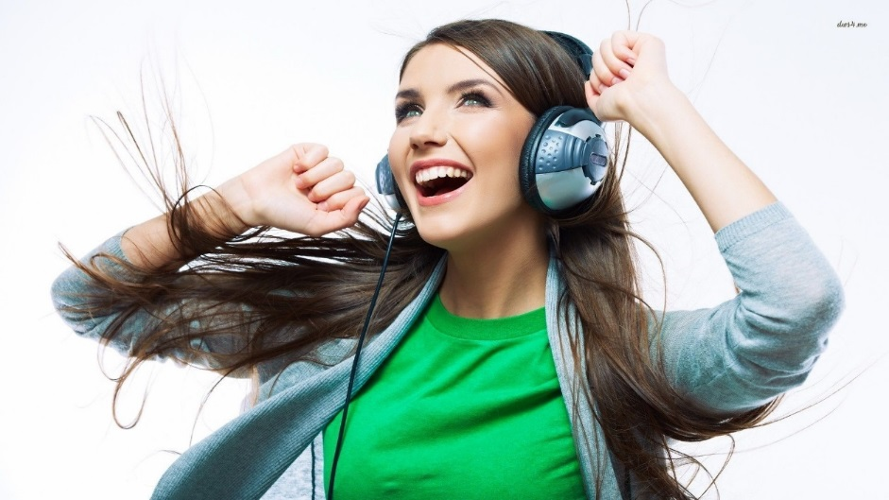
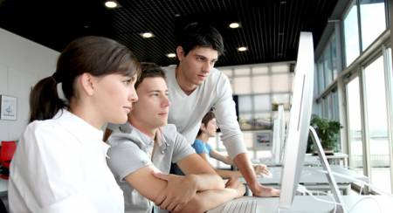
Look at the pictures and predict what will happen next

Slide 15
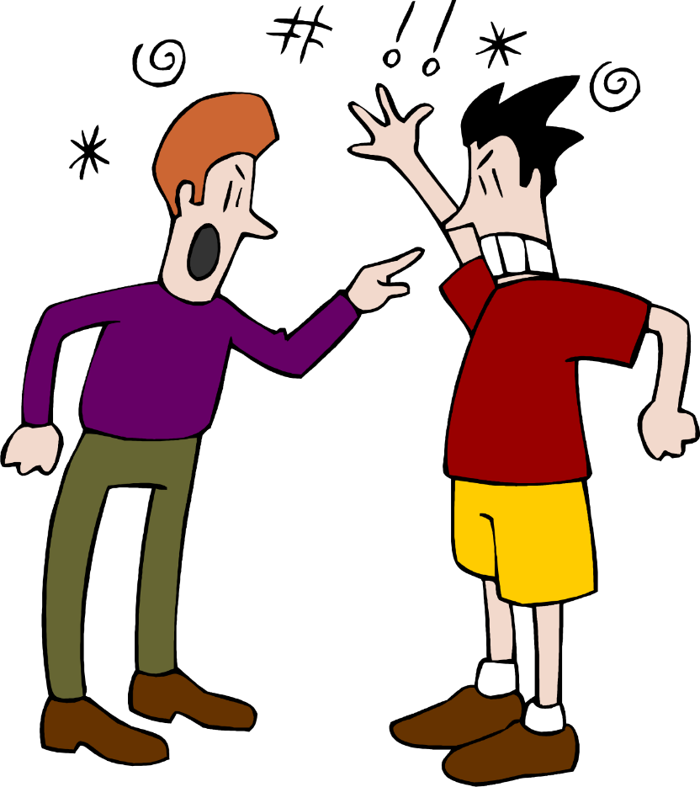
Make a prediction
I think they…

Slide 16
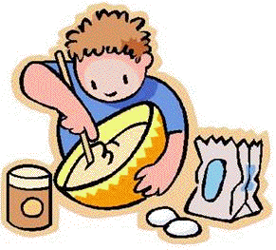
Make a prediction
I think Pepe…

Slide 17
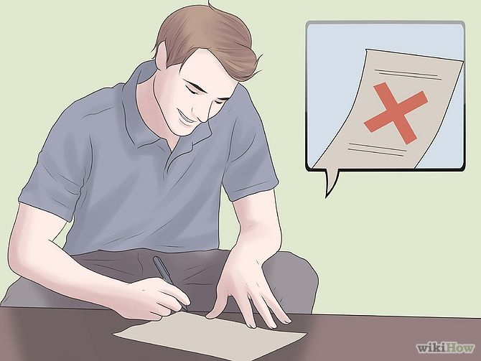
Make a prediction
Probably, he…

Slide 18
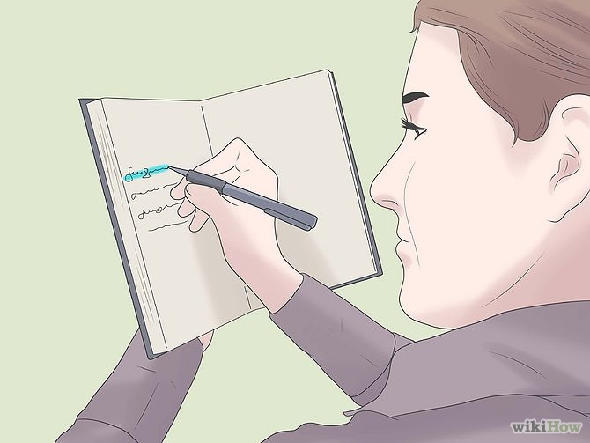
Make a prediction
I guess Jessica…

Slide 19
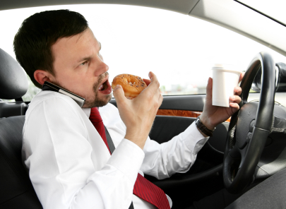
Make a prediction
I think John…

Slide 20
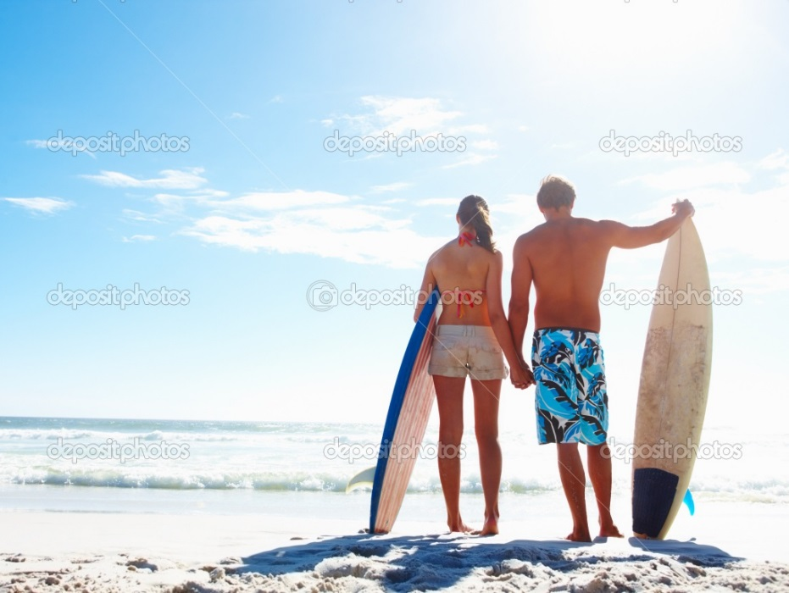
Make a prediction
Probably, they…

Slide 21
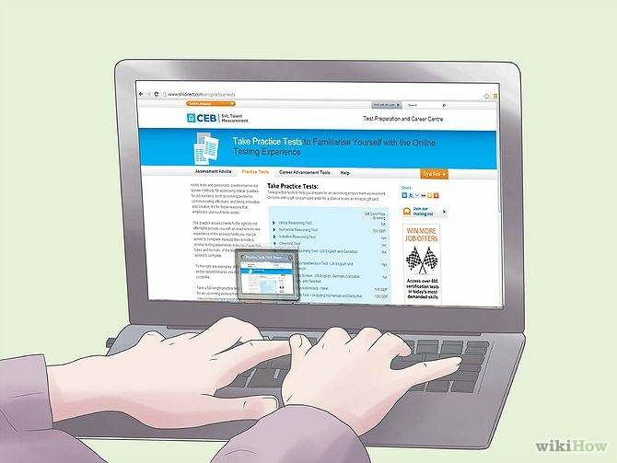
Make a prediction
I think he…

Slide 22

Make a prediction
I think he…

Slide 23
What will you do…?
Activity | Me
Tonight?
Tomorrow?
Next weekend?
Next holidays?
Next Birthday party?

Slide 24
What will you do…?
Activity | Me
Tonight? | I will watch TV.
Tomorrow? | I will buy a phone.
Next weekend? | I will eat in a restaurant.
Next holidays? | I will go to Mazatlán.
Next Birthday party? | I will celebrate it with some friends.

Slide 25
What will you do…?
Activity | Friend 1 | Friend 2
Tonight?
Tomorrow?
Next weekend?
Next holidays?
Next Birthday party?

Slide 26
What will you do in the following days?
Write 6 different activities using time expressions.
Positive
____________________________________________________.
____________________________________________________.
____________________________________________________.
Negative
____________________________________________________.
____________________________________________________.
____________________________________________________.

Slide 27
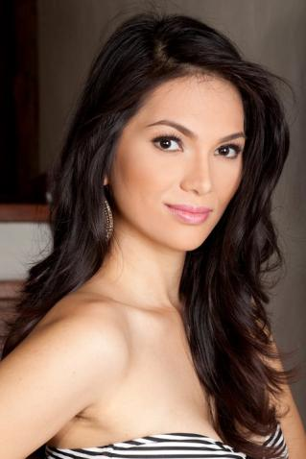
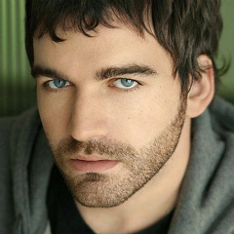
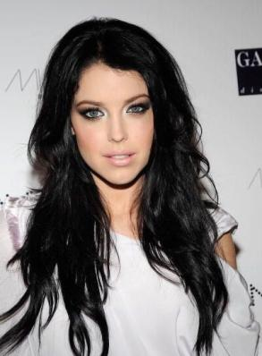
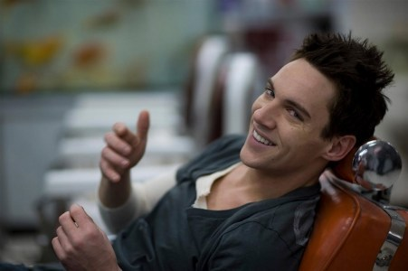
What are they going to do next month?

Slide 28
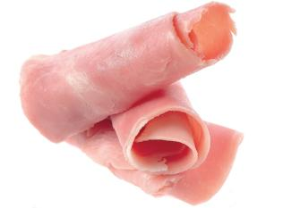
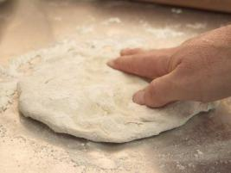
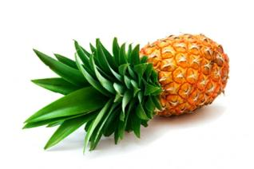
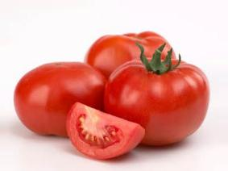

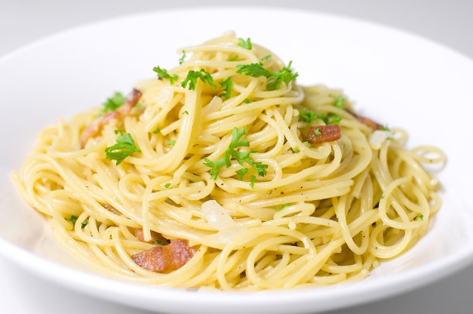
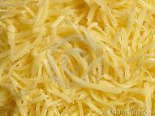

Kiera
Kiera is going to…

Slide 29
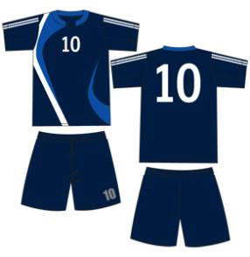
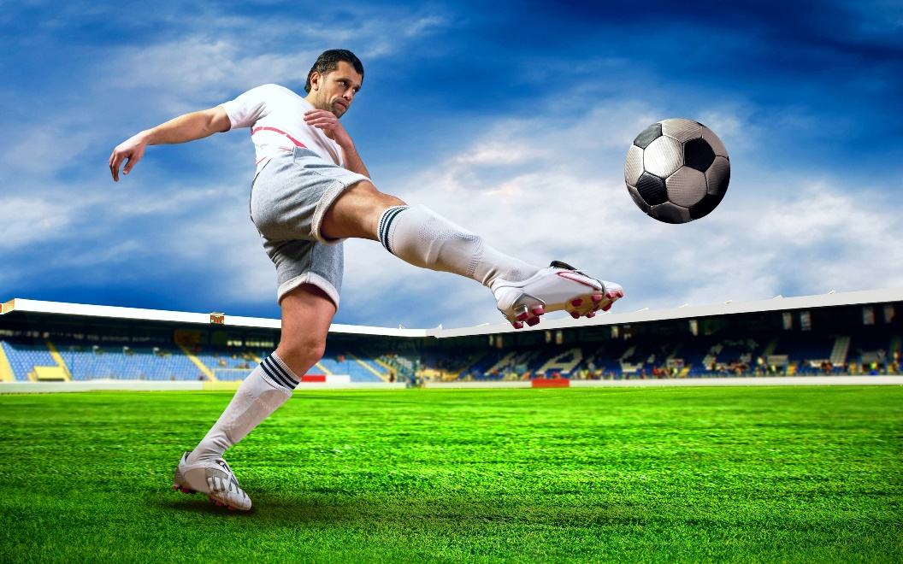

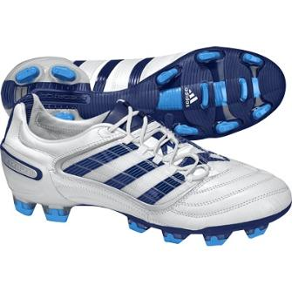
Steve
Steve is going to…

Slide 30
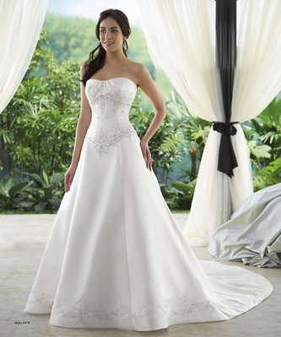
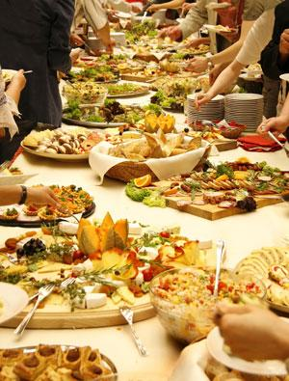

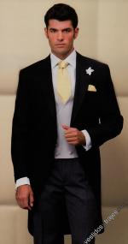

Camilla
Camilla is going to…

Slide 31
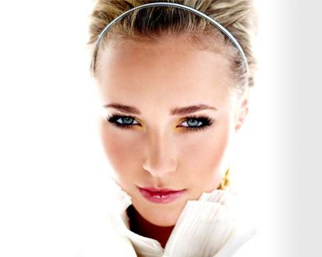
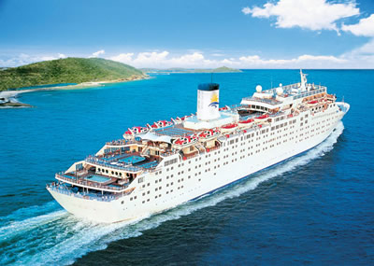
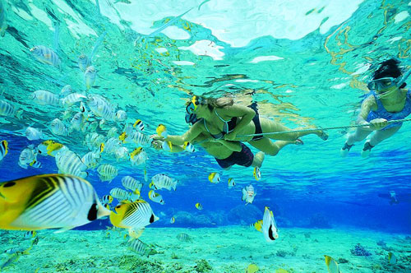
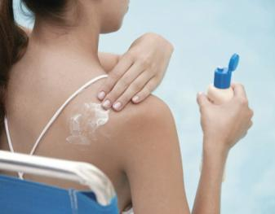
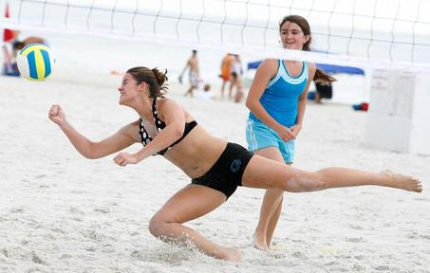
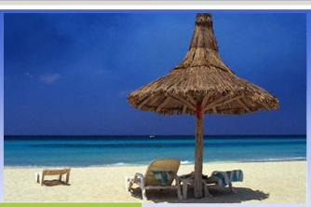
Hayden
Hayden is going to…

Slide 32
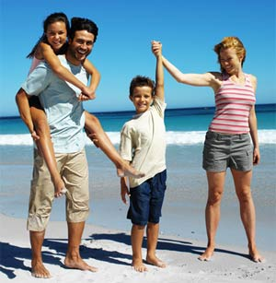
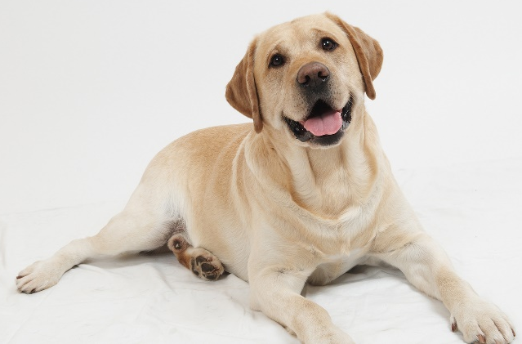
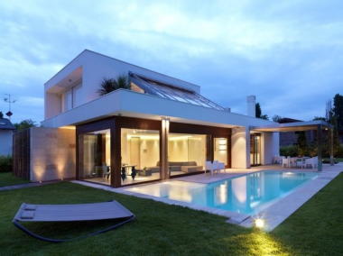
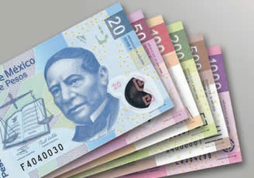
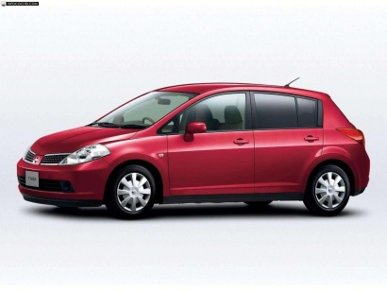
Jonathan
Jonathan is going to…

Slide 33
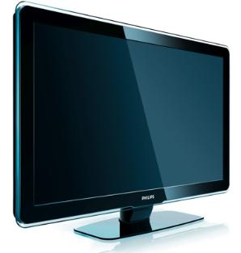

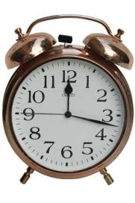

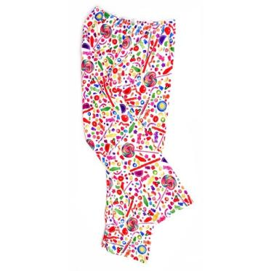
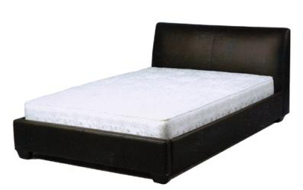

Maria
Maria is going to…

Slide 34
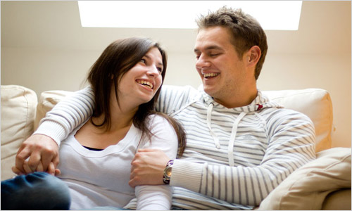
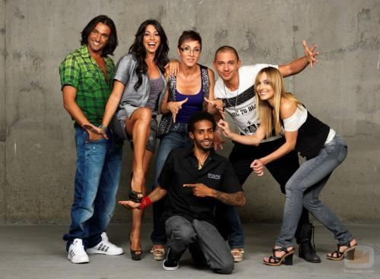
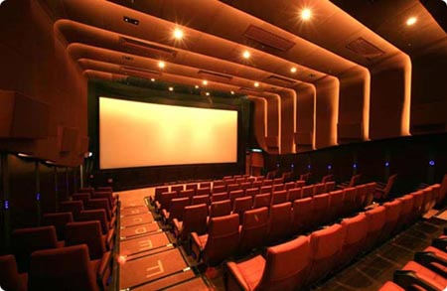


Monica &David
Monica and David are going to…

Slide 35
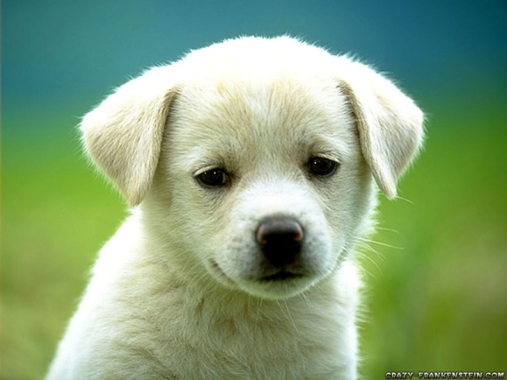
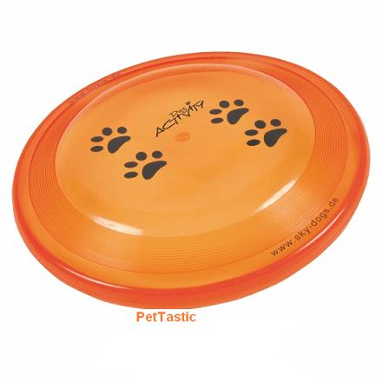

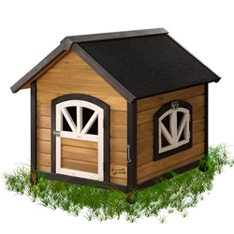
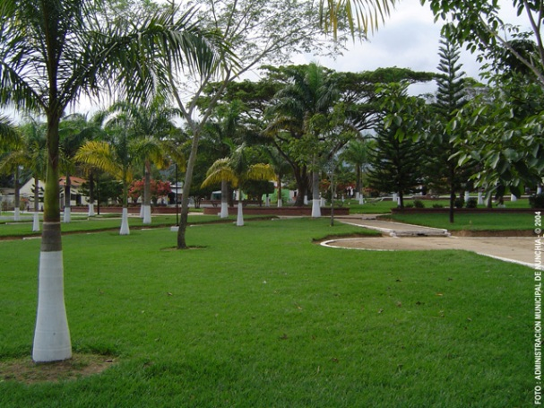

Snowball
Snowball is going to…

Slide 36
What are your plans for the next month?
Write 6 different activities using time expressions.
Positive
____________________________________________________.
____________________________________________________.
____________________________________________________.
Negative
____________________________________________________.
____________________________________________________.
____________________________________________________.

Slide 37
Conditionals
Cause and effect

Slide 38

What is a Conditional Sentence?
Conditional sentences are sentences expressing factual implications, or hypothetical situations and their consequences.

Slide 39
STRUCTURE
Conditional sentences have at least two clauses: IF clauses and THEN clauses.
IF CLAUSE
,
THEN CLAUSE
CAUSE
Condition
EFFECT
Result

Slide 40
IF Clauses (the condition)
IF clauses present the CONDITION.
Examples:
  If I go into town tomorrow…
  If he speaks Chinese…
  If they are faster…

Slide 41
THEN Clauses (the results)
THEN clauses present the RESULTS.
Examples:
… then I go to the movies.
…. then he can work as a guide in China.
… then they win the race.

Slide 42
Examples:
  If I go into town tomorrow, then I go to the movies.
  If he speaks Chinese, then he can work as a guide in China
  If they are faster, then they win the race.

Slide 43

ZERO CONDITIONAL
REAL FACTS

Slide 44

ZERO CONDITIONAL
The Zero Conditional is a structure used for talking about:
General Truths.
Scientific Facts.
Things which always happened under certain
conditions.

Slide 45
EXAMPLES
General truths:
If condition result
If it rains, we get wet.
Scientific facts:
If condition result
If the water boils, it is not cold.
Things which always happened under certain conditions:
If condition result
If I study, I get good marks.

Slide 46
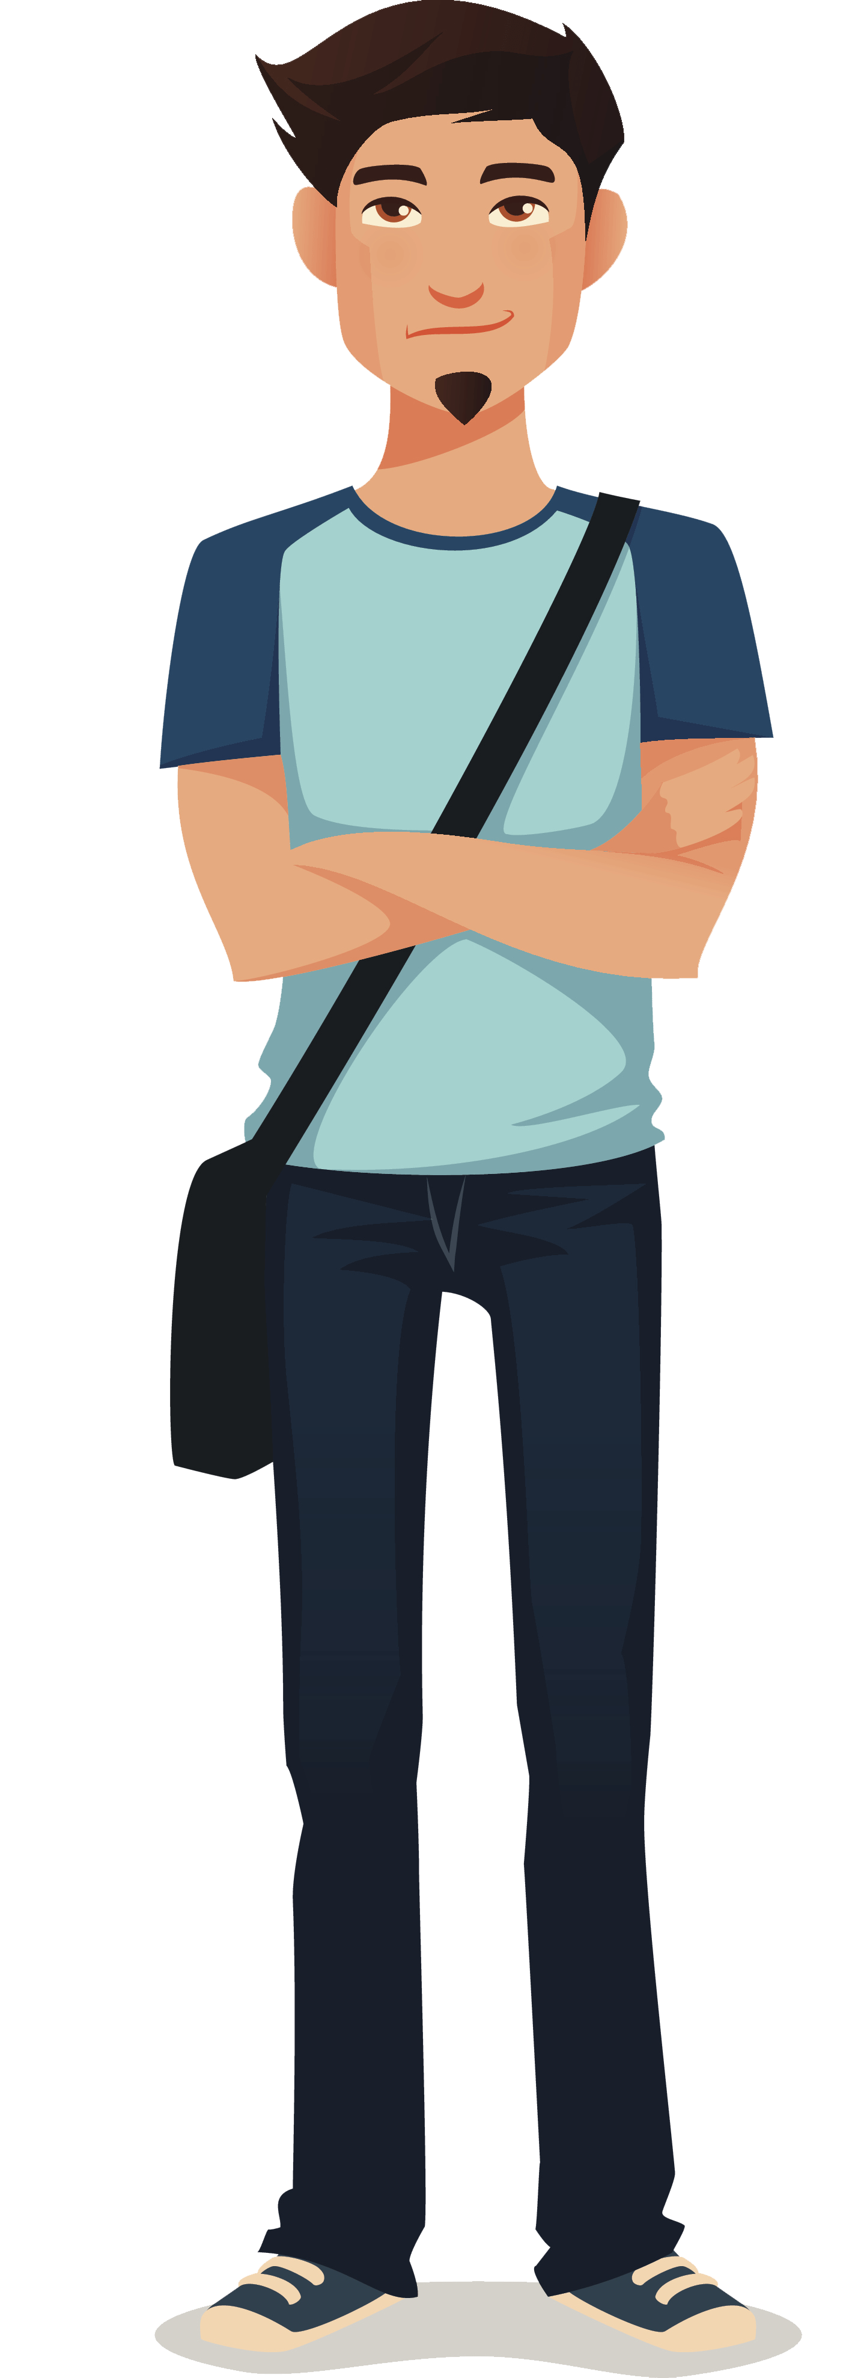
Read the following situations and try to give an answer
What happens if I do exercise?
What happens if I run 10 km?
What happens if I smoke a lot?
What happens if I don’t do homework?
What happens if I am late for school?
What happens if I study a lot?
What happens if I drive fastly?

Slide 47
STRUCTURE
IF CLAUSE
,
THEN CLAUSE
CAUSE
Condition
EFFECT
Result
Simple
Present
Simple
Present

Slide 48
If we come to the party, |  | you gain weight.
When the weather is good, |  | we can have a dog pet.
If you eat lot of fattening food, |  | give me a call.
If I fail my exams, |  | we go for a picnic.
If we miss the bus, |  | take your umbrella with you.
If we move to a bigger house, |  | we are late for class.
If it rains, |  | you have fun.
If the baby wakes up, |  | my parents get angry.

Slide 49
If we come to the party, |  | you gain weight.
When the weather is good, |  | we can have a dog pet.
If you eat lot of fattening food, |  | give me a call.
If I fail my exams, |  | we go for a picnic.
If we miss the bus, |  | take your umbrella with you.
If we move to a bigger house, |  | we are late for class.
If it rains, |  | you have fun.
If the baby wakes up, |  | my parents get angry.

Slide 50
ORDER
If we come to the party, we have fun.
We have fun if we come to the party.
If I fail my exams, my parents get angry.
My parents get angry if I fail my exams.

Slide 51
Read the sentences and complete them by writing a situation or a solution.
If we don’t feel well today,
We easily get tired if…
If I miss the bus for school,
We become ill if…
Put on your coat if…
If I forget my money,
I prepare dinner if…
We go shopping if…
If you see you BF or GF kissing another person,
We get good grades if…

Slide 52
Writing exercise
Think of 5 different situations and write them.
Example: If I do my homework,…
If I ________________________________,…
If I ________________________________,…
If I ________________________________,…
If I ________________________________,…
If I ________________________________,…

Slide 53

FIRST CONDITIONAL
POSSIBLE SITUATIONS

Slide 54
FIRST CONDITIONAL
We use FIRST CONDITIONAL when we are thinking about a possible situation in the future or things that are possible in the present or the future — things which may happen.
Examples
If I go to London this weekend, I’ll go shopping in Oxford Street.
If he has time, he’ll help you.
What will you do if it rains during the picnic?
She won’t be happy if you don’t lend her the money.
If Alice works hard, she will pass the exam.

Slide 55
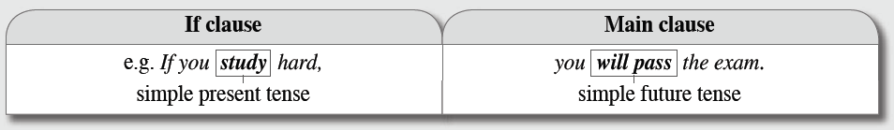
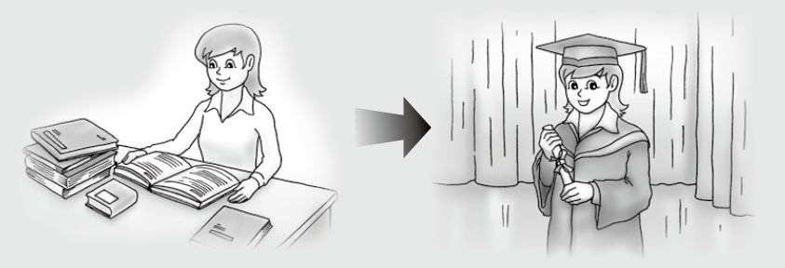

Slide 56
MATCH THE SENTENCES
If you use drugs
If I get bored in class
If that company fails
If you get in trouble
If he loves that girl
… I will assist my partners.
… I will punish you
… he might talk to her.
… you will be sorry sooner
or later.
… workers will lose their
jobs.

Slide 57
Writing exercise
Think of 5 different situations and their result.
Example: If I do my homework, I will go to the cinema.
If I ________________________________,…
If I ________________________________,…
If I ________________________________,…
If I ________________________________,…
If I ________________________________,…

Slide 58
Complete the following sentences
If you ___________ (go) to see this film, you ___________ (have) a good time.
If she ___________ (play) sports , she ___________ (live) longer.
She ___________ (not be) an architect if she ___________ (not go) to university
We ___________ (get) a 10 if we ___________ the exercises.
If it ___________ (rain) , we ___________ (not go) out.
If you ___________(take) an aspirin, your headache ___________ (go) away.

Slide 59
Write sentences
The weather/be good - go / the beach
Go/to school on foot - be / late
Have / money - buy / present
Do/ homework - find / notebook
Mum / give $20 - wash / windows

Slide 60
UNLESS = IF NOT
Unless is used with the present tense to talk about the future (in the same way as if).
It is always followed by a verb in the positive form.
Unless can usually be replaced by IF NOT.

Slide 61
UNLESS = IF NOT
Example
Unless you study hard, you won’t pass the exam. (If you don’t study hard)
Unless I drink coffee, I get a headache.
Unless I feel really tired, I will do my homework.

Slide 62
UNLESS = IF NOT
If I drink coffee, I have energy.
If I don’t drink coffee, I don’t have energy.
I drink coffee, I don’t have energy.
Unless ____________________________________
If I sleep for 8 hours, I will feel good.
feel good
If I don’t sleep for 8 hours, I don’t _______________
I sleep for 8 hours, I don’t feel good.
Unless ____________________________________

Slide 63
UNLESS = IF NOT
If I don’t eat healthy food, my weight will increase.
I eat healthy food, my weight will increase.
Unless ___________________________________________
If I don’t do my homework, I will not learn..
I do my homework, I will not learn.
Unless ______________________________________

Slide 64
Make your own sentences.
Unless I get married, ___________________________
Unless I get a passport, _________________________
Unless I get a driver’s license, ____________________

Slide 65


REFERENCIAS

Slide 66
Referencias
Mesografía
Presente Perfecto vs Pasado Simple
https://www.perfect-english-grammar.com/support-files/conditionals_zero_form.pdf
https://es.slideshare.net/nijheer/class-presentation-conditionals-i
https://es.slideshare.net/Lydiateacher/first-conditional-exercises
https://es.slideshare.net/teachermercedes/conditionals-30142114
Imágenes
Las imágenes se obtuvieron del sitio Freepik: http:www.freepik.com

