Slide 1
2° Q
In economic terms, the first process uses a small quantity of capital and a large quantity of labor, whereas the second process uses a large quantity of capital and a small quantity of labor. You could even choose a process that is in between these 2 extremes.
1° Q

Slide 2

Companies are generally going to want to choose the combination that produces a given quantity of output at the lowest cost.

Slide 3
Deciding the cheapest production
How can a company decide what combination is the cheapest?
One option would be to map out all of the combinations of labor and capital that would yield the desired quantity of output, calculate the cost of each of these options, and then choose the option with the lowest cost. Unfortunately, this can get pretty tedious and is in some cases not even feasible.
COST
what one has to give up in order to get it.

Slide 4
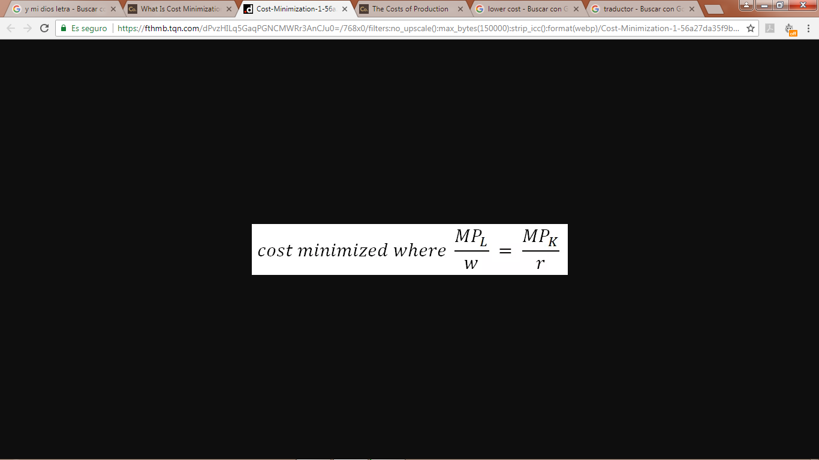
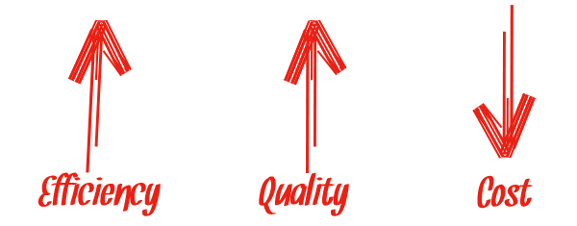
THE COST MINIMIZATION RULE
A better option to decide what combination is the cheapest?
Cost is minimized at the levels of capital and labor such that the marginal product of labor divided by the wage (w) is equal to the marginal product of capital divided by the rental price of capital (r).

Slide 5
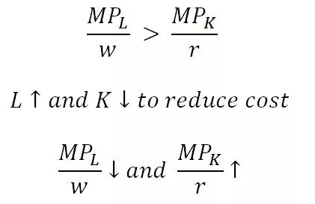
Why this rule Works?
Let's consider a production scenario, where the marginal product of labor divided by the wage is greater than the marginal product of capital divided by the rental price of capital.
In this situation, each dollar spent on labor creates more output than each dollar spent on capital.

Slide 6

If you were this company, wouldn't you want to shift resources away from capital and towards labor? This would allow you to produce more output for the same cost, or, equivalently, produce the same quantity of output at lower cost.

Slide 7
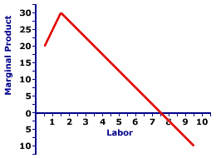
Of course, the concept of diminishing marginal product implies that it's generally not worthwhile to keep shifting from capital to labor forever, since increasing the quantity of labor used will decrease the marginal product of labor, and decreasing the quantity of capital used will increase the marginal product of capital.

Slide 8

This phenomenon implies that shifting towards the input with more marginal product per dollar will eventually bring the inputs into cost-minimization balance.

Slide 9


It's worth noting that an input doesn't have to have a higher marginal product in order to have a higher marginal product per dollar, and it may be the case that it could be worthwhile to shift to less productive inputs to production if those inputs are significantly cheaper.

Slide 10
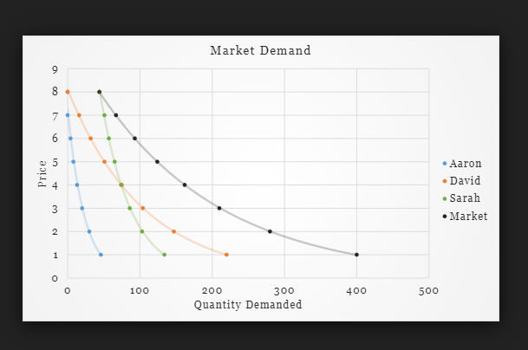
MARKET DEMAND AND CONSUMER SURPLUS
The market demand curve is simply the horizontal sum of the individual demand curves for all consumers in the market. Consumer surplus can be used to examine market demand as well as individual demand.
Extracted from: Worthington, Economics for business blending theory and practice (2nd ed). .

Slide 11
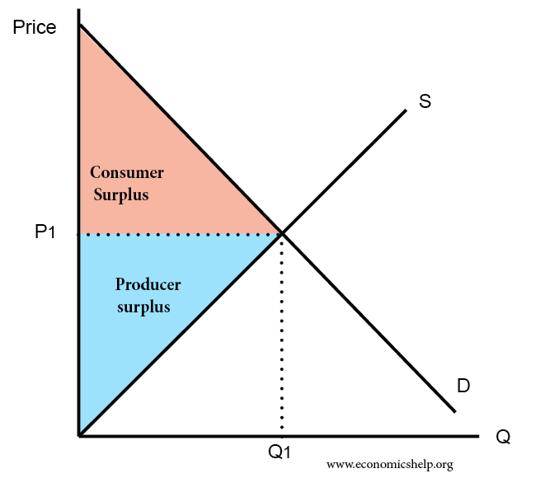
Consumer’s Surplus
Is an economic measure of consumer benefit, which is calculated by analysing the difference between what consumers are willing and able to pay for a good or service relative to its market price or what they spend.
It occurs when the consumer is willing to pay more for a given product than the current market price.

Slide 12

Demand
Is how many goods and services are bought at various prices during a certain period of time. Demand is the consumer's need or desire to own the product or service.

Slide 13
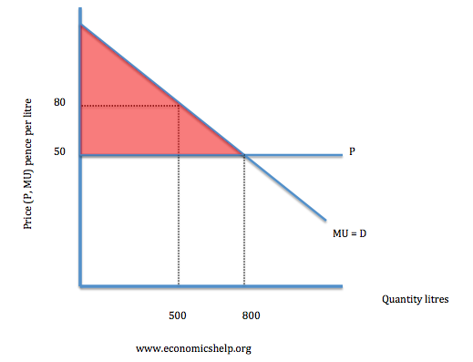
Demand for a Discrete Good
The consumer surplus can also be expressed using the demand curve, by integrating from the price up to where the demand curve intersects with the price axis.
Extracted from: Worthington, Economics for business blending theory and practice (2nd ed). .

Slide 14
Other Interpretations of Consumer´s Surplus
Suppose that the price of the discrete good is p. Then the value that the consumer places on the ﬁrst unit of consumption of that good is r1, but he only has to pay p for it. This gives him a “surplus” of r1 −p on the ﬁrst unit of consumption. He values the second unit of consumption at r2, but again he only has to pay p for it.
CS = r1 −p + r2 −p +···+ rn −p

Slide 15
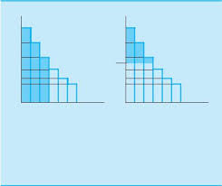
Constructing Utility from Demand
If we are given the demand curve, we can construct the utility function.
The reservation prices are deﬁned to be the diﬀerence in utility:
r1 = v(1)−v(0)
r2 = v(2)−v(1)
r3 = v(3)−v(2)

Slide 16
Concepts of Consumer’s Surplus
Refers to the surplus of a single consumer; consumers’ surplus refers to the sum of the surpluses across a number of consumers.
Serves as a convenient measure of the aggregate gains from trade, just as consumer’s surplus serves as a measure of the individual gains from trade.

Slide 17
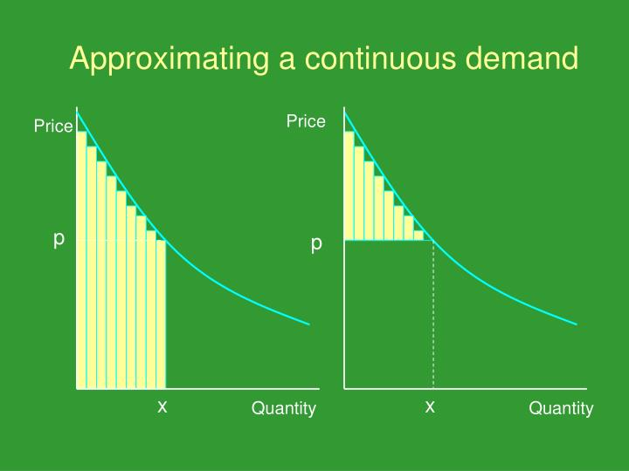
Approximating a continuous demand.
The consumer’s surplus associated with a continuous demand curve can be approximated by the consumer’s surplus associated with a discrete approximation to it.

Slide 18
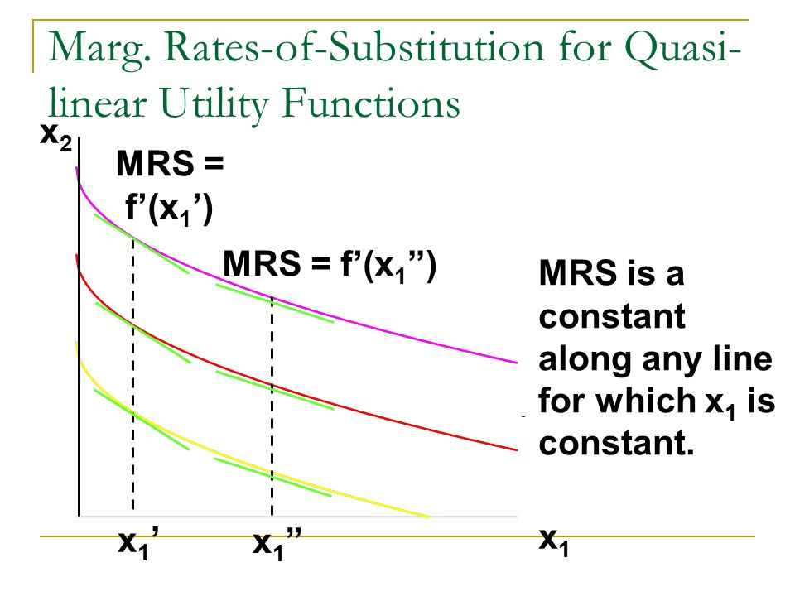
Quasilinear Utility
With quasilinear utility there is “no income eﬀect” since changes in income don’t aﬀect demand. Using the area under the demand curve to measure utility will only be exactly correct when the utility function is quasilinear.
Y= U – f(X)
Extracted from: Worthington, Economics for business blending theory and practice (2nd ed). .

Slide 19
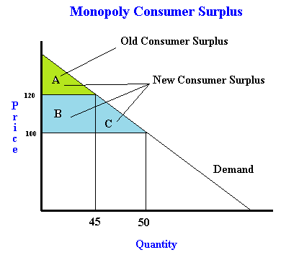
Change in Consumer’s Surplus
The change in consumer’s surplus will be the diﬀerence between two roughly triangular areas, and thus will have a roughly trapezoidal shape.
Extracted from: Worthington, Economics for business blending theory and practice (2nd ed). .

Slide 20
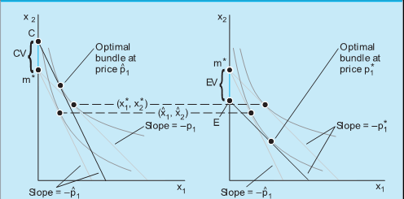
Compensating and Equivalent Variation
Compensating Variation
Equivalent Variation
Extracted from: Worthington, Economics for business blending theory and practice (2nd ed). .

Slide 21
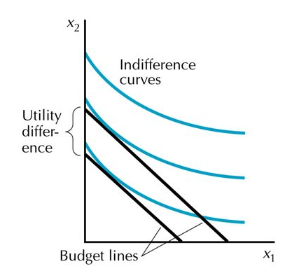
Quasilinear preferences.
The distance between two indiﬀerence curves is independent of the slope of the budget lines.
Extracted from: Worthington, Economics for business blending theory and practice (2nd ed). .

Slide 22
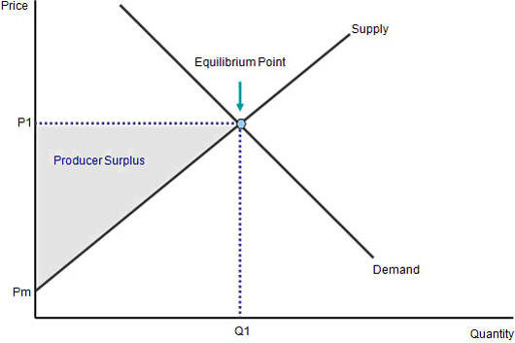
Producer’s Surplus
In the case of supply behaviour we can deﬁne a producer’s surplus that measures the net beneﬁts to the supplier from producing a given amount of output.

Slide 23
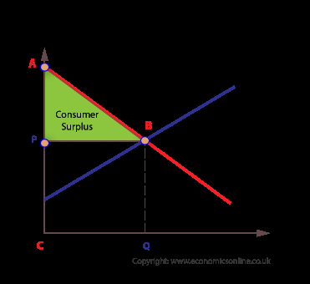
Function of Consumer’s Surplus
We can use the consumer surplus apparatus we have developed to calculate the beneﬁts and costs of various economic policies.

Slide 24
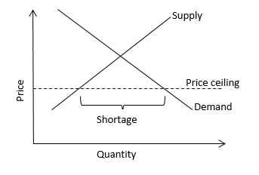
Price Ceiling
A price ceiling is the maximum price a seller is allowed to charge for a product or service, are usually set by law.

Slide 25
Questions for review

Slide 26

1; In victorian´s days how they defined utility?

Slide 27

2; Now how is defined?

Slide 28

3; “they are almost linear” these are the:

Slide 29

4; What is utility for commuting

Slide 30

6; Explain monotonic transformation

Slide 31

7; give us an example of perfect complements

Slide 32

8; what is ordinal utility

Slide 33

9; Formula of MRS

Slide 34

10; how we construct a utility function from indifference curve

Slide 35

11; If we have more of one good or another this is:

Slide 36
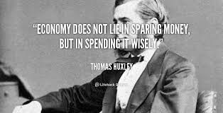

Slide 37
bibliography
Ian Worthington & Britton, Chris & Rees, Andy (2004).Economics for business blending theory and practice (2nd ed). New York Financial Times.
Samuelson, P.A. (2010). Economics. (10th ed). Mc Graw-Hill.

