Slide 1
"Explanatory script for the use of the material"
The slides that are presented have the purpose of fulfilling the following objective:
Publicize the Consumer Theory, as well as the dual analysis of it: the maximization of the Utility and the Minimization of Costs, consumer surplus and producer surplus. Also, identify the mathematical - economic analysis.
The slides presented “Demand and Consumer Theory" are used as support to provide Unit 3 "Demand and Consumer Analysis", in the Business Fundamentals Learning Unit, which is part of the curriculum of Bachelor in International Business Bilingual, first period.
It is considered appropriate to use these slides because it is a work that presents a planning clearly focused on student learning. Its content clearly and precisely discloses the basic concepts of Consumer Theory.
It is important to mention that this subject is taught in the English language, by the very nature of the Degree. As an additional recommendation for the understanding of this material, students can use the bilingual translation application from their mobile devices, in order to become familiar with business English.
For the use of these slides a video projector or cannon and a computer with the Power Point program are required. Since the material is provided to each of the students, they can also follow the teacher on their computer.

Slide 2
“Guión explicativo para el empleo del material”
Las diapositivas que se presentan tienen la finalidad de cumplir con el siguiente objetivo:
Dar a conocer la Teoría del Consumidor, así como el análisis dual de éste: la maximización de la Utilidad y la Minimización de Costos; el excedente del consumidor y del productor. Además que identifique el análisis matemático - económico.
Las diapositivas que se presentan “Demanda y Teoría del Consumidor” se utilizan como apoyo para impartir la Unidad 3 “Análisis de la demanda y el Consumidor”, en la Unidad de Aprendizaje de Fundamentos Económicos de los Negocios, la cual forma parte del plan de estudios de la Licenciatura en Negocios Internacionales Bilingüe, primer periodo.
Se considera adecuado utilizar estas diapositivas porque es un trabajo que presenta una planificación claramente enfocada al aprendizaje del alumno. Su contenido da a conocer de forma clara y precisa los conceptos básicos de la Teoría del Consumidor.
Es importante mencionar que esta asignatura es impartida en el idioma inglés, por la naturaleza misma de la Licenciatura. Como recomendación adicional para la comprensión de este material, los alumnos puedan utilizar la aplicación de traducción bilingüe desde sus dispositivos móviles, con la finalidad de ir familiarizándose con el inglés de negocios.
Para el uso de estas diapositivas se requiere un video proyector o cañón y una computadora con el programa Power Point. Dado que se proporciona el material a cada uno de los alumnos, ellos también pueden seguir al profesor en su computadora.

Slide 3


UNIVERSIDAD AUTÓNOMA DEL ESTADO DE MÉXICO
FACULTAD DE ECONOMÍA
Diapositivas
Plan de estudios: Licenciado en Negocios Internacionales Bilingüe
Unidad de aprendizaje: Fundamentals of Economics for Business, primer periodo
Créditos:08
Tema:
DEMAND AND CONSUMER THEORY
Profesora: M. en E.A . Pamela Guadalupe Gómez Mendoza
Toluca, México; septiembre 2018.

Slide 4
CONSUMER THEORY:
UTILITY MAXIMIZATION AND COST MINIMIZATION

Slide 5
CONSUMER EQUILIBRIUM
The condition in which an individual consumer’s budget is spent and the last dollar spent on each good yields the same marginal utility; therefore, utility is maximized.

Slide 6

what is maximum utility?
Economics concept that, when making a purchase decision, a consumer attempts to get the greatest value possible from expenditure of least amount of money. His or her objective is to maximize the total value derived from the available money.

Slide 7

FROM INDIVIDUAL TO MARKET DEMAND
Individual Demand
The individual demand is the demand of one individual or firm. It represents the quantity of a good that a single consumer would buy at a specific price point at a specific point in time.
Market Demand
Market demand provides the total quantity demanded by all consumers. In other words, it represents the aggregate of all individual demands. There are two basic types of market demand: primary and selective. Primary demand is the total demand for all of the brands that represent a given product or service, such as all phones or all high-end watches. Selective demand is the demand for one particular brand of product or service, such as the iPhone.

Slide 8
Market demand is an important economic marker because it reflects the competitiveness of a marketplace, a consumer’s willingness to buy certain products and the ability of a company to leverage itself in a competitive landscape. If market demand is low, it signals to a company that they should terminate a product or service, or restructure it so that it is more appealing to consumers.

Slide 9
If we fix all the monetary incomes and the price of good 2, we can illustrate the relation between the aggregate demand for good 1 and its price.

Slide 10
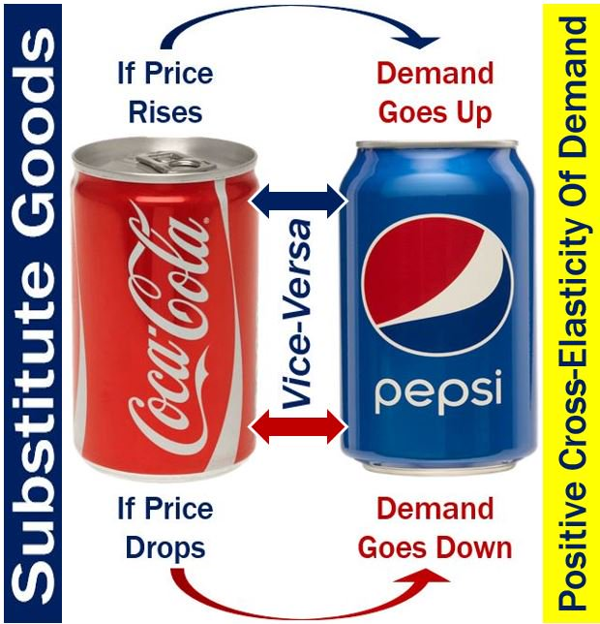
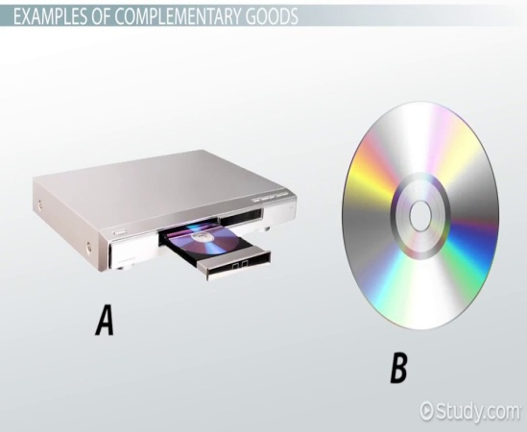

Substitutes: increasing the price of good 2 will tend to shift the aggregate demand curve for good 1 outward.
Complements: increasing the price of good 2 will shift the aggregate demand curve for good 1 inward.
Normal good: increasing monetary income, holding everything else fixed, will shift the aggregate demand curve outward.

Slide 11
THE INVERSE DEMAND FUNCTION
In economics, an 'inverse demand function', P = f−1(Q), is a function that maps the quantity of output demanded to the market price (dependent variable) for that output.
Quantity demanded, Q, is a function of price; the inverse demand function treats price as a function of quantity demanded, and is also called the price function

Slide 12
This changes demand from the independent to the dependent variable. Price changes from the dependent to the independent variable.
Here is an example inverse calculation: P = 2Q this implies P/2 = Q . This equation states that for every $1 increase in the price of this good, the quantity demanded will fall by 1/2 of a unit.
HOW TO CALCULATE THE INVERSE DEMAND?

Slide 13
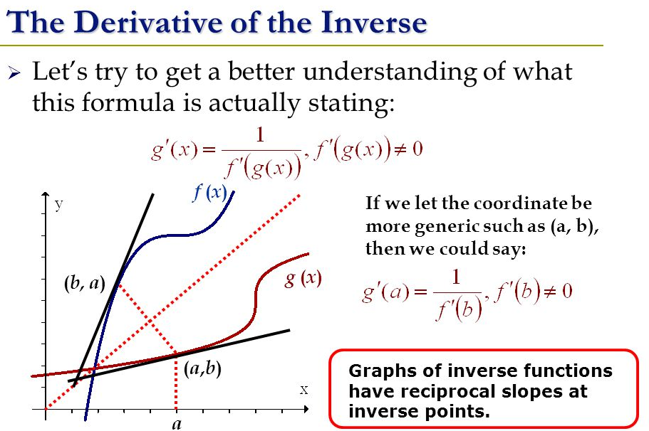
The inverse demand function is the form of the demand function that appears in the famous Marshallian Scissors diagram..
The slope of the inverse function is ∆P/∆Q. This fact should be kept in mind when calculating elasticity. The formula for elasticity is (∆Q/∆P) × (P/Q).

Slide 14
EXAMPLE: Adding Up “Linear” Demand Curves
Since the demand curves are only linear for positive quantities, there will be a kink in the market demand curve.

Slide 15
DISCRETE GOODS
If a good is available only in discrete amounts, then we have seen that the demand for that good for a single consumer can be described in terms of the consumer’s reservation prices. Here we examine the market demand for this kind of good. For simplicity, we will restrict ourselves to the case where the good will be available in units of zero or one.

Slide 16
THE EXTENSIVE AND THE INTENSIVE MARGIN
Extensive margin refers to the range to which a resource is utilized or applied. For example, the number of people working is one measure that falls under the heading of extensive margin.
Intensive margin refers to the degree (intensity) to which a resource is utilized or applied. For example, the effort put in by a worker or the number of hours the worker works.

Slide 17

As it relates to the production function, extensive margin and intensive margin can be thought of as substitutes to some degree- in other words, one could produce more output by either working longer (extensive margin) or working harder or more efficiently (intensive margin).
Consider the following example with a Cobb-Douglas production function having total factor productivity At, labor Lt, capital Kt, and effort et:
Y_{t}=A_{t}K_{t}^{α}(e_{t}L_{t})^{(1−α)}
The intensive margin regards the level of effort et (think intensity), and the extensive margin the quantity of labor supplied Lt.

Slide 18
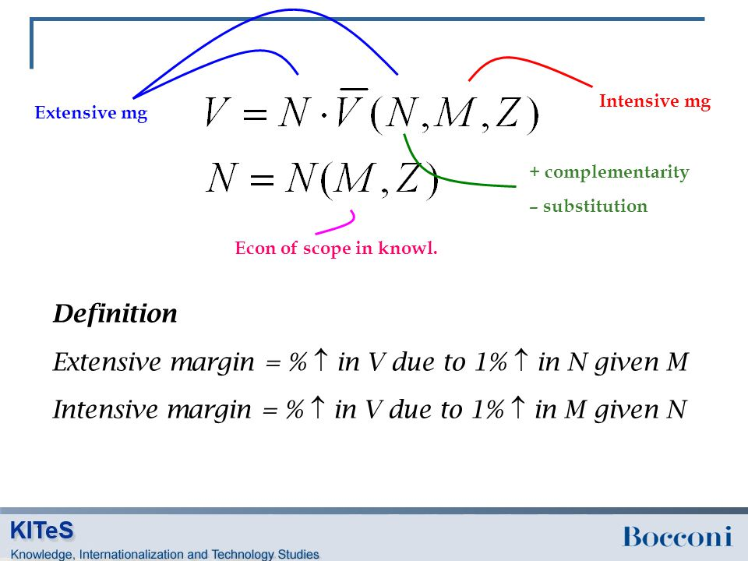

Slide 19
Some history:
Used as a thought of a numeric measure of a person’s happiness
This lead to many problems
  -How are we supposed to quantify the “amount” of utility associated with different choices?
  Is one person’s utility the same as another’s?
  Etc.

Slide 20

LAW OF DIMINISHING
MARGINAL UTILITY
MARGINAL UTILITY
The change in total utility derived from a one-unit change in consumption of a good.
The more of a good a person consumes per period, the smaller the increase in total utility from consuming one more unit, other things constant

Slide 21
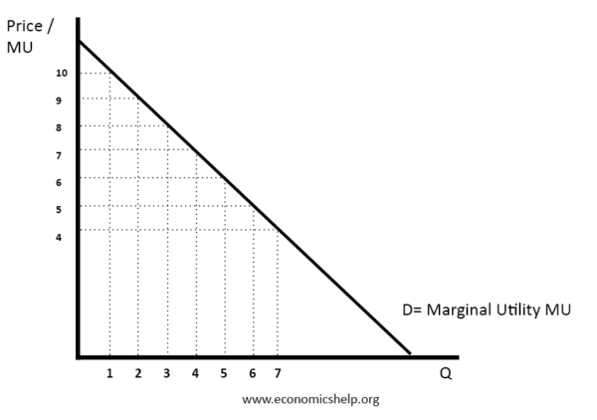
Cardinal utilitY
The Cardinal Utility approach is propounded by neo-classical economists, who believe that utility is measurable, and the customer can express his satisfaction in cardinal or quantitative numbers, such as 1,2,3, and so on.

Slide 22
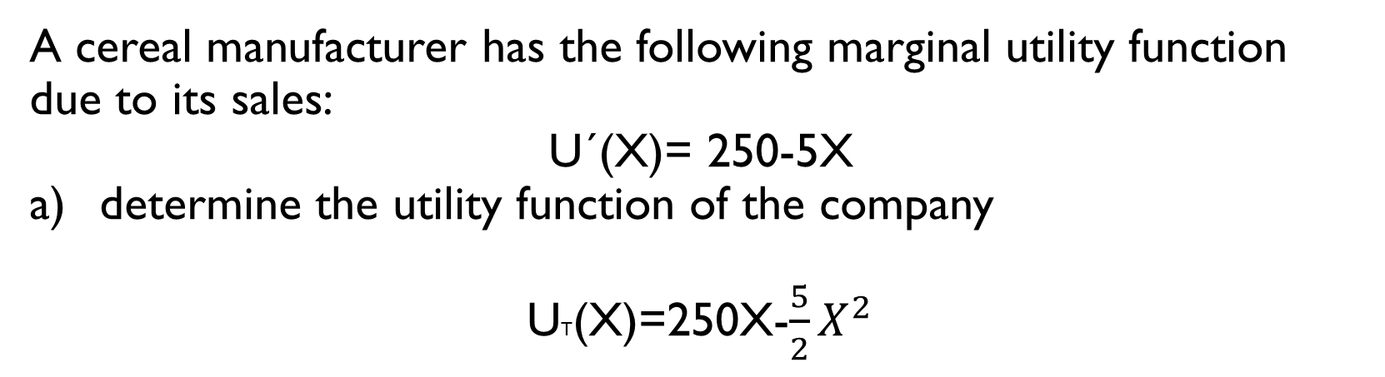
Contructing aN utility fuNction
A cereal manufacturer has the following marginal utility function due to its sales:
U´(X)= 250-5X
determine the utility function of the company
UT(X)=250X-$\frac{5}{2}X^{2}$

Slide 23
SOME EXAMPLES OF UTILITY FUCTIONS
Given two goods x1x1 and x2x2, we have:
u(x1,x2)=Axα1xβ2.u(x1,x2)=Ax1αx2β.
Taking the log of both sides:
lnu=lnA+αlnx1+βlnx2
Perfect substitutes are a linear function:
u(x1,x2)=Ax1+Bx2.u(x1,x2)=Ax1+Bx2.
Marginal utility is constant, since ∂u∂x1=A∂u∂x1=A, and so MRS=ABMRS=AB. So the consumer’s preference between the two goods is indifferent to the amount of each good.

Slide 24
Utility function
$$(x_{1},x_{2})>(y_{1},y_{2})↔U{(x}_{1},x_{2})>U(y_{1},y_{2})$$
(𝑥_1,𝑥_2)>(𝑦_1,𝑦_2)↔𝑈〖(𝑥〗_1,𝑥_2)>𝑈(𝑦_1,𝑦_2)
Ordinal Utility
$$U{(x}_{1},x_{2})=3 U\left(y_{1},y_{2}\right)=3$$
𝑈〖(𝑥〗_1,𝑥_2)=3 𝑈(𝑦_1,𝑦_2 )=3
Monotonic Transformation
$$U →f\left(U\right) U_{1}>U_{2}=f( U_{1})>{f(U}_{2})$$
𝑈 →𝑓(𝑈) 𝑈_1>𝑈_2=𝑓( 𝑈_1)>〖𝑓(𝑈〗_2)
$$(x_{1},x_{2})\sim (y_{1},y_{2})↔U{(x}_{1},x_{2})=U(y_{1},y_{2})$$
(𝑥_1,𝑥_2)~(𝑦_1,𝑦_2)↔𝑈〖(𝑥〗_1,𝑥_2)=𝑈(𝑦_1,𝑦_2)
$$U{(x}_{1},x_{2})=3 U\left(y_{1},y_{2}\right)=1$$
𝑈〖(𝑥〗_1,𝑥_2)=3 𝑈(𝑦_1,𝑦_2 )=1
Definition:the size of he utility difference between any two consumption bundles doesn’t matter.The only property of a utility assignment that is important is how itordersthe bundles of goods.
$$f\left(U\right)=3U f\left(U\right)=U+5 f\left(U\right)=U^{3}$$
𝑓(𝑈)=3𝑈 𝑓(𝑈)=𝑈+5 𝑓(𝑈)=𝑈^3
Definition: a monotonic transformation of a utility function is a utility function that represents
the same preferences as the original utility function.
Definition: is a way of assigning a number to every possible
consumption bundle such that more-preferred bundles get assigned larger numbers than less-preferred bundles.

Slide 25
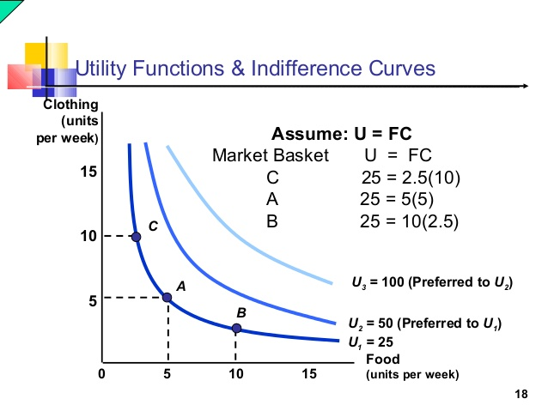
Example: indifference curve utility

Slide 26
Perfect complements
Perfect complements are goods which only provide utility or happiness when they are consumed together. They are an extreme case of complementary goods, which are goods which complement other goods (fries and ketchup are an example of complements). Perfect complements are different from normal complementary goods in that they only provide utility if consumed together whereas you can consume complements individually. The best way to think of perfect complement is "has to be consumed together, otherwise, they provide you with no happiness".

Slide 27
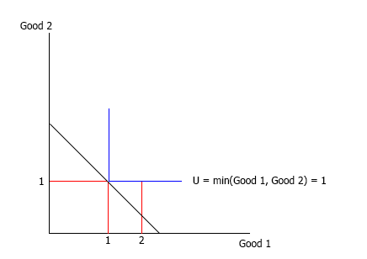
Maximizing utility with perfect complements
Suppose that we are looking at our shoe example again so our utility function is U = min(L, R) where L = left shoe and R = right shoe. Recall, that our values for utility do not matter as long as they display the following characteristic:
More is better, so having 2 left shoes and 2 right shoes is better than having 1 left shoe and 1 right shoe, which we can see is true since:
min(2,2) = 2 - which is the utility from having 2 left and right shoes
min(1,1) = 1 - which is the utility from having 1 left and 1 right shoe
So this characteristic is satisfied.

Slide 28
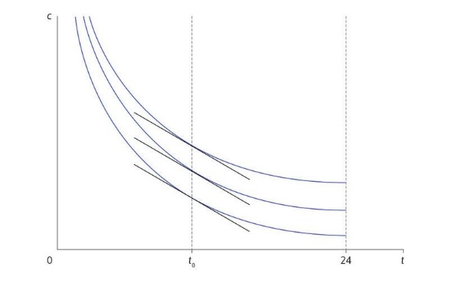
Quasi-linear
In previous Leibnizes, we have made extensive use of the Cobb-Douglas utility function. Now we explore an alternative: the quasi-linear utility function.
Let it be Angela's daily hours of free time, and 𝑐c the number of bushels of cereals she consumes per day. We assume, as in the main text, that the speed at which Angela is willing to exchange grain for free time remains constant as the consumption of grain increases. In other words, its marginal rate of substitution between the hours of free time and the bushels of grain depends only on the free time and not on the grain. We have sketched indifference curves with this property in Figure 1. For any amount of free time, say 𝑡0t0, the slope of the indifference curve at the point (𝑡0, 𝑐) (t0, c) is the same for all 𝑐c, which means that the tangent lines in the figure are parallel.

Slide 29
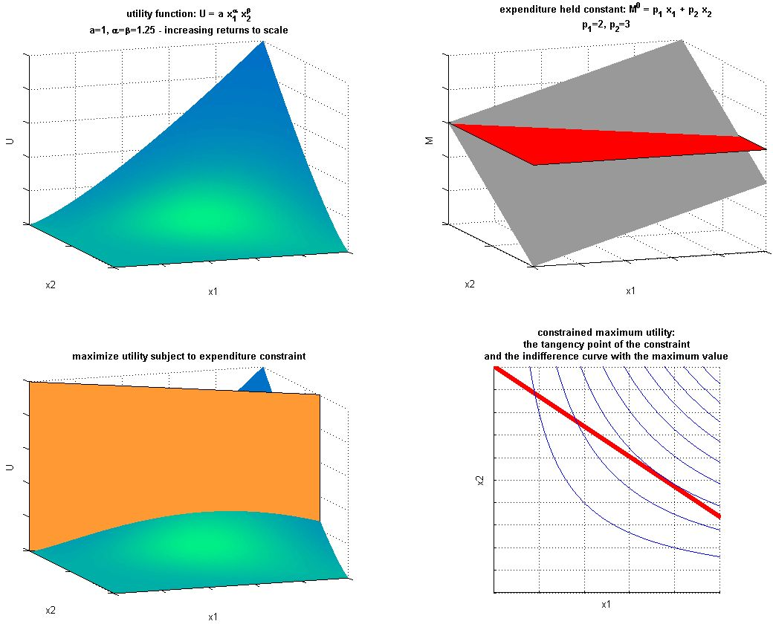
Cob-douglas
A consumer has a Cobb-Douglas utility function: U(x1,x2)=xα1xβ2U(x1,x2)=x1αx2β, where x1,x2x1,x2 denote the consumption of the two goods and α,βα,β are positive constants. The prices of the goods are p1,p2p1,p2 and the consumer's income is mm.
So the question asks to express the consumer's problem as a constrained maximisation problem and then to find the first-order conditions and find the demand functions.
So I have to maximise xα1xβ2x1αx2β subject to p1x1+p2x2=mp1x1+p2x2=m.
This leads to first-order conditions as αxα−11xβ2=λp1αx1α−1x2β=λp1 and βxα1xβ−12=λp2βx1αx2β−1=λp2. No problems here.
The answer for the demand functions are: x1=αm(α+β)p1,x2=βm(α+β)p2x1=αm(α+β)p1,x2=βm(α+β)p2
Further to this I am asked to give an economic interpretation of the parameters αα and ββ, I was slightly lost here too.
Could anyone shed some light on how to arrive at the demand functions? I found myself doing lots of algebraic calculations which didn't seem to get me anywhere.

Slide 30
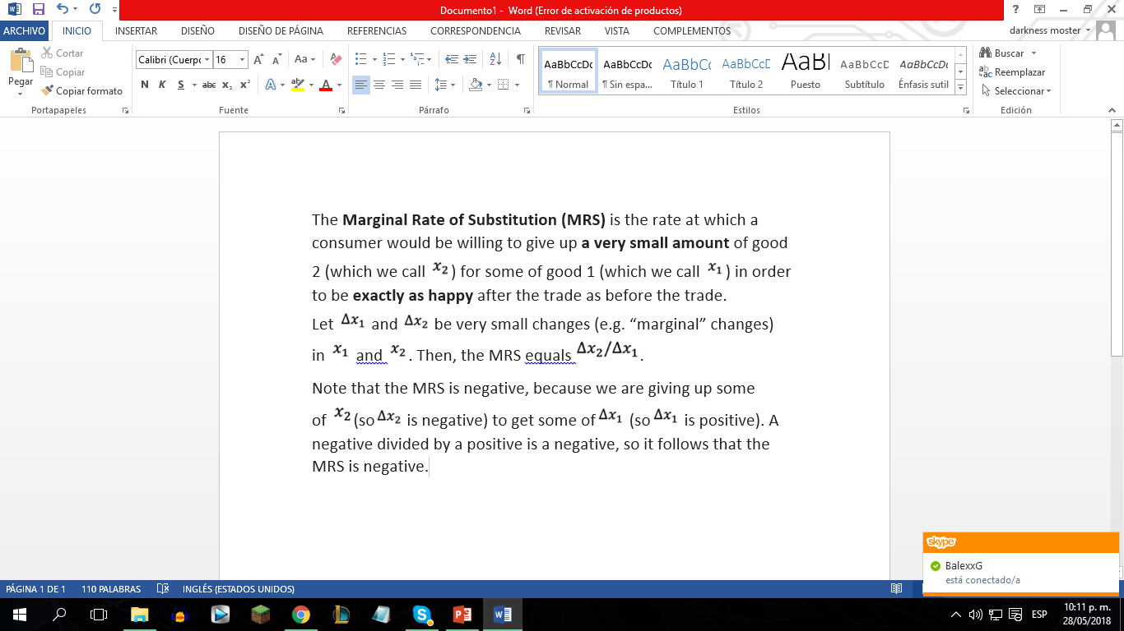
MARGINAL UTILITY AND MRS

Slide 31
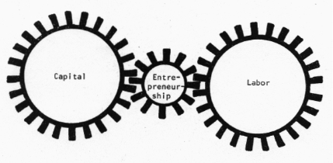
COST MINIMIZATION: What is it?
Cost minimization is a basic rule used by producers to determine what mix of labor and capital produces output at lowest cost. In other words, what the most cost effective method of delivering goods and services would be while maintaining a desired level of quality.

Slide 32
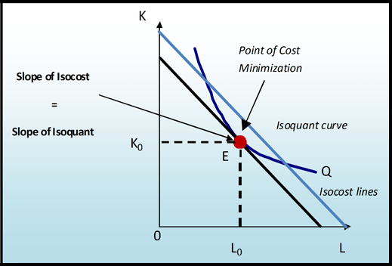
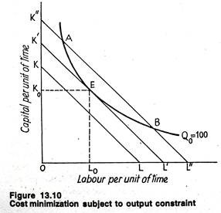
Cost-minimization graph
Extracted from: Worthington, Economics for business blending theory and practice (2nd ed). .

Slide 33
THE FLEXIBILITY OF THE PRODUCTION FUNCTION
In the long run, a producer has the flexibility over all aspects of production, how many workers to hire, how big of a factory to have, what technology to use, and so on.
LONG RUN
The time horizon needed for a producer to have flexibility over all relevant production decisions.

Slide 34

In more specific economic terms, a producer can vary both the amount of capital and the amount of labor it uses in the long run.

Slide 35
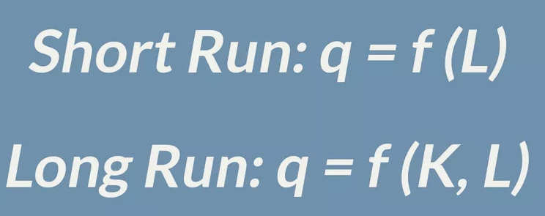
Therefore, the long-run production function has 2 inputs: capital (K) and labor (L). In the table provided here, q represents the quantity of output that is created.
PRODUCTION FUNCTION
The quantity of output (q) that a firm can produce as a function of the quantity of inputs to production, or . There can be a number of different inputs to production

Slide 36

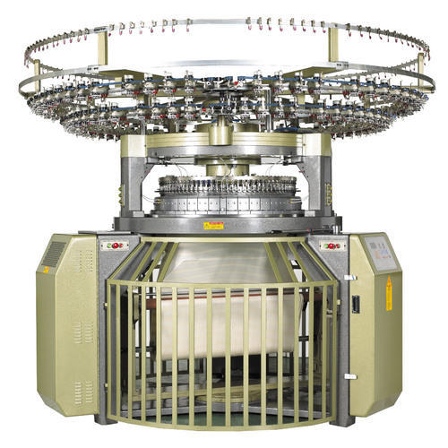
Choice of production process
In many businesses, there are a number of ways in which a particular quantity of output can get created. If your business is making sweaters, for example, you could produce sweaters either by hiring people and buying knitting needles or by buying or renting some automated knitting machinery.

