Slide 1
Universidad Autónoma del Estado de México
Facultad de Economía
Licenciatura en Negocios Internacionales Bilingüe
Finanzas Internacionales
Mercado de futuros
Dra. En A. Elizabeth Adriana Santamaria Mendoza
Septiembre 2018

Slide 2
Presentación
La unidad de aprendizaje Finanzas Internacionales impartida en la Licenciatura en Negocios Internacionales Bilingüe, toma como punto de partida los mercados financieros, uno de ellos es el Mercado de Futuros.
Este material didáctico visión sólo proyectable expone el tema de la unidad III. Mercado de Futuros.
Se explica el concepto de Mercado de Futuros, así como las características y ejemplo para su aplicación en empresas que buscan formas de inversión a partir de los diferentes tipos de mercados financieros, la presentación esta en el idioma inglés para que el alumno identifique los términos técnicos para su aplicación futura.

Slide 3
Introduction
The international finance are the cash flow of money or financial actives.
The financial markets are the places where sellers and buyers of financial products are interchanged in physical or on line markets.
The future market seeks the hegde with contracts to protect the prices of godos in the future.

Slide 4

Definition
Futures contracts can subscribe on agricultural products (wheat, coffee, soybeans), minerals (gold, silver, copper, oil), financial assets (stock price indices, fixed income instruments, interest rates) and coins, requiring necessarily a standardization of the quantity and quality of product traded.
Are contracts between two parties in which the obligation to buy or sell an asset (the underlying) at an agreed price (strike or exercise price) at a future date (maturity) is agreed. They traded on organized markets.

Slide 5
Historical background of futures markets
The first recorded use of these markets was in Japan in the year 1697.
At that time the rent was paid in rice and feudal lords they were forced to keep two houses of posting in the field and one in the city. As often had to deal with an emergency, they began issuing tickets (certificates of deposit). Traders began to buy those tickets to anticipate needs (coverage).
In that same century already existed in the US domestic markets for goods, but was in the year 1848 the foundation of the Chicago Board of Trade, today the futures market more important of the world.
Futures markets have been developed to help the participants of the grain market chain to improve their marketing practices and shopping.

Slide 6
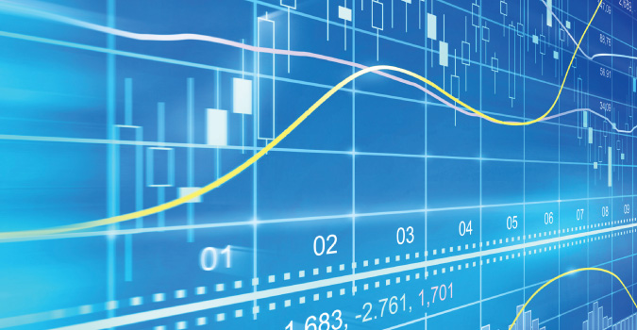
What are they for?
The basic objective of a futures market is to provide an efficient mechanism for price protection for individuals or companies exposed to adverse fluctuations of prices in their most relevant asset.
In addition, the prices reflect future price levels expected for the coming months for the different assets, which gives an information for decision-making of economic agents and is an important contribution to economic forecasting and financial planning in both the public and private sectors.
The future are attractive investment instruments, because they can present a considerable return on values invested.

Slide 7
In the futures price incorporates the expectations of the market about the probable evolution of the underlying asset price.
The majority of contracts are settled (before the clearing house) by taking a position that the counter before it reaches the delivery date. That is, for example, the buyer of a futures contract that you can sell it at any time before the date of delivery. In this way, offset by its position in the underlying asset, the availability of contracts for purchase and sale.

Slide 8
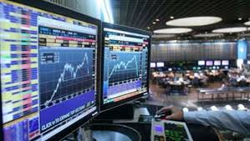

Futures markets are very specific characteristics that require daily monitoring of the evolution of prices and trading volume. Even when the market appears shaky this control should be done hour by hour, as price fluctuations can have a significant impact on investor positions.

Slide 9
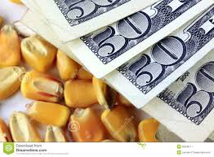
The operations of the future are made through brokers, intermediaries who are duly registered and serve as a link between the clients and the bag.
Unlike an operation in the spot market, which is required to deliver the total amount of the transaction or have the total amount of assets negotiated in future transactions should only deliver a corresponding initial margin at a fraction of the total amount of operation which has a significant multiplier effect on profits or losses from futures trading.

Slide 10
Initial margin: It is a fixed amount of money equivalent to a percentage of the value of contracts, customers must deliver the bag to maintain each open interest in the futures market.
Variation margin:The value of a futures position is updated daily closing price bringing it to market. The net difference of price change is debited from the current account position loss and credited to the account of the position at a profit.
The losses that occur should be delivered daily in money, while the profits also will be paid daily in cash.

Slide 11

How does it work?
The heart of a futures market is the Clearing House or Clearing. It is the confluence point where buyers and sellers of a product. This means that when one operates in a futures market does not strictly against an individual but against the clearinghouse market making operations are anonymous and in turn have a high operational safety.
To select a futures exchange on which it is to operate there are some prerequisites to consider: firstly that the physical asset to be back there as such or alternatively a very similar in their characteristics.

Slide 12
How does it work?
The second factor to consider is market liquidity (the number of operations per contract and per day). We always look for contracts that have important daily volume so that operations can be performed without complications.
In a futures market there are usually at least two basic types of financial products, these being:
1. Futures contracts
2.Options e

Slide 13
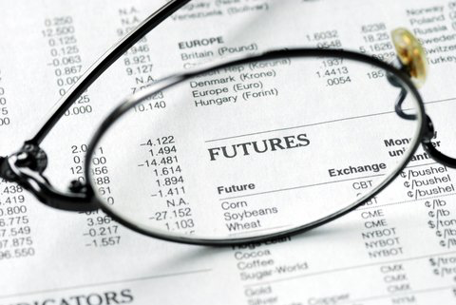
Another important economic function of futures markets is coverage. Through coverage they are bought and sold futures contracts to offset the risks of adverse price changes in the physical market.
In the futures market, standardized in quantity and quality to deliver on a specific month contracts are traded; that is, all buyers and sellers of contracts talk about the same.
The rules of standardization of futures contracts are determined by the exchanges or auctions; example: coffee contract amounts to 37,500 Lbs. gold premium quality coffee washing, to some specific month in the future.
A futures contract is an agreement of sale on credit, in which a specific price and date in which to conduct the operation in the future is fixed.

Slide 14
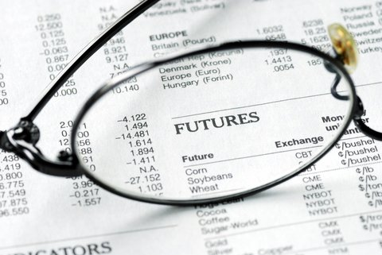
Future contracts
The futures contract is one whereby the commitment to deliver or receive goods performance of the contract at a price agreed in the wheel futures market operations acquired quality and standardized amount at a certain place and during the month.

Slide 15
Future contracts
The characteristics of futures contracts are:
Transactions are concentrated geographically in the stock market and the hour in which you can trade, are officially determined.
Delivery dates or expiration of contracts are standardized, no transactions with dates that are not officially authorized by the Exchange are mead.

Slide 16
Future contracts
There is a clearing house that works as a buyer for all sellers and the seller to every buyer; so, the chamber acts eat a third party that ensures all transactions.
The obligations of the parties to a contract are each with the Clearing house and not directly between them. The net position of the camera is always zero.

Slide 17
Future contracts
The type of goods traded futures has expanded over time; normally, to handle goods in the futures markets should be considered certain characteristics, including:
Units of homogeneous goods must, must be uncertainty as to the price, the goods must not be perishable and supply of goods should not be subject to restrictions artificial or monopolistic, whether private or governmental.

Slide 18
FUTURES CONTRACTS CAN BE CANCELED IN TWO WAYS
Compensation | The delivery of goods
Is to make a futures contract taking an opposite to the contract to be canceled position, i.e. cancel your original sales operation disassociating the commitment to the futures market. | Delivery of goods is available only in the month of expiration of the contract.

Slide 19

Coverage
The coverages are purchased because they provide protection against fluctuations in the value of the price or cost to minimize the risk of financial loss, this protection is achieved by buying or selling futures contracts.

Slide 20
Coverage
COVERAGE
Coverage of sale
(short)
Used by the holder to protect the price at which to sell their wares, involves selling futures contracts.
Used by holder to protect the purchase price at which the merchandise involves buying futures contracts.
Coverage of purchase (long)

Slide 21
Base
The difference between the price of a physical product and the future price for the same product is known as base, the more positive the base, higher will be the price of the physical product.
This difference is due to many factors including:
Local supply and demand of the product.
Supply and demand substitutes generally comparable products and prices.
Price expectations.
Interest rates.

Slide 22

TYPES OF OPERATORS
Hedgers
They use futures, forward contracts and options to reduce the risk to potential movements facing a changing market.
Speculators
They are individuals who buy and sell futures contracts in order to make a profit, assuming the risk of fluctuations presented by product prices.
Their participation in the markets of futures and options on futures is vital for there to be sufficient liquidity coverage allows those seeking to transfer the risk of possible adverse price fluctuations.

Slide 23

TYPES OF OPERATORS
Arbitrageurs
These people are responsible for buying a currency or a commodity in a market at a lower price and immediately selling it in another market at a higher price than at a profit by the price differential which causes the prices and rates in the different are matched or equalize markets for these opportunities.

Slide 24
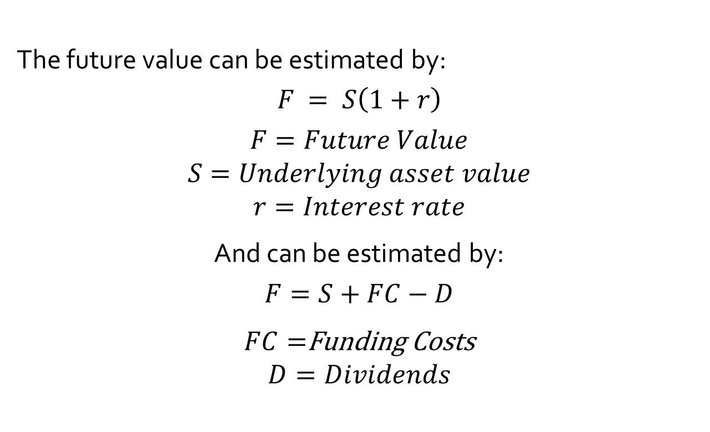
Future
The future value can be estimated by:
$$F = S\left(1+r\right)$$
$$F=Future Value \\ S=Underlying asset value \\ r=Interest rate$$
And can be estimated by:
$$F=S+FC−D$$
$FC=$Funding Costs
$$D=Dividends$$

Slide 25
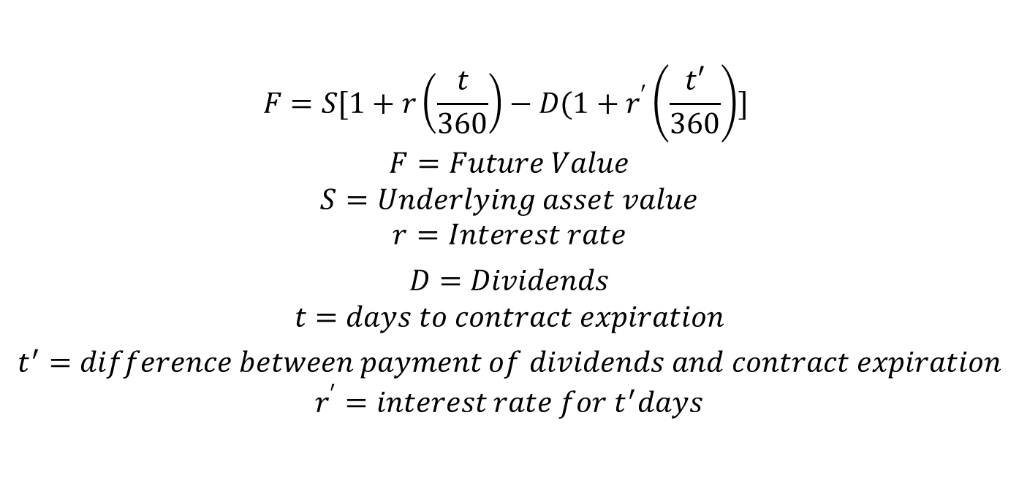
Future value
$$F=S[1+r\left(\frac{t}{360}\right)−D(1+r^{′}\left(\frac{t′}{360}\right)]$$
$$F=Future Value \\ S=Underlying asset value \\ r=Interest rate$$
$$D=Dividends \\ t=days to contract expiration$$
$$t^{′}=difference between payment of dividends and contract expiration \\ r^{′}=interest rate for t^{′}days$$

Slide 26
Example 1
Assume a person who wants to buy a car, the retailer wants to sell him one car in $100,000.
The buyer going to search for a funding source, The bank offers to lend him with a interest rate of 10%. That means that in one year he is going to pay $110,000.
On the other hand, seller tells to buyer, that the cost for maintain the car one year is $15,000.

Slide 27
Example 1
But the benefit for selling it is for $5,000.
In this case, the future agreed will be for: $110,000 (100,000+15,000-5,000)
If this happens, will exist an equilibrium and dont matter buy it now or later.
But if future agreed were $115,000, the buyer will get a funding to only pay $110,000.
On the contrary, if future agreed were $105,000, the buyer will agree the contract and will pay in one year.

Slide 28
Example 2
Suppose an investor, who wants to buy an asset (commodities).
Wheat price is 100 U$D per ton, but commodity price is rising considerably, he pact and contract with agricultures to buy 1 ton for 120 U$D in 1 year.

Slide 29
Example 2
In this case, imagine in 2016, wheat commodity price is 135 U$D per ton, farmers are obligated to sell their wheat although they could sell at higher price. In this hypothetical situation, the investor will save 15 U$D.
But, if wheat commodity price were 110 U$D, the investor is obligated to buy their wheat, in this circumstance, the investor would lose 5 U$D.

Slide 30
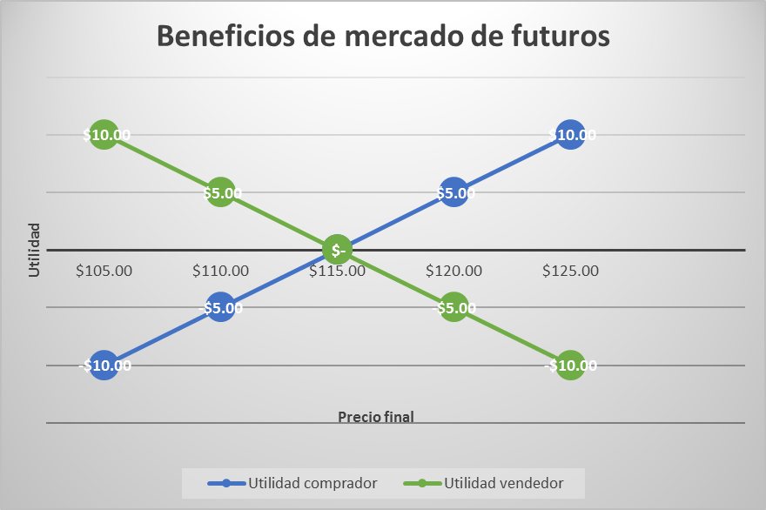

Slide 31
Conclusions
The inversors and the big companies want to protect the future movements in the cash flow.
The future market are conformed by commodities.

Slide 32
Reference
Gitman, L. (2012). Principios de Administración Financiera. 12ª ed. México: Pearson.
Madura, J. (2008). Mercados e Instituciones Financieras. 8ª edición. México: Cengage Learning.
MISHKIN F. S. (2008). Moneda, banca y mercados financieros. México: Pearson.

