Slide 1

Centro Universitario UAEM Valle de Teotihuacán.
Licenciatura en Contaduría
Inglés 5
UNIT 1
PRESENT TENSE EXPRESSIONS
Fecha de elaboración Septiembre 2019
Periodo 2019-A
M. en R.H. Miriam Elizabeth Ramos Muñoz
.

Slide 2
Centro Universitario UAEM Valle de Teotihuacán.
Licenciatura en Derecho
Inglés 5
Inglés 5
Expresiones en tiempos presentes
Clave | Horas teóricas | Horas prácticas | Total de horas | Créditos | Tipo de unidad de aprendizaje | carácter de la unidad de aprendizaje | Núcleo de la unidad de aprendizaje
LMU209 | 2 | 2 | 4 | 6 | Curso | Obligatoria | Básico

Slide 3

INDEX
1. Introduction
2. Purpose of the subject
3. Present tense expressions.
3.1 Facts, habits and routines
3.2 Actions in progress and actions that are about to take place.
3.3 Repeated actions with results in present.
4. Considerations for the use of simple present tense.
4.1 Frequency adverbs
4.2 States and actions
4.3 Negative and interrogative form
5. Bibliography

Slide 4
Introduction
The English Learning Unit program 5 is a guide that describes the minimum knowledge that the student must acquire and reinforce to develop communicative competences in English that allow him to interact safely in contexts of daily life using simple language and basic vocabulary.

Slide 5
Purpose of the subject
Recognize and apply the linguistic functions of different grammatical elements that allow the student to develop communicative competences necessary to interact in a semi-guided way in communicative situations of daily life to be able to exchange personal information, paraphrase information, express an opinion, describe experiences, present habits and past events, describing and comparing people, objects, situations and places, understanding rules and instructions, as well as the general idea of ​​an oral or written discourse

Slide 6
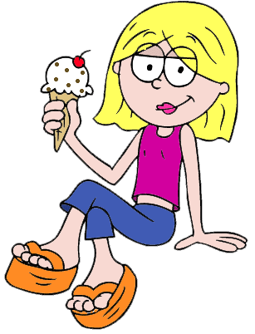
INTRODUCTION UNIT 1
EXPRESSIONS IN PRESENT TENSE
There are two different ways to express a situation in present.
The present tenses used in English are:
Simple present
Present continuous

Slide 7

3.Present tense expressions
3.1 Habits and routines
We use the Simple Present to express the idea that an action is repeated or usual. The action can be a habit, a hobby, a daily event, a scheduled event or something that often happens.

Slide 8
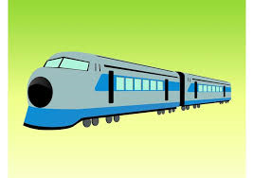
Simple present tense
Examples:
The train leaves every morning at 8 AM.
The train does not leave at 9 AM.
When does the train usually leave?

Slide 9
Rules for third person
Normally in the present tense we add S to the end of the verb in the 3rd person (He, She, It).
Verb | 3rd Person
Speak | Speaks
Play | Plays
Give | Gives
Make | Makes
He speaks three languages.
She drinks coffee every morning.
My dog hates my cat

Slide 10
1. If the verb ends in SS, X, CH, SH or the letter O, we add + ES in the third person.
Verb | 3rd Person
Kiss | Kisses
Fix | Fixes
Watch | Watches
Crash | Crashes
Go | Goes
A mechanic fixes cars.
She watches soap operas every afternoon.
He kisses his wife before he goes to work.

Slide 11
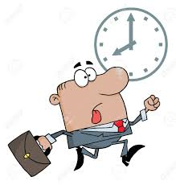
Exercises
Choose the correct option
1.We sometimes _________ books.
a) reads b) read
2.Emily________to the disco.
a) goes b) go
3.It often ____________ on Sundays.
a) rains b) rain
4.Pete and his sister________ the family car.
a) washes b)wash
5.I always___________ to the bus stop.
a)hurries b) hurry

Slide 12


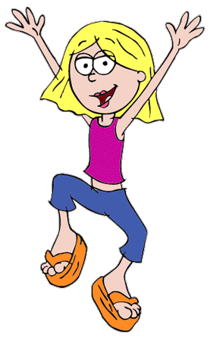
3.1 Facts
The Simple Present can also indicate the speaker believes that a fact was true before, is true now, and will be true in the future. It is not important if the speaker is correct about the fact. It is also used to make generalizations about people or things.

Slide 13
3.1 Facts, habits and routines.
Examples:
Cats like milk.
Birds do not like milk.
California is in America.
California is not in the United Kingdom.

Slide 14
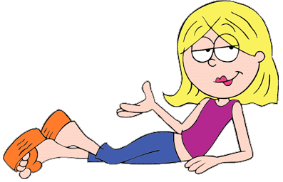
3.2 ACTIONS IN PROGRESS
Present progressive or present continuous.
In English, this tense is used mainly for actions that are taking place at the moment of speaking or that are only happening temporarily.

Slide 15

USES OF PRESENT PROGRESSIVE
1. actions happening at the moment of speaking
Peter is reading a book now.

Slide 16

USES OF PRESENT PROGRESSIVE
2. temporary actions
I am working in Rome this month.

Slide 17

USES OF PRESENT PROGRESSIVE
3. actions happening around the moment of speaking
My friend is preparing for her exams.

Slide 18
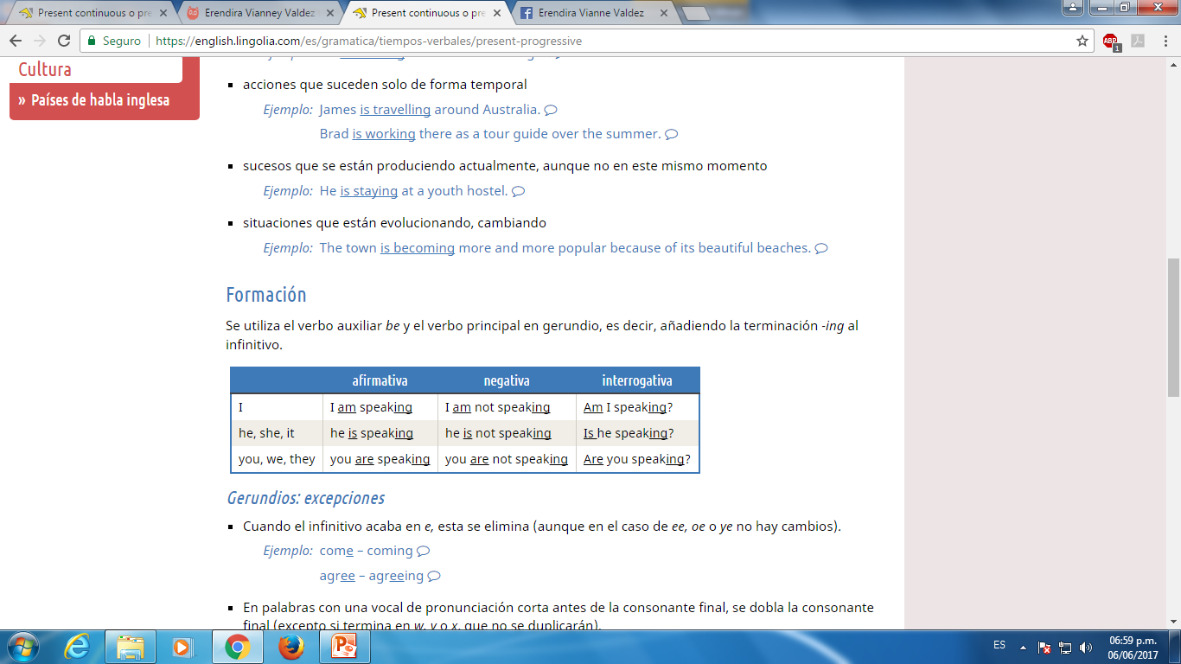

Slide 19
Spelling rules for ING
1.The general rule when changing a verb into its -ING form is just to add -ING to the end of the verb.
Infinitive | ING form
to feel | feeling
to go | going
to work | working
to sleep | sleeping

Slide 20

Spelling rules for ING
2. If the verb ends in an E we remove the E and add ING.
Infinitive | ING form
to live | living
to have | having
to make | making
to take | taking

Slide 21
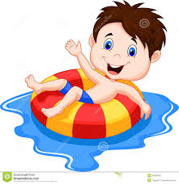
Spelling rules for ING
3. If the verb ends in a consonant + vowel + consonant, we double the final consonant and add ING.
Infinitive | ING form
to stop | stopping
to sit | sitting
to plan | planning
to get | getting
to swim | swimming

Slide 22
Spelling rules for ING
4.If a two-syllable verb ends in a consonant + vowel + consonant, we do not double the final consonant when the stress is on the first syllable.
Infinitive | ING form
to happen | happening
to enter | entering
to offer | offering
to suffer | suffering

Slide 23
Spelling rules for ING
5. But, we do not double the final consonant when the verb ends in W, X or Y or when the final syllable is not emphasized.
Infinitive | ING form
to fix | fixing
to enjoy | enjoying
to snow | snowing

Slide 24
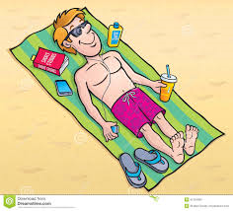
Spelling rules for ING
6. If the verb ends in IE we change it to YING.
Infinitive | ING form
to lie | lying
to die | dying
to tie | tying

Slide 25
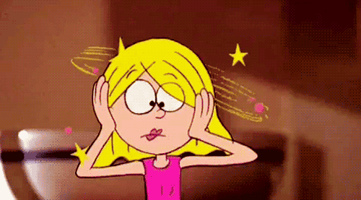
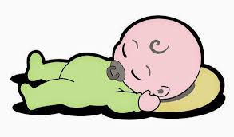

EXAMPLES
I am looking for my keys. I lost them.
The baby is sleeping. Don’t make noise.
They can’t go. They are working.

Slide 26
Exercise
Write sentences in present progressive
(they / work now)
(you / not / walk)
(they / learn new things)?
(when / he / start work)?
(it / get dark)?
(they / not / bring a cake)
(the dog / not / play with a ball)

Slide 27

3.3 Repeated actions with results in present
The present simple tense is very often used with adverbs of repeated time. Look at these examples:
I always come to school by car.
She frequently arrives here before me.
He never forgets to do his homework.
I often catch the late bus home.

Slide 28
4. Considerations for the use of simple present tense.

Slide 29
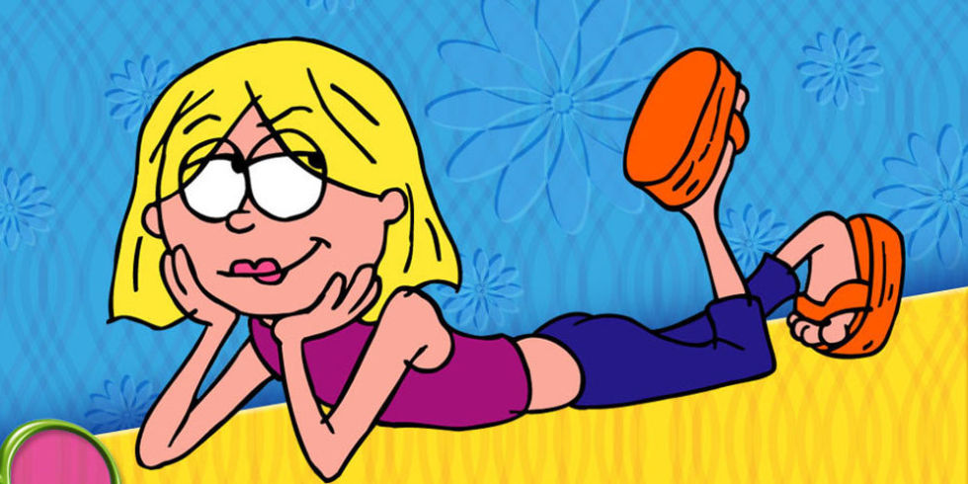
4.1 Frequency which a fact is carried out (adverbs of frequency)
These adverbs indicate how frequent an action is performed. To find out, we ask
always
usually
frequently
often
sometimes
occasionally
rarely
seldom
hardly ever
never

Slide 30
Examples
I always have corn flakes for breakfast.
They usually spend the summer in the mountains.
We frequently water our garden when it's hot.
You often dine at Peter's, don't you?
Ben sometimes goes to the theater.
Mrs. Hills rarely leaves home after 10:00 p.m.

Slide 31
Exercises
Rewrite the complete sentence using the adverb in brackets in its usual position.
Example: I often play tennis on Sunday
He listens to the radio. (often)
They read a book. (sometimes)
Pete gets angry. (never)
Tom is very friendly. (usually)
I take sugar in my coffee. (sometimes)
Ramon and Frank are hungry. (often)

Slide 32
4.2 States and actions
"Stative / static verbs" are verbs that in English are not used in Continuous or Progressive Verbs.
And it is precisely that, as its name implies, these verbs are used mainly to refer to feelings, senses, emotions or perceptions, but not to actions (which are more emphasis on Progressive or Continuous Times). The verbs that are called "static verbs"

Slide 33

The main "stative verbs" are:
Verbs that express sensations or senses:
to feel
to see
to hear
to smell
to taste
to notice
to seem
to look

Slide 34
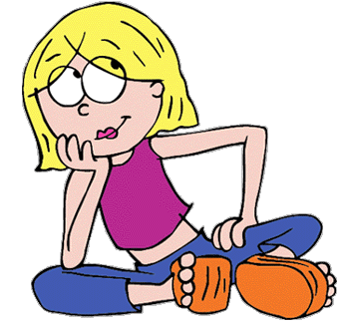
Verbs that express emotions or preferences:
to love
to hate
to like
to dislike
to want
to need
to prefer
to mind

Slide 35
Verbs that express perception or opinion:
to think/believe
to know
to understand
to remember
to forget
to hope
to mean
to imagine

Slide 36
4.3 Negative and Interrogative form
If you want to deny something in simple present you must add auxiliary verb 'do' plus 'not' after the subject and before the verb.

Slide 37
STRUCTURE
Subject + don’t/doesn’t + verb (infinitive) + (compl)
I don’t eat apples—
You don’t eat apples
He/She DOESN’T eat apples
We don’t eat apples
You don’t eat apples
They don’t eat apples

Slide 38
4.4 Interrogative form
In English to know that a phrase is going to be a question from the beginning, we must look at the order of words.
(Wh-word) + Aux (do/does) + Suj + Verb(Infinitivo) + (compl )?
What do I like?
What do you like?
What DOES he like?
What DOES she like?
What do we like?

Slide 39
Examples
DO YOU WATCH TV?
– YES, I DO.
– NO, I DON’T.

Slide 40
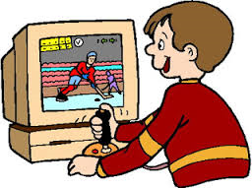
Exercises
Put in the correct verb forms into the gaps. Use Simple Present.
1._________you __________ mineral water? (to drink)
2. ________Sarah and Linda___________ their pets? (to feed)
3. ___________your teacher ___________ your homework? (to check)
4. _________they ____________ in the old house? (to live)
5.__________the cat____________ on the wall in the mornings? (to sit)
6. ___________Nina ____________ computer games? (to play)

Slide 41
BIBLIOGRAPHY
Oxeden, C and Latham-Koening (2008) American English File 1 England: Oxford Press University

